Slide 1

Power and Sample size boot camp
UNC Center for AIDS Research http://unccfar.org/tools-materials/
September 5, 2014
Michael Hudgens, PhD
Katie Mollan, MS

Slide 2
Please contact authors for permission to reproduce or publicly present any of these slides

Slide 3


UNC CFAR
http://unccfar.org/
Cores
    Administrative
    Developmental
    Clinical
    Virology, Immunology, Microbiology
    Clinical Pharmacology/ Analytical Chemistry
    Social & Behavioral Science
    Biostatistics
Biostatistics Core
Collaborative Services
  Design→ analysis→ manuscript
Connection & growth
HIV researchers ← → Statisticians
Innovation & leadership
Training & mentoring

Slide 4







UNC CFAR BIOS Core
Michael Hudgens, PhD
Core Director
Katie Mollan, MS
Biostatistician
Stephen Cole, PhD
Associate Core Director
Joseph Rigdon,
PhD Candidate
Semi-retired GRA
Owen Francis, MS
Bios PhD Student, GRA
Drew Allmon, BS
Bios PhD Student, GRA
Busola Sanusi, MS
Future GRA?

Slide 5
Boot camp objectives
To learn…
basic understanding of power / sample size concepts and terminology
inputs needed to compute power / sample size
how to use nQuery or SAS to estimate sample size
how to use rule of thumb formulas to approximate sample size for large studies
how to use reference tables for small n studies

Slide 6
Outline
Power / SS overview
Examples
  2-sample t-test
  Paired-t
  Exact signed-rank
  Exact Mann-Whitney
  Mann-Whitney ordinal
  Survival analysis
Resources
  CFAR Bios Core
  SAS PROC POWER
  nQuery

Slide 7
Sample size and power calculation
Most grants/protocols include sample size justification
Sample size (n) too small: may miss scientifically meaningful differences/associations
Sample size (n) too big: waste of resources
Sample size justification typically in terms of statistical power or precision

Slide 8
Grants: an ideal timeline
Inouye, Sharon K., and David A. Fiellin. "An evidence-based guide to writing grant proposals for clinical research." Annals of internal medicine 142.4 (2005): 274-282.

Slide 9
Sample size/power & endpoints
Sample size/power determination based on endpoint(s) associated with primary aim(s)
Requires prior knowledge/guess regarding the endpoints (e.g., mean, SD, rates) in each arm of the study (or at each time point)
Considerations when selecting an endpoint:
  Relevance
    What is the most important question to answer ?
  Reliable (precise) and valid (accurate)
    Substantial measurement error or bias ?
  Rate
    How often does the endpoint occur (e.g., incident HIV infection) in the population of interest ? This will affect power (more to come)

Slide 10
Types of endpoints
Clinical endpoints
  HIV infection, AIDS-defining event, death
  e.g., HIV vaccine efficacy studies use HIV infection as endpoint
Surrogate endpoints
  Not always feasible or ethical to wait for clinical endpoints
  Laboratory: HIV-1 RNA, CD4, lipids, biomarkers…
  e.g., early phase HIV vaccine studies rely on immunogenicity endpoints
  Potentially misleading, i.e., effect on surrogate may not imply effect on clinical endpoint
Composite endpoints
  e.g., time until HIV infection or death (BAN)
  More relevant from public health or policy standpoint ?
  Can simplify analysis and increase power, but results may be difficult to interpret

Slide 11
Sample size and power calculation
Takes one of the following forms:
  Given a particular effect size that we would like to detect (e.g., difference in mean outcome between study arms/groups), what sample size is required to insure adequate power ?
  For fixed sample size, what effect size can be detected with adequate power ?
Generally three approaches
  1. Mathematical formula in a book/article
  2. Statistical software (which often relies on 1)
  3. Simulation study (modeling)

Slide 12
Terminology
Power/sample size inherently linked to the statistical notion of hypothesis testing
Null hypothesis (H₀) : typically no association or effect
  Eg, HIV incidence will be the same in two study groups
  Eg, viral load will be the same before and after new ART received
Alternative hypothesis (H₁) : association/effect present
  Eg HIV incidence will be 50% lower in vaccine group
  Eg viral load will be undetectable after new ART received
  Effect size
Conduct statistical test of null based on observed data
  Reject null or not

Slide 13
Terminology
Type I error and significance level (α)
  Type I error: incorrectly reject null when the null is true
  false positive
  Significance level: α = pr[type I error]; commonly α = 0.05
  Type II error (β)
    Type II error: fail to reject null when alternative true
    false negative
    β = pr[type II error]
Power (1- β)
  prob. correctly reject the null when alternative true
  typically choose n such that power ≥80% (i.e. β ≤20%)

Slide 14
Type I and Type II error: hypothesis testing
Population (Truth) | DECISION
Null hypothesis… | Reject the null | Do not reject the null
Is True | Type I error (α) false positive | Correct
Is False | Correct power | Type II error (β) false negative
Typically α set to 5% and power (1-β) set to ≥80%

Slide 15
From aims to powered study
PI: Form a hypothesis and primary research objective
  Often a grant contains several research questions/aims, which questions are most important (will drive the sample size) ?
PI/Stat: Choose endpoint(s) that address the primary research question(s)
Stat/PI: Choose appropriate statistical analysis approach to evaluate the research question(s)
Stat/PI: For fixed α (0.05) and power (80% or 90%),
  determine effect size (H₁) for given sample size
  determine sample size for given effect size

Slide 16
Assumptions
Computing SS/power relies on a priori assumptions about distribution of endpoints, loss-to-follow-up rate, etc
Typically informed by prior studies/literature
Often there is uncertainty in many assumptions
  Sensitivity analysis: explore a range of likely assumptions
  Eg, assume SD 2.5, determine power for SD = 2.0, 2.5, 3.0
Effect size / alternative hypothesis H₁
  “If I already knew what the effect was, I wouldn’t be doing a study!”
  Minimum effect size that considered scientifically important
  Previous studies may suggest plausible effect size

Slide 17
Ex: Two sample continuous outcome
Suppose want to compare mean continuous outcome (eg viral load or CD4 count) between two independent groups (eg drug versus placebo)
PI: provide assumed mean (μ) and SD (σ) in each group
Need pilot data or previous literature to inform these assumptions
Effect size Δ=(μ_{b}-μ_{a})/σ difference in means between the two groups (a and b) divided by the population SD, i.e., standardized difference

Slide 18
Two sample continuous outcome
Assume alpha = 0.05, power = 80%
Sample size per group
n=16/Δ²
where effect size Δ=(μ_{b}-μ_{a})/σ
For 90% power, replace 16 with 21
Assuming balanced design, which typically is the most powerful
Approximation for large n study
Gerald van Belle. Statistical Rules of Thumb. Chapter 2

Slide 19
Two sample continuous outcome
Sample size per group: n=16/Δ²
Want to detect a 0.5 log10 difference in mean HIV DNA between groups
Let’s say SD=1.2 in each group [ref: hypothetical]
Δ=0.5/1.2 = 0.4167
n per group = 16/0.4167² = 93 (evaluable)
Gerald van Belle. Statistical Rules of Thumb. Chapter 2
Notes:
Subscript the log10…

Slide 21
Statistical software
For sample size/power
  SAS PROC POWER
  nQuery Advisor
  Both are free to UNC faculty, staff, and students!
  http://software.sites.unc.edu/software-category/science-and-statistics/

Slide 22
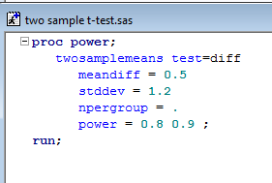
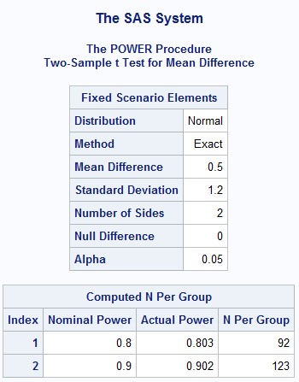

SAS code: 2-sample t-test
Press the running man to execute SAS code
(or) Run → Submit

Slide 23
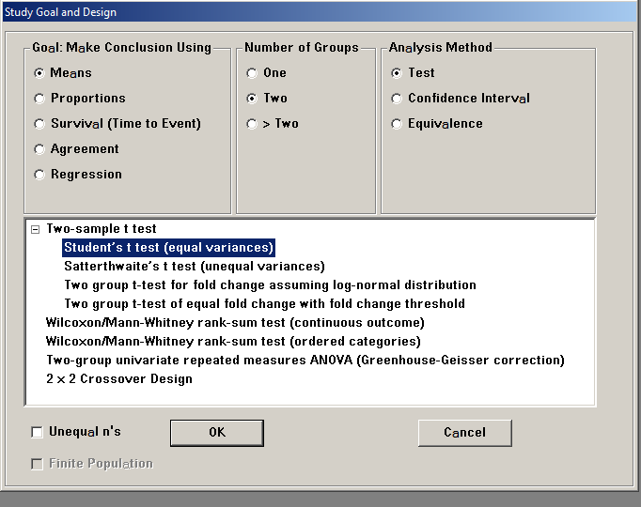
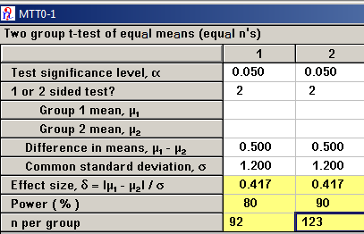
nQuery Advisor: 2-sample t-test
File → New

Slide 24
Two sample binary outcome
Sample size per group (α=0.05, power=80%)
n=16/Δ²
where Δ=(p_{b}-p_{a})/σ and σ²={p_{b}(1-p_{b}) + p_{a}(1-p_{a})}/2
For 90% power, replace 16 with 21
Approximation for large n study
SAS: Proc Power; twosamplefreq … ;
nQuery: Proportions -> Two groups -> Test …

Slide 25
What impacts n?
Effect size of interest or # of events
  The smaller the effect size (# of events), the larger n will need to be (e.g. HR = 1.5 requires a larger n than HR = 2)
Variability of outcome measure (e.g. standard deviation)
  The greater the variability, the larger the n will need to be
Alpha and power (e.g. 5% and 80%)
  The smaller alpha or the greater the power, the larger n will need to be
Number of groups and multiple comparisons (MC)
  The greater the number of MC, the larger n will need to be
Missing data / loss to follow-up

Slide 26
Planning for attrition
In a small study, may replace individuals who are not evaluable for the primary endpoint
In a larger study, anticipate expected loss to follow-up, and adjust enrollment sample size
Example
  n=150 evaluable (non-missing) achieves 90% power
  But we expect 20% attrition (loss of subjects)
  Enroll= Eval/(1-loss)
  We should enroll 150/0.8 = 188 (round up to maintain power)

Slide 27
Additional considerations
Below discuss several power/SS calculations recently conducted by the CFAR Bios Core, with corresponding SAS code and nQuery computation
Sometimes there are enough complications (drop-out, missing data, censoring, repeated measures, correlated responses, etc) that software or formula not available; in this case, simulation studies can be conducted to estimate power
In some settings there is not a hypothesis to test (one sample problem), but rather sample size considerations are driven by anticipated precision / confidence interval width

Slide 28
CFAR Power Examples
Data! Data! Data! I can't make bricks without clay!
---Sherlock Holmes

Slide 29
Paired t-test: continuous data change from baseline to follow-up pre & post measure on same subject
Assumes a sufficiently large sample size -OR-
a normally distributed outcome variable

Slide 30
Paired t-test
Aim: Evaluate changes in women's perceptions of the availability of condoms on campus 3 months after implementation of the condom dispenser initiative
Design: pre-post longitudinal survey design, survey at baseline and 3 months
Statistical considerations: n=300 women will be recruited into the study. Assuming an 80% retention rate, which we have achieved in other studies [citation], the follow-up sample size would be n=240. For the condom availability endpoint, an effective sample size of n=240 will provide 90% power to detect a mean change of 0.3 or greater on the 5 point scale using a paired t-test with a 2-sided significance level of 0.05.

Slide 31
Paired t-test cont’d
Power calculation assumed SD=1.0 at pre and post measures (estimated from pilot data) and 0 correlation between pre and post measures.
Might expect a woman’s pre and post responses to be positively correlated, but perhaps the amount of correlation is unknown.
  Assuming correlation=0 is conservative
  (unless pre and post are negatively correlated)
  If correlation>0, power will be higher

Slide 32
Compute SD of difference
If SD is available only at fixed time points then compute SD for difference
σ ⁼ √Variance
Var(Y_{post} -Y_{pre})= Var(Y_{post})+Var(Y_{pre}) – 2*Cov(Y_{post}, Y_{pre})
  Y_{post}: 3 month response
  Y_{pre}: baseline response
For correlation=0, the covariance piece is 0
Noar’s pilot data: σ_{pre} =1, assume same for σ_{post}
σ_{post-pre}= √(1²+1² - 0)= √2 = 1.414

Slide 33
Paired continuous outcome
Rule of thumb sample size (alpha 0.05, power 80%)
n=8/Δ²
where effect size Δ=μ_{post-pre}/σ
Here μ_{post-pre} is the mean difference (post-pre) and σ is the SD of the differences
For 90% power, change 8 to 10.5
Example:
  Suppose μ_{post-pre}=0.3 and σ=1.414
  Then for 90% power, n=10.5/(0.3/1.414)²=233.3
  Total sample size of approximately 234
Notes:
8 comes from using
2 in place of qnorm(1-a/2)=1.96, as mentioned in Van Belle, (2 + qnorm(.8))^2

Slide 34
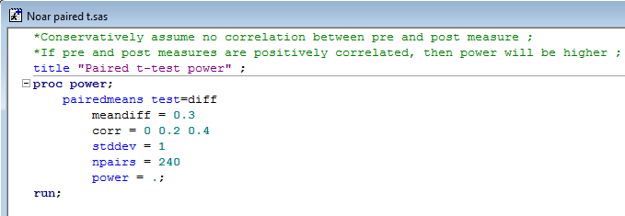
SAS: paired t-test power
corr: correlation between members of a pair
stddev: standard deviation assumed to be common to both members of a pair. SD at a fixed time point (e.g. pre survey)
Power to detect mean change from baseline to month 3: +0.3 on Likert scale with n=240 paired pre-post observations.
σ = 1 at pre and post measurement
Correlation between pre & post | Computed Power
0.0 | 0.905
0.2 | 0.955
0.4 | 0.988

Slide 35
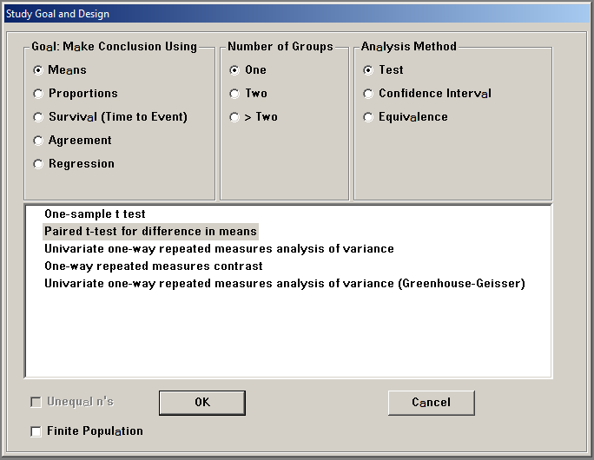
nQuery: paired t-test power
File→ New

Slide 36
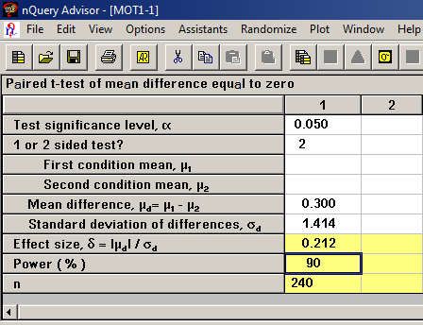
nQuery: paired t-test power
Recall…
SD(Y_{post}-Y_{pre})
Notes:
White boxes are user inputs
N=240 was an input, nQuery computed effect size and power = 90

Slide 37
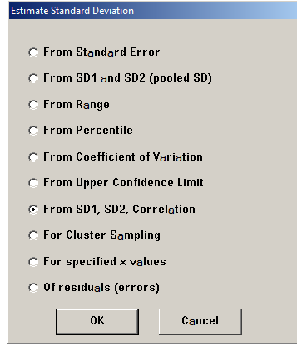
nQuery Assist
Assistants (on the tool bar) → Estimate SD
nQuery can help with that pesky SD calculation

Slide 38
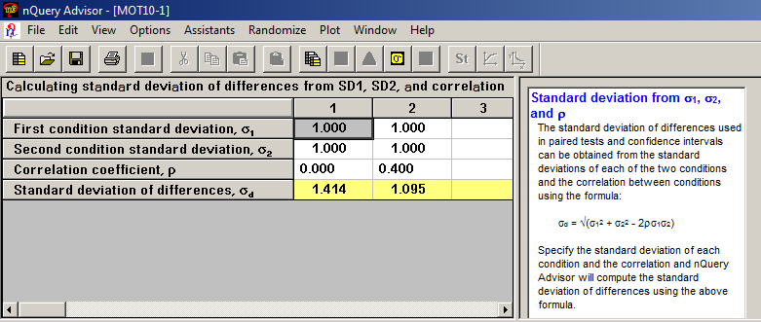
nQuery Assist
Notes:
nQuery computes SD of difference

Slide 39
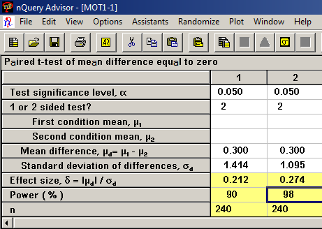
nQuery: paired t-test power
σ ⁼ √Variance
Var(Y_{post} -Y_{pre})= Var(Y_{post})+Var(Y_{pre}) – 2*Cov(Y_{post}, Y_{pre})
Cov(Y_{post},Y_{pre})=Correlation* σ_{post}* σ_{pre}
Noar’s pilot data: σ_{pre} =1, and let’s assume correlation of +0.4
σ_{post-pre} = √(1²+1² – 2*0.4*1*1)= √(2-0.8) = 1.095
Notes:
Same results as SAS, n=240 for 90% power, and 98% power if correlation = 0.4
If pre and post were negatively correlated, then the SD would get bigger

Slide 40

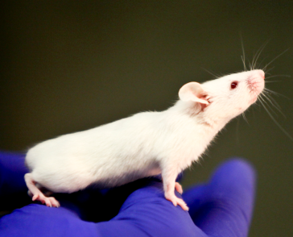
Exact Wilcoxon signed-rank test continuous –or- ordinal paired DATA
Rank-based analysis approach
Exact test, no large sample assumptions

Slide 41
Small n, exact Wilcoxon signed-rank
2-sided 0.05 significance level
1 arm study to assess pre to post change in a continuous measure
null hypothesis μ =0
Detectable effect sizes in this table based upon 10,000 empirical simulations from a normal distribution
n=12 subjects provides 80% power to detect a mean change from baseline to follow-up of 0.94 SDs
 | Standardized Effect Size Δ
N total | 80% Power | 90% Power
6 | 1.82 | 2.14
8 | 1.26 | 1.46
10 | 1.03 | 1.20
12 | 0.94 | 1.09
14 | 0.83 | 0.98
Δ = μ/SD

Slide 42
Wilcoxon signed-rank example
Hypothetical study
  n=12 subjects initiate a new experimental therapy we hope will reduce viral load in the GI tract tissue
  Endpoint: change from baseline to week 24 in HIV RNA log₁₀ copies/mg in GI tract tissue
  Suppose the assay is awesome; expect a continuous measurement with minimal censoring
  In the case of substantial censoring (eg, below limit of quantification) contact the Bios Core
Notes:
If we’re expecting considerable censoring, we’ll talk to the Bios Core

Slide 43
Wilcoxon signed-rank example
  Baseline SD=0.7 from literature
  Compute SD for change from baseline to follow-up
    SD(Y₂₄-Y₀) = √(0.7²+0.7²)= 0.99.
    assuming correlation=0 in this example
  If reference paper gives SD for change from baseline to follow-up, then skip SD calc. above
  Detectable mean change= Δ*SD = 0.94*0.99 = 0.93
Notes:
If we’re expecting considerable censoring, we’ll talk to the Bios Core

Slide 44
Wilcoxon signed-rank example
Hypothetical study cont’d
  Change in HIV RNA log₁₀ copies/mg in GI tract tissue from baseline to week 24 will be evaluated using a Wilcoxon signed-rank test with 2-sided alpha=0.05. Assuming a SD of 0.99 in the change measure, n=12 subjects provides 80% power to detect a mean change from baseline to week 24 of 0.93 log₁₀ copies/mg.

Slide 45
Small n reference table
  Could make a customized table of Δ*SD for a range of n’s to guide discussion about study size
  Plug in several SD assumptions (say 0.8, 1.0, 1.2) to produce a table of detectable mean changes at 80% power for a given n
  Detectable mean changes, 80% power, n=12
Assumed SD | Detectable mean change
0.80 | 0.75
0.99 | 0.93
1.00 | 0.94
1.20 | 1.13
← 0.94*SD

Slide 46
mann-whitney U test continuous –or- ordinal DATA
2 independent samples
a.k.a. Wilcoxon rank-sum test
a.k.a. Wilcoxon-Mann-Whitney test

Slide 47
Small n, exact Mann-Whitney test
 | Standardized Effect Size Δ
N per group | 80% Power | 90% Power
6 | 1.94 | 2.24
8 | 1.56 | 1.81
10 | 1.41 | 1.62
12 | 1.26 | 1.46
14 | 1.14 | 1.32
2-sided 0.05 significance level
Detectable effect sizes based upon 10,000 empirical simulations from two independent normal distributions
n=10 per group provides 80% power to detect a difference in the means of group A vs. group B of 1.41 SDs
Δ=(μ_{b}-μ_{a})/σ

Slide 48
Exact Mann-Whitney Example
Endpoint: HIV RNA log₁₀ copies/mg in GI tissue
2 independent groups of n=10
  Arm A raltegravir, Arm B dolutegravir (both with TDF-FTC)
Express specific alternative hypothesis as difference between means, μ_{b}-μ_{a} = Δ*σ
  From the table on previous slide: Δ=1.41
  SD (σ) = 0.69 (published data)
  detectable difference in means, μ_{b}-μ_{a} = 1.41*0.69 = 0.97

Slide 49
Exact Mann-Whitney Example
Assuming HIV RNA log₁₀ copies/mg in GI tract tissue has a SD of 0.69 [citation], n=10 subjects per group provides 80% power to detect a 0.97 log₁₀ difference between the means in arms A vs. B using an exact Mann-Whitney test with a 2-sided significance level of 0.05.
Protocol states : 82% power to detect a 1.0 log₁₀ difference between means

Slide 50
Notes on Mann-Whitney table
Reference table: empirical power of exact test using data simulated from normal distribution
Mann-Whitney test does not assume normal distribution
For a measure ranging from 0 to ∞, consider log transformed individual-level data
For ordinal data, see next example
For a continuous outcome ranging from 0 to 1 (0-100%), such as “% infected cells”, contact the Bios Core
Simulation used a common SD in both groups, contact Bios Core if SD is different in each group

Slide 51
Mann-Whitney test
Ordinal outcome variable
Cumulative stress (scale 0-5) will be compared between African American and White participants with a 2-sided Mann-Whitney test.
Assuming cumulative stress scores are measured on a 0-5 scale, and 5% loss for missing data, with n=75 enrolled per race group, there is 80% power to detect a difference in cumulative stress between race groups using a 2-sided Mann-Whitney test and a 0.05 significance level.
Power was estimated empirically by a simulation study with the assumed distribution of the number of stressors among African Americans and Whites based on Table 2 of Sternthal et al 2011.

Slide 52
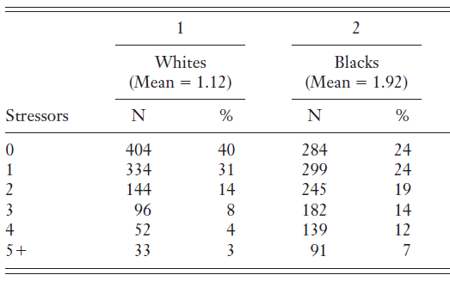
Background data
Distribution of number of stressors by race
Sternthal, Michelle J., Natalie Slopen, and David R. Williams. "Racial disparities in health." Du Bois Review: Social Science Research on Race 8.01 (2011): 95-113.

Slide 53
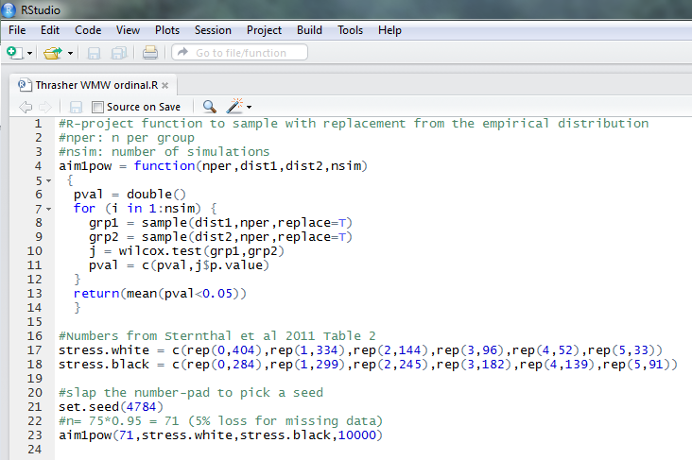
R simulation code: 80% power
Notes:
The Wilcoxon rank-sum (i.e. Mann-Whitney) test applied to a 2 x c table with c ordered columns is equivalent the extended Mantel-Haenszel mean score statistic using ridit, modified ridit, or rank scores (Stokes, Davis, Koch 2nd edition page 73). The Cochran-Armitage trend test using any of the three rank scores above gives similar but slightly different results.

Slide 54
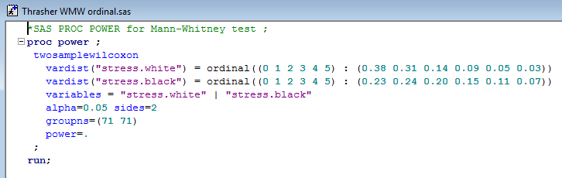
SAS PROC POWER code
Result: 78% power
Probabilities for categories 0-5 computed from N’s in Sternthal table
Notes:
The Wilcoxon rank-sum (i.e. Mann-Whitney) test applied to a 2 x c table with c ordered columns is equivalent the extended Mantel-Haenszel mean score statistic using ridit, modified ridit, or rank scores (Stokes, Davis, Koch 2nd edition page 73). The Cochran-Armitage trend test using any of the three rank scores above gives similar but slightly different results.

Slide 55
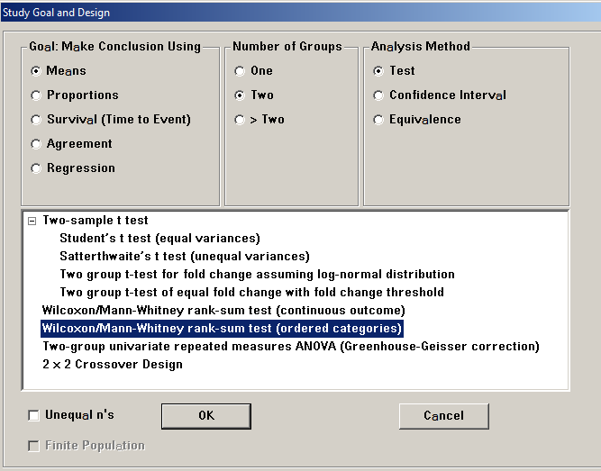
nQuery Advisor: Mann-Whitney Ordered Categories
File→ New

Slide 56
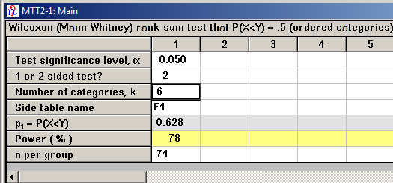
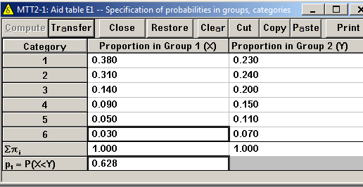
nQuery Advisor: Mann-Whitney Ordered Categories
Assistants →
Compute Effect Size
nQuery Side table:
Enter background data from Sternthal paper
Click ‘Compute’ to get P(X<Y)
Notes:
P(X<Y) is the probability that an observation in group 1 “X: white” will be less than an observation in group 2 “Y: black” when the alternative hypothesis is true. Null hypothesis: P(X<Y) = 0.5

Slide 57
Survival analysis

Slide 58
Effect size: survival analysis
What we need to know:
  Length of follow-up per individual (eg, 2 years)
  In some designs, length of follow-up varies by individual:
    eg, 1 year of accrual, then all subjects followed for an additional 2 years after accrual
  Survival at given time(s) or hazard rate in each group, or
  hazard ratio (HR) and survival (or hazard) in 1 group
  Attrition in each group at given time(s)
    20% prematurely discontinued study by 2 years of follow-up
    Loss often assumed equal in all groups

Slide 59
Survival analysis example
Survival = Probability(remain event-free)
Event: fertile mucus
Depo-Provera vs. Jadelle (both with EFV)
Assume 70% vs. 90% probability of remaining free of fertile mucus through 2 years of follow-up
Plan to follow each woman for 2 years
Anticipate 10% loss to follow-up per year

Slide 60
Survival analysis rule of thumb
Two sample problem, time to event outcome
Effect size is defined by hazard ratio (HR)
Total number of events (eg, deaths, infections) for alpha=0.05 and 80% power is
d=31.4/log(HR)²
For example, if HR=0.30, then d=21.7
Need to observe approximately 22 events to provide 80% power to detect HR of 0.30 or smaller
For 90% power, replace 31.4 with 42.0
Reference: Collett “Modelling Survival Data in Medical Research” (2003, 2nd edition), Chapter 10

Slide 61
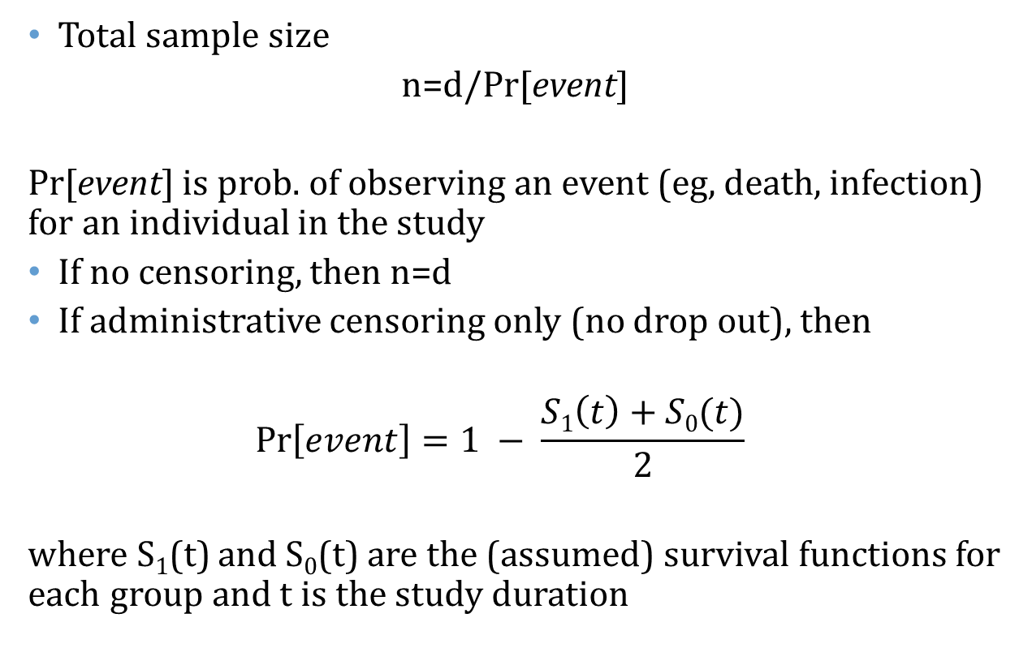
Survival analysis example
Total sample size
n=d/Pr[event]
Pr[event] is prob. of observing an event (eg, death, infection) for an individual in the study
If no censoring, then n=d
If administrative censoring only (no drop out), then
$$\operatorname{Pr}\left[event\right]=1 − \frac{S1\left(t\right)+S0(t)}{2}$$
where S₁(t) and S₀(t) are the (assumed) survival functions for each group and t is the study duration
Notes:
Average survival at study duration: [S1(t)+S0(t)]/2

Slide 62
Survival analysis example
eg, suppose S₁(t)=.7 and S₀(t)=.9 at t=2 years
Pr[event]= 1 – 0.8 = 0.2
If d=22, then n=22/.2=110 total sample size needed
If additionally 20% will be loss-to-follow-up prior to 2 years, then inflate total sample size to 110/.8 = 138
138/2 = 69 per group

Slide 63
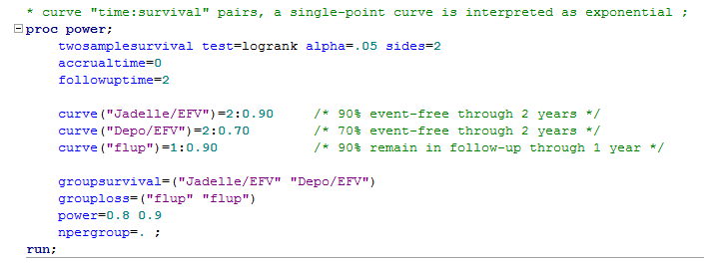
SAS code
80% power: n=69 per group
90% power: n=92 per group

Slide 64
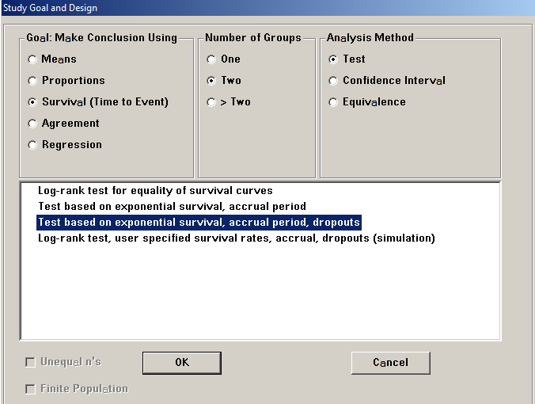
nQuery

Slide 65
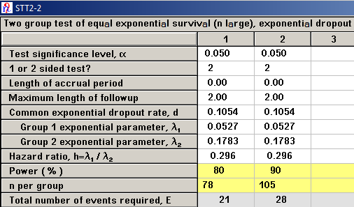
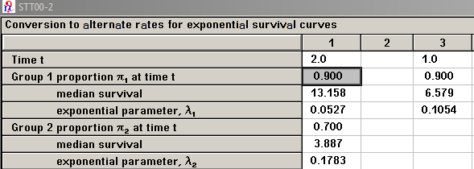
nQuery cont’d
Assistants → Conversion Between Parameters
Notes:
SAS and nQuery using different methods for SS estimation. Method used in SAS is recommended (Lakatos)

Slide 66
General additional considerations
Controlling alpha (α)
  Multiple comparisons (family of hypotheses)
  Interim analyses (alpha spending)
  1-sided hypothesis test
    Check with your statistician before using a 1-sided test
Correlated observations
  Longitudinal endpoint (3+ repeated measures)
  Clustered data (intra-class correlation, cluster size)
Non-inferiority or equivalence hypothesis
Notes:
MC: Control the probability of making one or more type I errors among a “family” of hypotheses

Slide 67
Statistical Software
For sample size/power
  SAS PROC POWER
    User guide: http://support.sas.com/documentation/cdl/en/statug/63962/HTML/default/viewer.htm#statug_power_sect002.htm
  nQuery Advisor
    http://www.statsols.com/wp-content/uploads/2013/10/nQ70_version2_manual.pdf
  Both are free to UNC faculty, staff, and students!
  http://software.sites.unc.edu/software-category/science-and-statistics/

Slide 68


Slide 69
Biostatistics Training at UNC
Biostatistics Department
http://sph.unc.edu/department-pages/biostatistics/
BIOS 610 BIOSTATISTICS FOR LABORATORY SCIENTISTS (3). Prerequisite, elementary calculus. Introduces the basic concepts and methods of statistics, focusing on applications in the experimental biological sciences.
BIOS 668: DESIGN OF PUBLIC HEALTH STUDIES (3). The course provides an overview of the design and analysis of the most common types of study designs used in public health research today: cross-sectional, case-control, prospective, and experimental (including clinical trials). The course also covers concepts of validity, measurement error, sample size determination, matching and random allocation methods.

Slide 70
UNC CFAR
http://unccfar.org/
Cores
    Administrative
    Developmental
    Clinical
    Virology, Immunology, Microbiology
    Clinical Pharmacology/ Analytical Chemistry
    Social & Behavioral Science
    Biostatistics
Biostatistics Core
Collaborative Services
  Design→ analysis→ manuscript
Connection & growth
HIV researchers ← → Statisticians
Innovation & leadership
Training & mentoring

Slide 71
Thank you!
Owen Francis
Steve Cole
Joseph Rigdon
CFAR Power Examples
  Seth Noar
  Angela Thrasher
  Angela Kashuba
  Kristina DeParis
  Jennifer Tang
This and last year’s slides are on CFAR website
http://unccfar.org/tools-materials/

