Slide 1
UNC Health
Physician Compliance
Pathology New Provider and Reappointment Training

Slide 2
Review basic principles of coding and documentation of pathology services
Review resident/fellow supervision and documentation requirements
Objectives

Slide 3
Coding and Documenting Pathology Services

Slide 4
Documentation for cytopathology services
Preliminary results
Reference results of all additional studies
The diagnosis for each specimen
Type of specimen
Preparation of additional slides
Special stains, including +/- results
Clinical history
Specimen source
The documentation should include (as applicable):

Slide 5
Documentation for surgical pathology services should include as applicable
Clinical history
Itemization of each specimen received and analyzed
Specimen source
Gross description
Microscopic description
Special stains, including +/- results
Reference results of all additional studies
Reference and results of all consults and frozen sections
The diagnosis for each specimen

Slide 6
Clinical pathology consultations
Clinical consultations are paid under the Medicare Physician Fee Schedule (MPFS) only if they:
Are requested by the patient’s attending physician;
Relate to a test result that lies outside the clinically significant normal or expected range in view of the condition of the patient;
Result in a written narrative report included in the patient’s medical record; and
Require the exercise of medical judgment by the consultant physician.
Routine conversations held between a laboratory director and an attending physician about test orders or results do not qualify as consultations unless all four requirements are met.
Reporting of a test result(s) without medical interpretive judgement is not considered a clinical pathology consultation.
80500
Clinical pathology consultation; limited, without review of patient's history and medical records
Include a written report with medical interpretation of the results
80502
Clinical pathology consultation; comprehensive, for a complex diagnostic problem, with review of patient's history and medical records

Slide 7
Anatomic or surgical pathology consultations
When pathologists refer cases to each other for second opinions on anatomic or surgical pathology tests
The documentation should indicate whether the slides were prepared elsewhere (88321) or required preparation (88323)
Documentation must support when the consulting pathologist needs to review previous medical records and specimens in order to render an opinion (88325)
For cytology specimens from a single anatomic site, only one unit of service shall be reported for each special stain regardless of the number of slides from that site stained with the special stain
88329 is used when a pathologist is consulted during a surgery to render an opinion on the presence or absence of diseased or abnormal tissue provided (gross examination without concurrent microscopic examination)

Slide 8
Modifier 91: Repeat Clinical Diagnostic Laboratory Test
During treatment, it may be necessary to repeat the same laboratory test on the same day to obtain subsequent (multiple) test results. Under these circumstances, the laboratory test performed can be identified by its usual procedure number and the addition of modifier 91.
This modifier may not be used when tests are rerun to confirm initial results; due to testing problems with specimens or equipment; or for any other reason when a normal, one-time, reportable result is all that is required.
This modifier may not be used when other code(s) describe a series of test results (e.g., glucose tolerance tests, evocative/suppression testing).
This modifier may only be used for laboratory test(s) performed more than once on the same day on the same patient.

Slide 9
Diagnosis coding: tests ordered without a definitive diagnosis or signs and symptoms
If the results of the study are normal or non-diagnostic, and the referring physician records a diagnosis preceded by words that indicate uncertainty (e.g., probable, suspected, questionable, rule out, or working), then the interpreting physician should not code the referring diagnosis.
When the interpreting physician does not have diagnostic information as to the reason for the test and the referring physician is unavailable to provide such information:
It is appropriate to obtain the information directly from the patient or the patient’s medical record if it is available
An attempt should be made to confirm any information obtained from the patient by contacting the referring physician
The interpreting physician should report the sign(s) and/or symptom(s) that prompted the study

Slide 10
Teaching Physician Guidelines

Slide 11
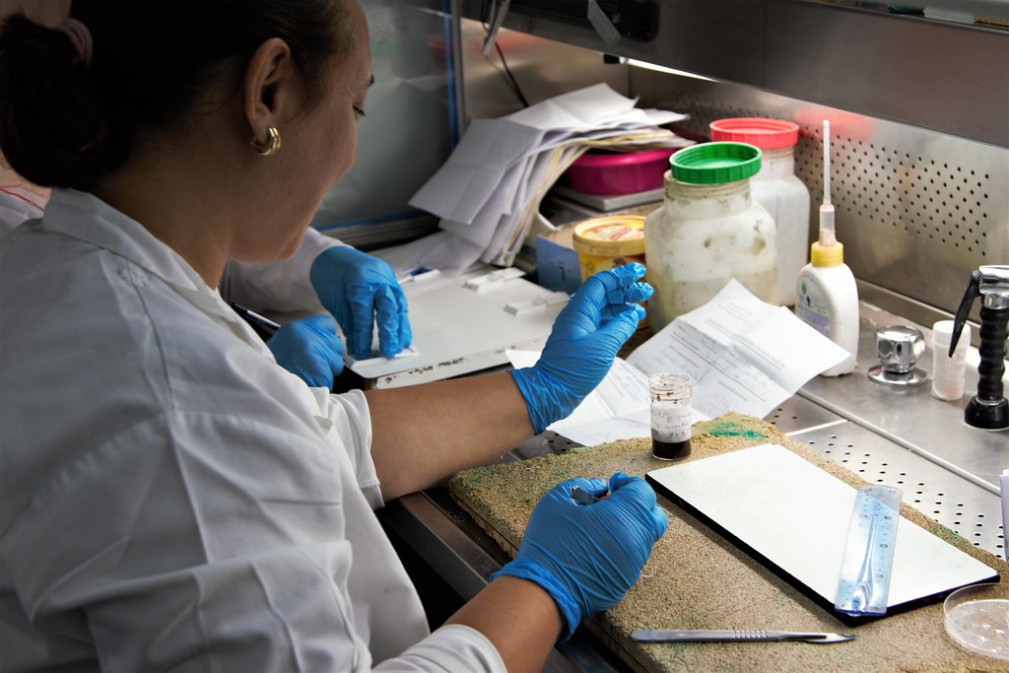
Teaching Physician must personally review specimen
Teaching Physician (TP) must indicate that they have personally reviewed the specimen and the resident’s interpretation and either agrees or edits the finding
A co-signature only is insufficient
Utilize smart phrase .TP30 or .TPPAINTR
PATHOLOGY
INTERPRETATION
(.TP30 or .TPPAINTR):
I independently reviewed the
specimen (s) and agree with
the resident/fellow's
interpretation.
Notes:
For pathology specimen services the teaching physician must indicate they have personally reviewed the specimen, and that they have reviewed the resident’s interpretation. The teaching physician may either agree with the resident or fellow’s interpretation, or edit the resident/fellow’s finding. The teaching physician can use the attestation and short cut on the screen to document their involvement. Please remember a co-signature alone from the teaching physician is not sufficient to bill.

Slide 12
Teaching Physician (TP) Policy will provide internal guidance for TPs working residents and fellows
Purpose of policy is to ensure TP follow supervision requirements for Medicare, Medicaid, TRICARE, and United Healthcare and TP’s supervision and participation are documented in Epic.
Provide definitions applicable to policy (physically present, primary care exception, etc.)
Will restrict TP to use attestations available in Epic@UNC to document their supervision and participation in resident and fellow services
Outlines supervision requirements for Medicare, Medicaid, Tricare, and United Healthcare for Evaluation and Management services, procedures, operative cases, diagnostic radiology, diagnostic tests, anesthesia services, and student services
Addresses Telehealth TP supervision requirement current to date
Highlights
Notes:
Applicable to: UNC Medical Center, UNC Physician Network, Rex Healthcare, Margaret R. Pardee Memorial Hospital
Provide definitions applicable to policy (critical/key portion, direct medical & surgical services, fellow, immediately available, physically present, primary care center, resident, primary care exception, student, teaching physician)
Teaching Physicians are restricted to using attestations available in Epic@UNC to document their supervision and participation in services involving Residents. However, these attestations may be modified to expand upon the Teaching Physician’s participation. Will restrict TP to using attestations available in Epic@UNC to document their supervision and participation in services. However, these attestations may be modified to expand upon the Teaching Physician’s participation. Due to claim logic in Epic that assists billing compliance, Teaching Physicians should not create their own attestations.
Outlines supervision requirements for Medicare, Medicaid, and Tricare for Evaluation and Management services, procedures, diagnostic radiology, diagnostic tests, and anesthesia services, students
Provides Moonlighting guidance for residents and fellows who have completed a GME program

Slide 13
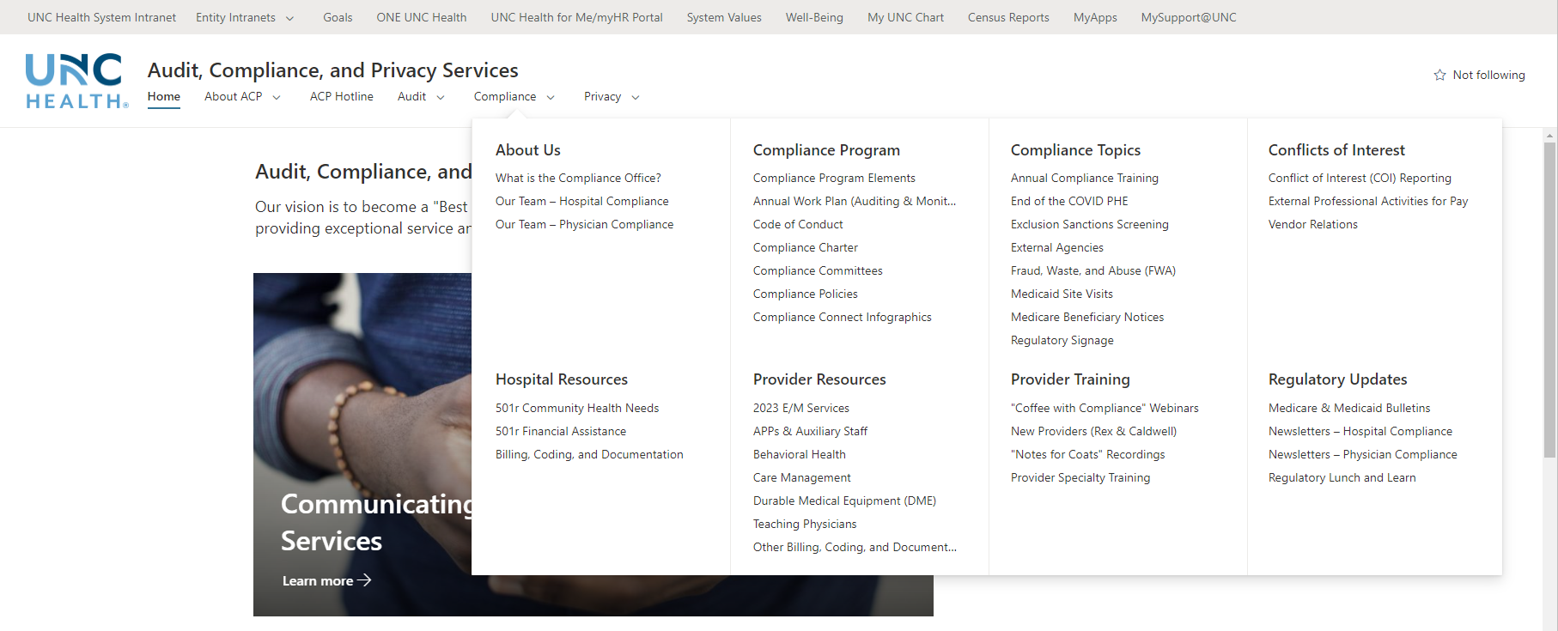
Visit Physician Compliance SharePoint Site for More Information
Audit, Compliance, and Privacy Services - Home (sharepoint.com)
Notes:
If you want to review additional resources pertaining to today’s topic of PHE transition and psychotherapy, visit our intranet site located at the bottom of the slide and click on the 2023 E/M changes channel on the left slide of the page.
There are additional resources available which address psychiatric services and other changes for CY2023.

Slide 14
Thank you!

