Slide 1
UNC Health
Department of Physician Compliance
Radiology New Provider and Reappointment Training

Slide 2
Today’s Agenda…

Slide 3
Review Basic Principles of Coding and Documentation
Coding and Documenting Radiology Services
Consultations
Modifiers
Diagnosis Coding
Teaching Physician Guidelines
Review Data Replication and Scribe Policies
Attestations
Today's Agenda

Slide 4
Principles of Coding and Documentation

Slide 5

Principles of Coding and Documentation
Appropriate billing requires three components:
    Doing only what is medically necessary
    Documenting what is done
    Billing what is documented
Understanding and applying coding and documentation conventions allows for compliant billing, potential for increased revenue, and generally improved quality of the medical record documentation. Appropriate documentation and billing practices make for good patient care and maximized compensation.

Slide 6
Coding and Documenting Radiology Services

Slide 7
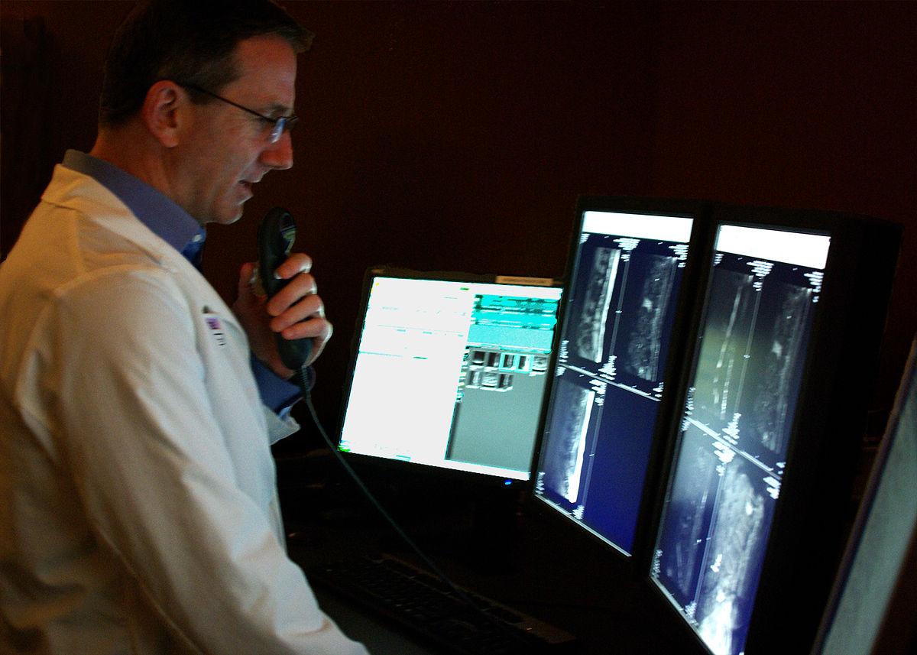
Documentation should include the reason for service, radiological guidance if used, and any associated diagnosis codes
  Documentation for Interventional Radiology (IVR) procedures should include the following:
  The reason for the service
  Specific documentation of radiological guidance, if used during the procedure
  Any associated diagnosis codes

Slide 8
Procedures Requiring Supervision
Some radiology CPT code descriptions refer specifically to supervision of the imaging such as:
  CPT 75605 – Aortography, thoracic, by serialography, radiological supervision and interpretation.
Procedures that include the “supervision and interpretation” notation are known as S&I codes, which include two distinct parts:
  Personal supervision of the radiologic portion of a procedure
  The interpretation of the findings

Slide 9
Billing for Supervision and Interpretation (S&I) Services
Physician must be present during the performance of S&I procedures.
  Interpretation may be performed later by another physician.
  Only one interpretation of an imaging study is billable.
  Use modifier -52 to indicate a limited service
Medicare, Medicare Advantage, and Tricare require the teaching physician to be present during the procedure.
Example: A radiologist is not usually present when an intraoperative angiogram is performed but may interpret the study following the procedure.
In the example above, the radiologist would bill the service with a -52 modifier to indicate an “interpretation only” and the surgeon would also bill using a -52 modifier to indicate “supervision only.”
Billing for
supervision
Billing for
interpretation
Physician not
present

Slide 10

A radiologist can change an active order from a referring provider for only two reasons
If the diagnostic radiologist determines:
  An ordered test is “clinically inappropriate or suboptimal” (e.g., an MRI should be performed instead of a CT scan because of the clinical indication)
  OR
  The results of the ordered test are normal and an additional test should be performed (e.g., a renal sonogram was normal and based on clinical indication, the interpreting physician believes an MRI will reveal the diagnosis)
Additional tests may NOT be performed without a new or additional order from the treating provider.

Slide 11
In certain circumstances a radiologist can perform an additional test when a new order cannot be obtained from referring provider
The testing center performs the diagnostic test ordered by the treating physician/practitioner.
The interpreting physician at the testing facility determines and documents that, because of the abnormal result of the diagnostic test performed, and additional diagnostic test is medically necessary.
Delaying the performance of the additional diagnostic test would have an adverse effect on the care of the patient.
The result of the test is communicated to and is used by the treating physician/practitioner in the treatment of the patient.
The interpreting physician at the testing facility documents in their report why the additional testing was performed
If the testing facility cannot
reach the treating provider
to change the order or obtain
new order and documents this
this the medical record, then
the testing facility may furnish
the additional diagnostic
test if ALL the criteria
apply.
  Example: Bone scan reveals lesion on femur requiring plain films to make a diagnosis.

Slide 12
Consultation Services

Slide 13



Use the recommended statement when documenting consultations “Patient is seen in consultation at the request of *** for evaluation of ***.”
I’m sending my
recommendations
to you
I need your
opinion on…..
The intent of the visit is the overarching determinant for code selection.

Slide 14
Modifiers

Slide 15
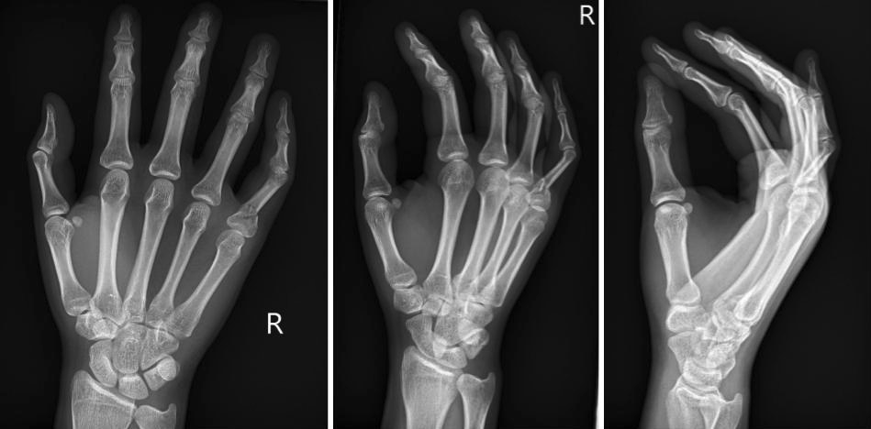
Modifiers That Impact Payment
Modifier 26 – Professional Component
  Imaging studies are a combination of a professional and a technical component. The professional component applies to the supervision and/or interpretation performed by the physician. When the professional component is reported separately, the service may be identified by adding the modifier 26 to the CPT procedure code.
  **Modifier 26 is not used when the CPT code describes the procedure as being the professional component only.**
TC – Technical Component
  The technical component refers to the resources utilized to perform the study or procedure and is typically billed by the hospital.
LT and RT
  Indicate which side of the body was viewed.
This Photo by Unknown Author is licensed under CC BY-NC-ND

Slide 16
Diagnosis Coding

Slide 17

Diagnosis Coding – Code to highest level of specificity; avoid unspecified codes when possible
Tests ordered due to signs and/or symptoms:
  If the physician has confirmed a diagnosis based on results of the diagnostic test, the physician interpreting the test should code that diagnosis. The signs and/or symptoms that prompted ordering the test may be reported as additional diagnoses if they are not fully explained or related to the confirmed diagnosis. The definitive diagnosis code should be sequenced before the symptom code.
  If the diagnostic test did not provide a diagnosis or the diagnosis was normal, the interpreting physician should code the sign(s) and/or symptom(s) that prompted the treating physician to order the study.
This Photo by Unknown Author is licensed under CC BY-SA

Slide 18
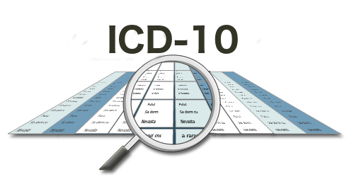
Diagnosis Coding
Tests ordered without a usable diagnosis or signs/symptoms:
If the results of the imaging study are normal or non-diagnostic, and the referring physician records a diagnosis preceded by words that indicate uncertainty (e.g., probable, suspected, questionable, rule out, or working), then the interpreting physician should not code the referring diagnosis. Rather, the interpreting physician should report the sign(s) and/or symptom(s) that prompted the study.
On the occasion when the interpreting physician does not have diagnostic information as to the reason for the test and the referring physician is unavailable to provide such information, it is appropriate to obtain the information directly from the patient or the patient’s medical record if it is available. However, an attempt should be made to confirm any information obtained from the patient by contacting the referring physician.
This Photo by Unknown Author is licensed under CC BY-SA

Slide 19
Diagnosis Coding
Tests ordered for screening:
    When a diagnostic test is ordered in the absence of signs/symptoms or other evidence of illness or injury, report the screening code as the primary diagnosis code.
    Any condition discovered during the screening should be reported as a secondary diagnosis.

Slide 20
Teaching Physician Guidelines
Notes:
No we will review the Teaching Physician guidelines!

Slide 21
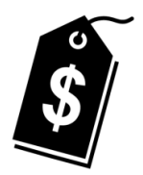


Teaching Physicians must participate and document their involvement to receive payment from Medicare
Residents and fellows enrolled in a Graduate Medical Education (GME) approved program provide services paid through Part A to the hospital.
Teaching Physicians (TP) can be paid through Medicare Part B, when the Teaching Physician participates and documents their involvement in the resident/fellow service.
  3 Things Teaching Physicians can do to avoid refunds and penalties at Academic Medical Centers:
1
Ensure your participation in the critical or key portions of the service performed and in the management of the patient is documented in the medical record.
    UNC Health follows Medicare guidelines for Medicare Advantage Plans and Tricare.
2
Choose the attestation that reflects how you participated in the service.
3
Documentation in the note must support the service that is billed.
Notes:
Medicare pays for resident physician services through Part A to the hospital. Medicare makes the payments based on the proportionate share of Medicare patients seen at the teaching hospital. Teaching Physicians are paid by Medicare Part B on a fee-for-service basis. Medicare Part B will pay for Teaching Physician (TP) services with the resident physician, when the Teaching Physician participates and documents their involvement in the service. If the Teaching Physician does not participate in a given patient service when a resident is involved, and meet specific documentation requirements, then the Teaching Physician may not bill for the service. Of course, we all know Medicare does not want to pay for the service twice.
Three things to remember when working at a Academic Medical Centers to avoid refunds and penalties:
Ensure your participation in the critical or key portions of the service performed and in the management of the patient is documented in the medical record.
Choose the attestation that reflects how you participated in the service.
Documentation in the note must support the service that is billed.
Remember Documentation is key to payment!

Slide 22
Procedures

Slide 23
Universal Protocol for Operative/Invasive Procedures requires time out prior to starting procedure
Identification of Patient
Procedure Site Marking
If possible, the mark should remain visible after completion of the skin prepping and draping
Debrief
Second Time Out- Prior to Incision or Procedure Start
First Time Out- Prior to induction or regional block performed in the OR
Universal Protocol for Operative/Invasive Procedures
Notes:
Identification of Paitent
A registered nurse should identify the patient using two (2) patient identifiers on the patient's ID band upon arrival in the preoperative/procedural area, upon arrival in the OR, upon arrival in the post anesthesia area, and anytime transfer of care occurs.
Preoperative identification of a patient: Verification can be provided by the patient's designee/family member, legal guardian, or significant other if the patient is unable to provide information, ask patient/parent/legal guardian to state first and last name, Ask patient/parent/legal guardian to state date of birth, and compare the Medical Record number on the patient's armband with the electronic medical record (EMR) and patient labels
Nurse should confirm the presence of implants and/or surgical hardware as applicable.
Surgical Site Marking:
The surgical site should be marked by the Attending surgeon who is responsible for the case or the Resident surgeon who is designated by the Attending surgeon and is directly involved in the case and should be present at the time the procedure is performed.
Whenever possible the patient should participate in site marking. If the patient is unwilling or unable, a designee/family member, legal guardian, or significant other may participate
In the case of multiple procedures:
-Same surgical site - the surgeon who begins the procedure should initial the site & participate in the timeout process.
-Subsequent surgeons should complete additional timeout processes immediately prior to their procedure(s) (Section V D.2.) but do not need to mark the site
-Multiple surgical sites and/or multiple surgeons - one representative from each surgical team should initial the appropriate site(s) related to their planned case while the patient/designee can participate in the process. Only 1 marking is required for each site. Each team should participate in a timeout process prior to beginning their procedure(s)
The procedure incision site(s) or area(s) should be marked when procedures involve laterality (right/left distinction),specific digits (fingers and toes), specified lesions, or levels (spine)
Both sides are marked for bilateral cases
For procedures that involve laterality of organs, but the incision or approach may be from midline or natural orifice, the site is still marked and laterality noted. The site marking of this organ may not be within the aperture of the drape, but should be noted during the draping process
Site marking is not required for:
Procedures including mid-line sternotomy, cesarean section, laparotomy, diagnostic laparoscopy, and interventional procedures for which the site of insertion is not predetermined, Procedures done percutaneously, or through/immediately adjacent to a natural body orifice (i.e., GI endoscopy, dental procedures, tonsillectomy, and hemorrhoidectomy), Procedures on the genitalia or other situations in which marking the site would be impossible or technically impractical are also exempt, Premature infants, for whom the mark may cause a permanent tattoo
The area or skin closest to the operative site should be marked with the initials of the surgeon with an indelible marker. When possible, the mark should remain visible after completion of the skin prepping and draping.
The site may be marked prior to the day of surgery
If the site of surgery has not been marked, the pre-op nurse should page the Attending or Resident surgeon to have them complete the marking.
FIRST TIME OUT – Prior to Induction or Regional Block performed in the Operating Room
Anesthesia provider should lead
Relevant Surgical team members required to participate in the First Time Out include: the Resident surgeon or Attending surgeon/proceduralist, Anesthesia care provider, circulating nurse, and scrub person
Prior to INDUCTION, all other activities undergo a CRITICAL PAUSE without compromising patient safety
All appropriate team members are to confirm the following during the first time out
Patient identity with name, DOB, and medical record number using the armband and the medical record
Planned procedure(s)
Side/site(s) and visible site marking, if applicable
The Surgical Safety Checklist should be reviewed and completed
The First Time Out should not be combined with the Second Time Out.
SECOND TIME OUT - Prior to Incision or Procedure Start
Attending surgeon should call for Time Out and Circulating RN should check off all components of checklist on the white board
Relevant Surgical team members required to participate in the Second Time Out include: Attending surgeon / proceduralist, Anesthesia care provider, circulating nurse and scrub person
Prior to INCISION, all other activities undergo a CRITICAL PAUSE without compromising patient safety
All appropriate team members are to confirm the following during the first time out:
Patient identity with name, DOB, and medical record number using the armband and the medical record
Planned procedure(s)
Side/site(s) and visible site marking, if applicable
The Surgical Safety Checklist should be reviewed and completed
The First Time Out should not be combined with the Second Time Out. KEY POINT:All team members should demonstrate CUS (State your CONCERN, Explain why you are UNCOMFORTABLE, Discuss the SAFETY issue), CLOSED LOOP COMMUNICATION, and MUTUAL SUPPORT throughout the case. Any staff member can initiate the Time Out process to ensure it is completed.
Outpatient Endoscopic Procedural Areas
In Outpatient Endoscopic Procedural Areas outside of the OR where there is no incision, (e.g., EndoGI, Cysto procedures), the Pre-Induction Identification Verification may be combined with the First Time Out if the following parameters are met:
The patient / parent / legal guardian is awake and able to participate (if clinically possible) in the process
The Attending Physician / proceduralist must be present for the verification / Time Out and not leave the room prior to instrumentation / scope placement
If either the Attending is NOT present for the verification / Time Out (only fellow / resident) OR the Attending is present but leaves the room prior to instrumentation / scope insertion, a separate Time Out will be performed
All other activities undergo a CRITICAL PAUSE without compromising patient safety
The Second Time Out is not required for these areas unless the Attending is not present for the First Time Out OR the Attending leaves the room prior to the instrumentation / scope placement.
Debrief
Should always occur before Attending surgeon leaves the OR
Relevant Surgical team members required to participate in the Debrief include: Attending surgeon, Anesthesia care provider, circulating nurse, and scrub person
The Debrief should be completed prior to the Attending surgeon/proceduralist leaving the OR/Procedure suite
The Surgical Safety Checklist should be reviewed and completed by the circulating nurse.

Slide 24
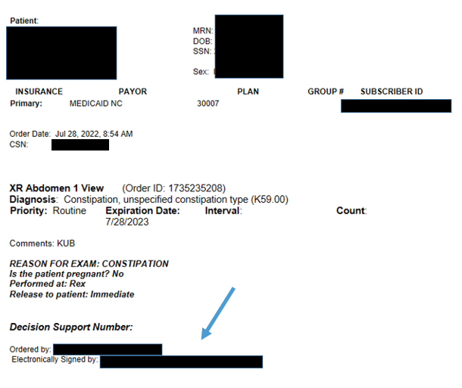

All diagnostic tests must be ordered by a Physician or Advanced Practice Provider (APP)
A provider who treats the patient must order all diagnostic x-rays, diagnostic laboratory tests, and other diagnostic tests for a specific medical problem
      A signed order, a signed requisition, or signed note may be used to support the provider’s intent to order tests
The provider should use test results to manage the patient’s specific medical problem and may provide a consultation
      Tests not ordered by the provider are not considered reasonable and necessary

Slide 25


Additional tests or changed studies may not be performed without a new or additional order from treating provider
If the diagnostic radiologist determines:
  An ordered test is “clinically inappropriate or suboptimal” (e.g., an MRI should be performed instead of a CT scan because of the clinical indication)
  OR
  The results of the ordered test are normal and an additional test should be performed (e.g., a renal sonogram was normal and based on clinical indication, the interpreting physician believes an MRI will reveal the diagnosis)
Additional tests may NOT be performed without a new or additional order from the treating provider.
Okay I will
enter it
Patient needs
MRI instead
of CT
Dr. Smith,
I need a
new order
https://www.cms.gov/regulations-and-guidance/guidance/transmittals/downloads/r80bp.pdf
Notes:
https://www.cms.gov/regulations-and-guidance/guidance/transmittals/downloads/r80bp.pdf

Slide 26
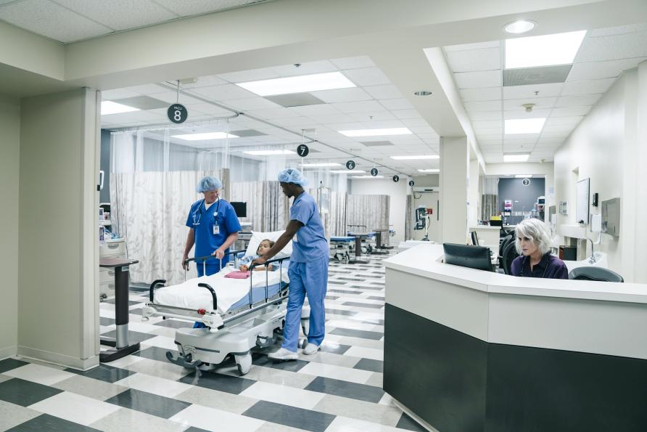
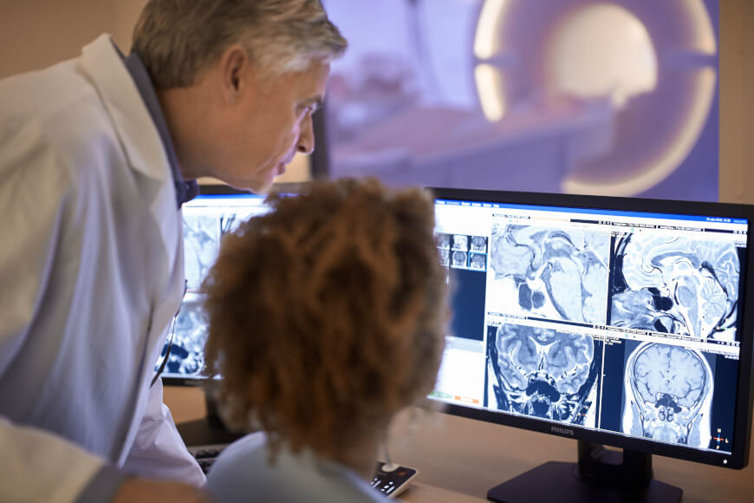



When referring provider/facility cannot be reached to update the order the radiologist or testing facility must perform meet certain criteria
If the testing facility cannot reach the treating physician/practitioner to change the order or obtain a new order and documents this in the medical record, then the testing facility may furnish the additional diagnostic test if ALL the below are present.
The testing center performs the diagnostic test ordered by the treating provider.
Interpreting physician at testing facility determines and documents that, because of the abnormal result of the diagnostic test performed, and additional diagnostic test is medically necessary.
Delaying the performance of the additional diagnostic test would have an adverse effect on the care of the patient.
The result of the test is communicated to and is used by the treating provider in the treatment of the patient.
The interpreting physician at the testing facility documents (in report (why, the additional test was performed.
Notes:
If the testing facility cannot reach the treating physician/practitioner to change the order or obtain a new order and documents this in the medical record, then the testing facility may furnish the additional diagnostic test if all the listed criteria apply.
The testing center performs the diagnostic test ordered by the treating physician/practitioner.
The interpreting physician at the testing facility determines and documents that, because of the abnormal result of the diagnostic test performed, and additional diagnostic test is medically necessary.
Delaying the performance of the additional diagnostic test would have an adverse effect on the care of the patient.
The result of the test is communicated to and is used by the treating physician/practitioner in the treatment of the patient; and
The interpreting physician at the testing facility documents in their report why the additional testing was performed.
Examples:
The last cut of an abdominal CT scan with contrast shows a mass requiring a pelvic CT scan to further delineate the mass.
A bone scan reveals a lesion on the femur requiring plain films to make a diagnosis.

Slide 27
Teaching Physician Guidelines for Procedures

Slide 28



Teaching Physician (TP) Policy will provide internal guidance for TPs working residents and fellows
Purpose of policy is to ensure TP follow supervision requirements for Medicare, Medicaid, TRICARE, and United Healthcare and TP’s supervision and participation are documented in Epic.
Provide definitions applicable to policy (physically present, primary care exception, etc.)
Will restrict TP to use attestations available in Epic@UNC to document their supervision and participation in resident and fellow services
Outlines supervision requirements for Medicare, Medicaid, Tricare, and United Healthcare for Evaluation and Management services, procedures, operative cases, diagnostic radiology, diagnostic tests, anesthesia services, and student services
Addresses Telehealth TP supervision requirement current to date
Highlights
Notes:
Applicable to: UNC Medical Center, UNC Physician Network, Rex Healthcare, Margaret R. Pardee Memorial Hospital
Provide definitions applicable to policy (critical/key portion, direct medical & surgical services, fellow, immediately available, physically present, primary care center, resident, primary care exception, student, teaching physician)
Teaching Physicians are restricted to using attestations available in Epic@UNC to document their supervision and participation in services involving Residents. However, these attestations may be modified to expand upon the Teaching Physician’s participation. Will restrict TP to using attestations available in Epic@UNC to document their supervision and participation in services. However, these attestations may be modified to expand upon the Teaching Physician’s participation. Due to claim logic in Epic that assists billing compliance, Teaching Physicians should not create their own attestations.
Outlines supervision requirements for Medicare, Medicaid, and Tricare for Evaluation and Management services, procedures, diagnostic radiology, diagnostic tests, and anesthesia services, students
Provides Moonlighting guidance for residents and fellows who have completed a GME program

Slide 29

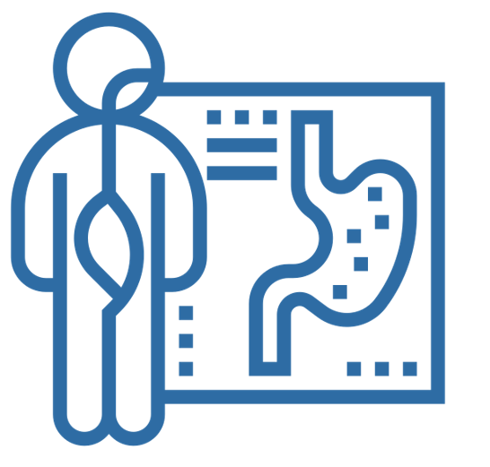


TP must be present for procedures less than 5 minutes, endoscopies, and all time-based procedures in order to bill
    I will use the
    short cut .TP15 to
    document my presence.
    I was present for
    the entirety of
    the procedure(s).
  Minor procedures: 5 minutes or less
    TP must be present the entire time in order to bill
  Endoscopies (other than surgical operations)
    TP must be present for entire viewing, including insertion and removal
  All time-based services
    TP must be present the entire amount of time billed
Notes:
For minor procedures that are 5 minutes or less the teaching physician must be present for the entire procedure in order to bill.
For Endoscopy procedures such as colonoscopies and endoscopies, the teaching physician must be present for the insertion, the entire viewing, and the removal of the scope in order to bill for the procedure.
The teaching physician must be present in order to bill for any service that is based on time.
Teaching Physicians can use the dotphrase .TP15 to document they were present for the entire procedure.

Slide 30

Teaching Physician must be present for all key and critical portions of surgery
  All Surgeries excluding Complex and High-Risk:
    The Teaching Physician (TP) must be present during critical and key portions & immediately available throughout the surgical procedure.
    The TP’s presence is not required during the opening and closing of the surgical field unless these activities are considered to be critical or key portions of the procedure.
    Single Surgery
    The TP decides what portions are critical and key.
      If the TP is present the entire time, the resident/fellow can document their presence.
      If present for critical/key portions only, TP must document extent of involvement.
SmartPhrase MULTIPLE PROCEDURES .TP14 or .TPKEY:
“I was present during all critical and key portions of the procedure and immediately available to furnish services throughout the entire duration of the procedure. See resident note for details.”
Notes:
For surgeries the teaching physician decides what portions are critical and key. This will be based on the procedure and the experience and skill level of the resident or fellow the teaching physician is working with.
For ALL surgeries, the teaching physician must be present during ALL key and critical portions. During non-critical or non-key portions of the surgery, if the teaching surgeon is not physically present, they must be immediately available to return to the procedure. For example the teaching physician cannot be performing another procedure.
When a teaching physician performs a single surgery and the teaching physician is present for the ENTIRE time, the resident or fellow can document their presence. When a teaching physician is only present for the critical and key portions of the surgery, the teaching physician must document their involvement.
The recommended dotphrase is on the slide.

Slide 31
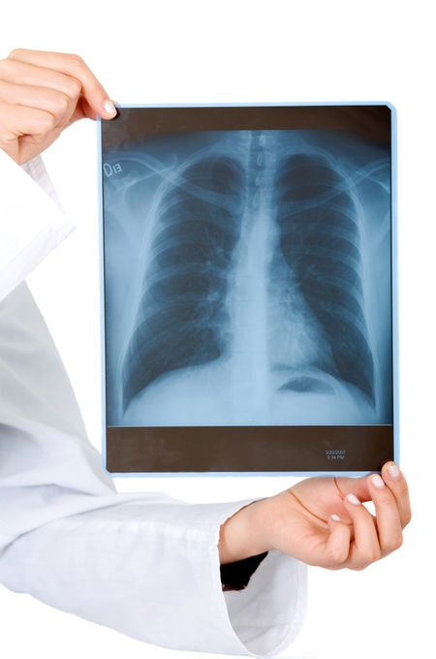
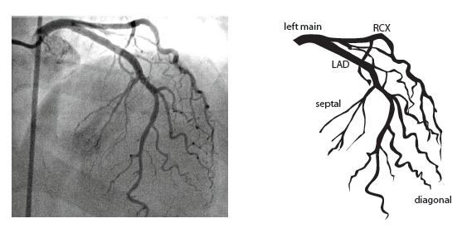
Teaching Physician Presence and Attestation Requirements
Diagnostic Tests
Medicare requires interpretation of diagnostic radiology and other diagnostic tests to be performed or reviewed by a Teaching Physician (TP).
If a resident prepares and signs the interpretation, the teaching physician must indicate they personally reviewed the image and the resident’s interpretation and either agrees with it or edits the findings.
Interventational Radiology
The TP must be present for the entire time for complex or high-risk procedures.
Procedures include but are not limited to interventional radiologic and cardiologic supervision and interpretation codes, cardiac catheterization, cardiovascular stress tests, and trans-esophageal echocardiography. Any procedure that requires personal (in person) supervision.
DotPhrase: .TP29 or .TPRDINTR
I independently reviewed the image(s) and agree with the
resident/fellow's interpretation.
DotPhrase .TP25 or .TPCOMPLEX
I was present for the entirety of the complex procedure. I
Agree with the resident's documentation of the complex
procedure. The procedure was complex because ***.
Notes:
Diagnostic Tests
Medicare requires interpretation of diagnostic radiology and other diagnostic tests to be performed or reviewed by a teaching physician. If a resident prepares and signs the interpretation, the teaching physician must indicate they personally reviewed the image and the resident’s interpretation and either agrees with it or edits the findings.
If the teaching physician’s signature is the only signature on the interpretation, Medicare assumes that he/she is indicating that he/she personally performed the interpretation.
Medicare does not pay for an interpretation if the teaching physician only countersigns the resident’s interpretation.
The presence of the resident alone would not establish a basis for fee schedule payment for such services.

Slide 32

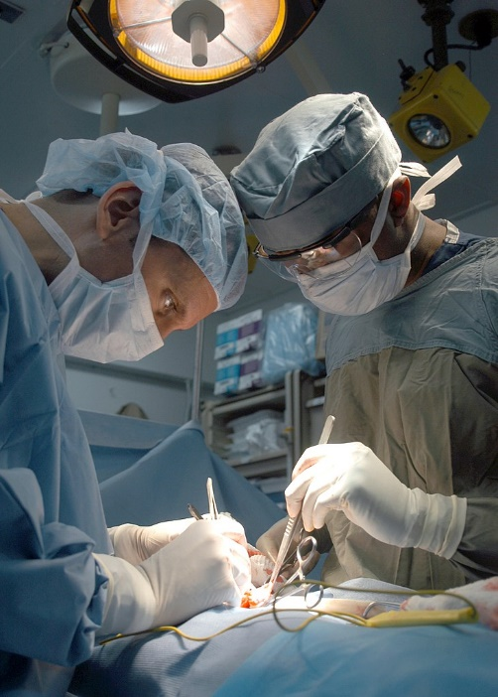
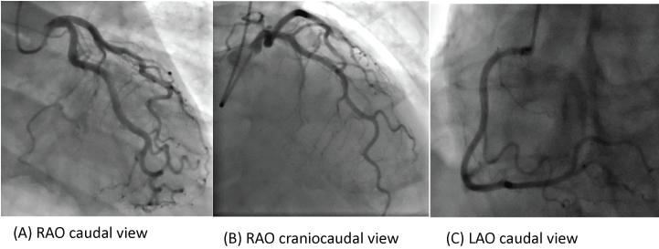
TP must be present physically present throughout the entire complex and high risk procedure
  Specific complex or high-risk procedures require continual personal supervision by the TP (i.e., TP is in the room)
    Interventional radiology
    Cardiac catheterization
    Stress tests
    Trans-esophageal echocardiography
SmartPhrase .TP25:
“I was present for the entirety of the complex procedure. I agree with the residents documentation of the complex procedure. The procedure was complex because ***. TP Name”
Yes, you must be
present for the entire
complex procedure.
Do I have to
be present for a
complex
procedure?
Notes:
For all complex or high risk procedures the teaching physician must provide continual personal supervision which means the teaching physician must be present in the room with the resident or fellow performing the surgical procedure. Some complex or high risk procedures include, cardiac caths, stress tests, and Interventional radiology procedures.
Teaching physicians can use the DotPhrase .TP25 or .TPCOMPLEX to document their presence for the entirety of the complex procedure.

Slide 33

Unacceptable TP Attestations for Medicare
  Examples: Unacceptable Attestations
    “Agree with above.”
    “I was available.”
    An electronic countersignature or identity alone
Notes:
Such documentation is not billable, because the attestation does not make it possible to determine whether the TP was present, evaluated the patient, and/or had any involvement with the plan of care.

Slide 34
NC Medicaid Procedures
Notes:
Now we will turn our attention to the requirements for procedures for NC Medicaid. As with E/M services Medicaid is not as stringent with procedure requirements.

Slide 35

Procedures for NC Medicaid require direct supervision
    The degree of supervision is based on the skill, level of training, and experience of the resident as well as the patient's condition.
    TP must provide “direct supervision” (available in the office or procedural suite).
    Written documentation in the medical record for NC Medicaid patients must clearly designate the
    supervising physician and be signed by that physician.
This Photo by Unknown Author is licensed under CC BY-NC-ND
IMMEDIATELY AVAILABLE PROCEDURE SmartPhrase .TP20 or .TPAVAL
“This service was rendered under my overall direction and control. I was immediately available in the procedural suite providing direct supervision.”
Notes:
When providing care and billing the Medicaid program for services to patients, Teaching Physicians assume full responsibility for the health and safety of the patient.
Medicaid requires the teaching physician to provide direct supervision which means the teaching physician must be present in the procedural suite or available in the office for minor procedures. NC Medicaid states the degree of teaching physician supervision should be based on the skill level, training, and experience of the resident, as well as the patient's condition. For example, patients that are highly complex may require the teaching physician to be present for the entire procedure. NC Medicaid requires the medical record to clearly designate the supervising physician and the note be signed by the same supervising physician.

Slide 36
Documentation Integrity in the Medical Record

Slide 37

Data Replication in Electronic Documentation
Altering notes improperly may undermine the integrity of the electronic health record (EHR) and jeopardize reimbursement and patient safety.
  Medicare allows documentation changes within limits, including amendments, corrections, addenda, and delayed entries if they are clearly identified and there is no tampering with original content.
The billing provider is responsible for the content of the documentation including its accuracy and any copied information.
Clinical documentation must demonstrate clearly distinct variation between notes.
The HPI, ROS, exam, and impression and plan must demonstrate documentation relevant to EACH clinical encounter and be reviewed and edited appropriately.
When possible, the use of copying and pasting of laboratory, pathology or radiology results in its entirety should be minimized in order to reduce “note bloat.” Summarizing findings and medical judgment is encouraged.
UNC Health Policy: Copying and Pasting and Data Replication in Electronic Documentation

Slide 38
Attestations

Slide 39

Use Epic attestations for all residents note (.ALLATTESTATIONUNCHCS)
Type .ALLATTESTATIONSUNCHCS directly in your note to access the Compliance built attestations in Epic.
Utilize the Compliance attestation shortcuts (.TPXX) to save you time.
Choose the attestation that represents how you participated in the service. Epic logic will determine if the service is billable.
Do not create your own attestations or Epic logic will not work. You may edit the attestations if needed.
Notes:
It is important to remember the attestation that you choose determines if the service is billable.
Teaching physicians can Utilize the Compliance attestation shortcuts (.TPXX) to save you time or you can type .ALLATTESTATIONSUNHCS directly in your note to access the Compliance built attestations in Epic.
Teaching physicians should choose the attestation that represents how they participated in the service. Epic logic has been built behind the attestations and will determine if the service is billable.
Do not create your own attestations or Epic logic will not work. You may edit the attestations if needed.

Slide 40

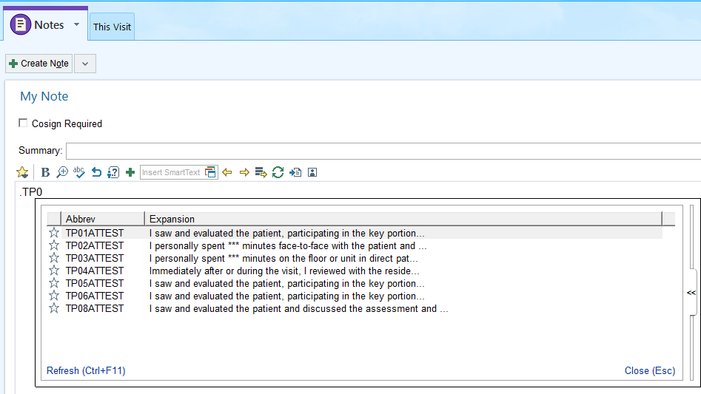
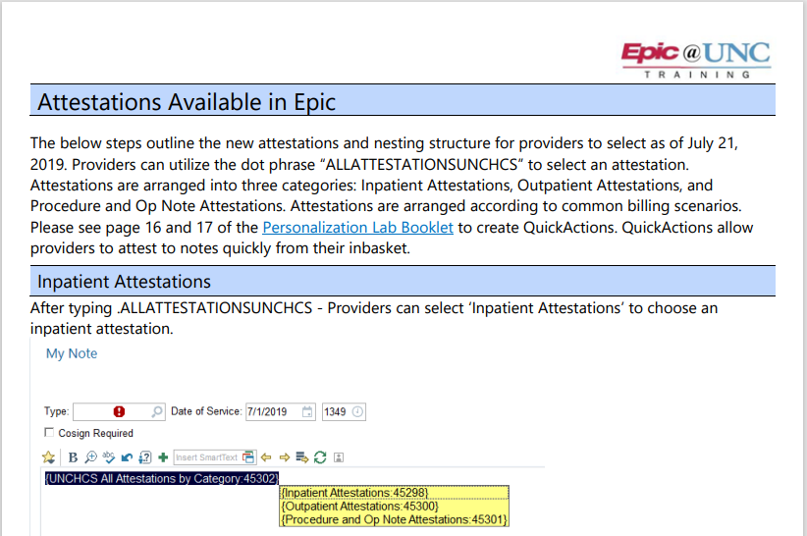
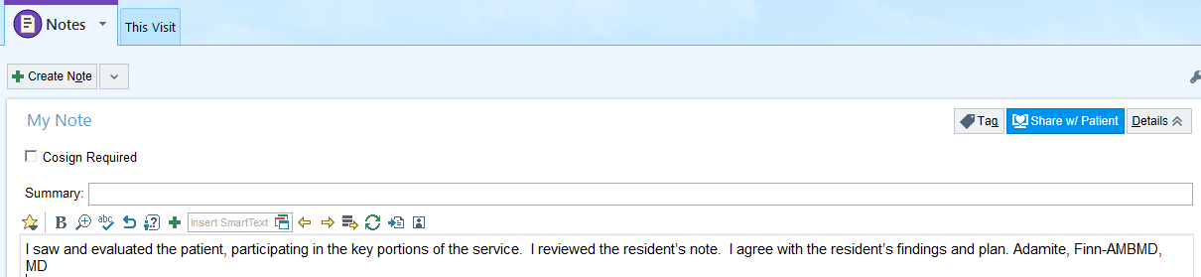
Utilize Compliance Attestations in Epic
Compliance Attestations.pdf (unchealthcare.org)
Notes:
Here we have a snip it of where .TP0 was typed in a progress note. You can see the list of attestations providers can choose from. The appendix in this slide deck lists all the attestations and the shortcuts providers can use. On the right side of the screen is a snipit from our attestation handout.

Slide 41
Contact us – We are here to help!
    PhysicianCompliance@unchealth.unc.edu
    https://unchcs.intranet.unchealthcare.org/dept/ACP/compliance/
EXECUTIVE DIRECTOR
Robin Davis Shuping, RN, MHA, CPC | Executive Director, Physician Compliance UNC Health Phone 984.974.1017 Robin.Shuping@unchealth.unc.edu
ASSOCIATE DIRECTOR
Noel Wagner, RN, MSN, CPC | Associate Director, Physician Compliance
UNC Health
Phone 984.974.1308
Noel.Wagner@unchealth.unc.edu
Confidential Hotline: 1-800-362-2921 http://hotline.unchealthcare.org

Slide 42
Thank you!

