Slide 1
Physicians as Advocates
Jasmine Shell, MD
Marci Morgenlander, MD MPH
December 8, 2020

Slide 2
Welcome to POPTOPs
Population Health Topics brought to you by the UNC Preventive Medicine Residency
Bringing population health information to AHEC residents in our state

Slide 3
This project is made possible through an
AHEC Innovations Grant
Notes:
AHEC Area Health Education Centers

Slide 4
Objectives
Introduction to Preventive Medicine and Population Health
Discussion about advocacy in medicine
Notes:
Each of our poptops lectures has a twofold purpose. The first is to introduce you to population health and the specialty of preventive medicine, specifically our preventive medicine residency program at the University of North Carolina, Chapel Hill. The second is to provide an overview of a population health topic and its relevance to you as a primary care resident in North Carolina.

Slide 5
What is Preventive Medicine?
One of 24 recognized board specialties
Definition from ACGME:
the medical specialty which focuses on the promotion, protection, and maintenance of health and well-being and the prevention of disease, disability, and the premature death of individuals in defined populations
Quick definition: population health practice
2 main settings:
Governmental public health
Health care
Notes:
Specialties: Aerospace, Occupational Medicine, Public Health/Gen. Prev Med
Subspecialties: Addiction Medicine, Clinical Informatics, Medical Toxicology, Undersea/Hyperbaric Medicine

Slide 6
What is PM training?
2 years following one clinical year
MPH, MSCR or equivalent degree
required rotations
individual patient care
governmental public health
clinical population health
electives
Additional requirements
teaching
research

Slide 7
Population health definition
Health outcomes of a group of individuals and the distribution of defined outcomes within the group.
(Kindig, 1988)

Slide 8
Why Advocacy as a Population Health Topic?
Notes:
Brief interactive discussion of what is population health and why we chose this topic.
Population Health Milestones in Graduate Medical Education (Duke, UNC, ECU, AAMC – CDC funded project on pop health in GME, 2015) was basis for our survey
21/25 AHEC Residency Program Directors Responded , etc.

Slide 9
Advocacy Agenda
Definition
Pertinence to Primary Care Providers
Spectrum of advocacy
Case studies
Educational Initiatives
Resources
Notes:
(this should include gov links for healthcare bills as well as AMA and professional society advocacy links)

Slide 10
Definitions of Advocate
Publicly recommend or support (Google)
To plead in favor of (Merriam-Webster)

Slide 11
Definition of Physician Advocacy
“Action by a physician to promote those social, economic, educational, and political changes that ameliorate the suffering and threats to human health and well-being that he or she identifies through his or her professional work and expertise.”
(Earnest, 2010)
Notes:
From Academic Medicine article “Perspective: Physician Advocacy: What Is It and How Do We Do It?” Earnest, Mark A. MD, PhD; Wong, Shale L. MD, MSPH; Federico, Steven G. MD 2010 Academic Medicine

Slide 12
Definition of Physician Advocacy
Issues identified through professional work
Example topics
Health insurance coverage
Access to healthcare
Women’s health
Human trafficking
Gun violence
Vaccine mandates
Notes:
It is important to note that the definition specifies issues identified through professional work. This may include multitudinous topic areas. Health insurance coverage, access to care, women’s health……… are just a sampling of these topics. Naturally, successful advocacy work undertaken by physicians likely generates from the passions and value systems of those physicians. However, an important takeaway point is that physician advocacy does NOT refer to using one’s professional standing to lobby for personal opinion or gain. It does refer to using one’s professional standing to foster connections and mobilize resources thereby optimizing social factors which promote the best health outcomes for the patients served.

Slide 13
Definition of Physician Advocacy
Identify an issue of concern
Gather information
Commit to action
Collaborate with others
Mobilize resources
Sustain the effort
(Haq, 2019)
Notes:
Earnest’s definition begins with the word “action”. Here is a more specific elucidation of what that “action” looks like. First, identify an issue of concern. As a trained scientist who operates from an evidence base, you should gather available information. Next, commit to action. Recognize the strength and necessity of collaboration, mobilize available resources, and finally, plan for sustainability.

Slide 14
Levels of Engagement
Interpersonal
Organizational
Health System
Policy
(Haq, 2019)
Notes:
Haq 2019 offers one framework based on the social ecological model of public health that describes distinct categories of advocacy, or the various levels engagement can occur to address any identified topic of concern.

Slide 15
Why should you care about advocacy?
The AMA and ANA endorse advocacy
AMA: “advocate for the social, economic, educational, and political changes that ameliorate suffering and contribute to human well-being.”
The ACGME promotes advocacy
training mandated in pediatrics
Professional societies including ABIM, ACOG, AAP, APA, AAFP, ACS endorse advocacy
Notes:
Why should you as a resident physician care about advocacy. First of all, your governing bodies have already decided that you should care. Since 2002, the American Board of Internal Medicine has endorsed advocacy as a necessary component of professionalism. The American Medical Association also calls physicians to advocate. The accreditation council for graduate medical education (ACGME) promotes advocacy, and mandates it for pediatric trainees.

Slide 16
Why should you care about advocacy?
Notes:
I would propose that another reason you should care is that your patients are whole people and their health can only be optimized by addressing factors outside of the medical encounter. As frameworks and competencies are being developed to enhance your skills in physician advocacy, only you will decide how or if advocacy works in your practice of medicine. This may look very different to an academic cardiothoracic surgeon than it looks to a rural pediatrician. However, the evidence continues to mount that social factors affect health outcomes across all diagnoses.

Slide 17
Physician Endorsement
Over 90 % of resident physicians believe advocacy is a physician’s duty
Less than 20% believe they received adequate training
(Wright, 2005; Garg, 2019)
Notes:
What do your colleagues believe about advocacy? From the limited existing evidence, we know that …..
Wright 2005
Garg 2019

Slide 18
Physician Engagement
Physicians vote less often than lawyers and the general public
Physician contributions and lobbying more likely relate to financial incentives than public health initiatives
(Grande, 2007; Wright, 2005; Landers, 2004)
Notes:
Despite the high level of endorsement of the importance of advocacy, it is interesting to note that on a basic index of civic involvement, voting, physicians score lower than attorneys or the general public. There is also some evidence that physicians’ political involvement is more likely related to protection of economic well-being than on public health initiatives. No actual data on percentage of physicians engaging in advocacy.
Grande 2007 Do doctors vote
Wright 2005
Landers 2004

Slide 19
Spectrum of Physician Advocacy
Patient
Local
State
Federal
Global
Notes:
The spectrum of physician advocacy ranges from advocating for the patient in front of us, likely the most familiar to physicians in training, to advocating on a global level. To illustrate advocacy at each of these levels, we will examine case studies for each. Let’s begin with physicians as patient advocates.

Slide 20
Physicians as Patient Advocates
As an advocate for the patient, “the concerns and best interests of the patient are at the core of all decisions and interactions.”
Physicians should listen to their patients, respect their autonomy and beliefs, and allow patients to be fully involved in their healthcare decisions
(Schwartz, 2002)
Notes:
Schwartz L. Is there an Advocate in the House? The role of Health Care Professionals in Patient Advocacy. J Med Ethics 2002

Slide 21
Case Study
A 29-year-old single mother of five children from Mexico with limited English proficiency and no transportation has missed three previous appointments and has arrived 20 minutes past today’s scheduled appointment time. The rules of your practice state that she should not be seen today and is to be dismissed from the practice.
How can you advocate for this patient?

Slide 22
Possible Solutions
You utilize a Spanish medical interpreter to accurately communicate with this patient
If Spanish language services are not available, you meet with clinic administration to express the need for these services
You see the patient today and be sure she is not dropped from the practice
You promote screening for transportation needs in your clinic and modification of policies to support patient needs
Notes:
This case study shows the natural progression of advocacy for an individual patient to advocacy at a broader systems level. If you find yourself repetitively dealing with the same barrier to care, you can spend time repeating the same action every day, or you can look outward to create a collaborative team or a working solution so that your patient is better taken care of AND so that you can do the job you are trained to do with greater efficiency and satisfaction. This case also illustrates that even one patient encounter may spur action on a number of topics; in this case you might choose to target culturally competent services, clinic policies, screening for SDH, or public transportation routes. This leads us to the role of physician as local advocate.

Slide 23
Physicians as Local Advocates
Physicians play diverse roles in society, often bridging individual and community perspectives.
(Haq, 2019)
Notes:
Haq 2019 American Family Physician
https://www.ncmedsoc.org/

Slide 24
Case Study
You have seen several patients from the same apartment complex with severe asthma exacerbations over the past few weeks. On further questioning, you learn that the apartment complex was flooded in a recent hurricane and that the carpet and walls remain damp and moldy. The landlord does not plan further renovations.
How can you advocate for these patients?

Slide 25
Possible Solutions
You familiarize yourself with your state’s laws on mold mitigation
You call the landlord of the property to share your belief that living conditions are contributing to poor health
If he does not agree to renovations, you contact a local news station to cover the story
You identify local housing coalitions and offer to publicly speak on their behalf of the health consequences of mold

Slide 26
Physicians as State/Federal Advocates
It is important to share your voice, contact your representative and/or lobby on legislation that affects your field, your patients and the care you provide.
Notes:
Advocacy 101 ACOG

Slide 27
Case Study
In your work in an emergency department, you have seen an increasing number of combustion injuries and other morbidities related to electronic cigarette use.
How can you advocate for these patients?

Slide 28
Possible Solutions
Familiarize yourself with your state senators and representatives
Write letters and make phone calls to your legislators informing them of your position
Join national coalitions such as American Cancer Society or Tobacco Partners
Write an op-ed or letter to the editor of your local paper OR use social media presence
Organize an advocacy day at the State Capitol
Notes:
NC Senators Thom Tillis (R) and Richard Burr (R)
13 Representatives CH, Durham, Raleigh are District 4 (David Price D)

Slide 29
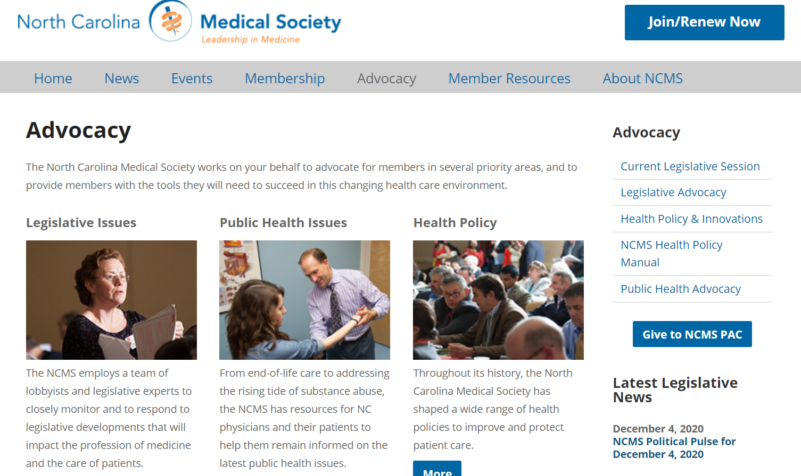
https://www.ncmedsoc.org/

Slide 30
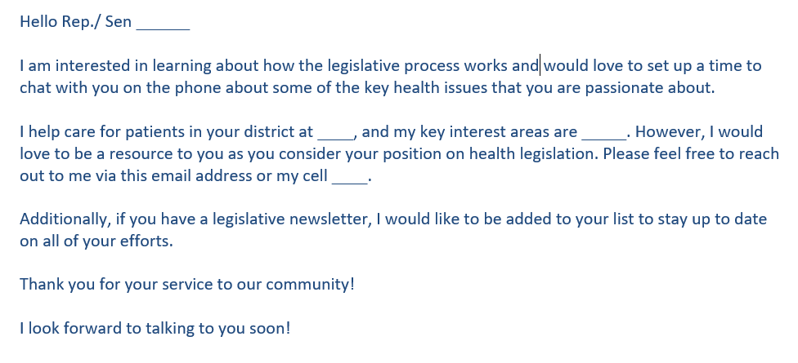
Example letter to legislators
Website to find legislators: https://www.ncleg.gov/FindYourLegislators

Slide 31
Global case study and solutions
On a medical mission trip to a Latin American country, you note that sick people in rural communities have to travel over 3 hours to receive medical care resulting in poor outcomes.
How can you advocate for these patients?
Notes:
Let’s look at one final case

Slide 32
Possible Solutions
Learn about the existing healthcare infrastructure of that country
Garner support from your mentors and affiliate institutions in the US
Build trust with local partners
Help to pilot, or fund, a medical clinic or small hospital
Notes:
This case study is loosely based on the work of Dr. David Gaus of Andean Health and Development who has built a sustainable primary and secondary care health system in Ecuador over the past 2 decades. You can read more about his work at andeanhealth.org .

Slide 33
Advocacy Education Initiatives
Canada RCPSC CanMEDS added Health Advocacy Competencies in 2005 update
Social Medicine Network
ACGME Pediatric requirement for residency review committee
Cambridge Health Alliance (CHA) yearlong experiential rotation (Basu, 2017)
Notes:
While there are many powerful examples of physician advocates, the notion that advocacy skills training should be intrinsic to medical education is a newer concept with multifactorial origins. CanMEDS which is looked to internationally as a guide to physician education delineates advocacy competencies. In the US, the way we instill these competencies into physician training can vary from a 2 week block rotation, to a year long experiential learning curriculum. At this point pediatrics is the sole ACGME specialty requiring advocacy training, and competencies state only that pediatric trainees participate in an ambulatory rotation that includes “elements of child advocacy”. The CHA (Harvard affiliated primary care residency) has published its model of a year long experiential rotation which includes mandatory scholarly products. 2012-2015; early eval shows residents regard it a high quality rotation and a strength of the residency.
IM curriculum (Basu)
AAFP Framework (Haq)

Slide 34
Advocacy Education Initiatives
Early results from the CHA rotation
High marks from CHA trainees
According to trainees, experiential learning results in
Increased knowledge of resources
Increased skills
(Basu, 2017; Luft, 2019)
Notes:
CHA program 2012-2015; early eval shows residents regard it a high quality rotation and a strength of the residency. (Basu)
The essential role of physician as advocate: how and why we pass it on
LeeAnne M. Luft^{1,2}

Slide 35
Barriers to Advocacy
Medical school admission favors academics over service orientation
Medical training isolates physicians from the community
Ambiguity of the advocacy role
Time constraints
Perception of institutional disapproval
(Earnest, 2010)
Notes:
Proposed by Earnest

Slide 36
Another perspective
Civic virtues are outside the professional realm
Even if civic virtues were professionally obligatory, it is unclear that civic participation is necessary for such virtue
The profession of medicine ought not to require any specific political stance
(Huddle, 2011)
Notes:
All physicians are not in agreement that advocacy is a necessary part of the practice of medicine. In fact, Dr. Thomas Huddle has actively argued against it in the pages of Academic Medicine making the points that…..
He further states that advocacy is counter to academic pursuits since it “seeks change rather than knowledge”
Perspective: Medical Professionalism and
Medical Education Should Not Involve
Commitments to Political Advocacy
Thomas S. Huddle, MD, PhD

Slide 37
Take Home Points
Health advocacy has been endorsed as a physician competency
The spectrum of advocacy is vast
Educational curricula are evolving
More evaluation is needed
You can and should be an active decision maker on the incorporation of advocacy into your practice of medicine

Slide 38
Resources
https://www.ncmedsoc.org/
https://www.ncleg.gov/FindYourLegislators
https://www.ama-assn.org/member-groups-sections/residents-fellows/resident-fellow-section-rfs-advocacy-initiatives
https://www.govtrack.us/congress/bills/subjects/health/6130
http://www.physiciansadvocacyinstitute.org/
http://imapny.org/physician-advocacy/physician-advocacy-program-overview/
Notes:
Here are some websites where you can learn more about physician advocacy. I also encourage you to go to your professional society website and search the advocacy tab.

Slide 39
References
1. Earnest MA. Perspective: Physician advocacy: what is it and how do we do it? Acad Med;85(1):63-67. doi: 10.1097/ACM.0b013e3181c40d40
2. Haq C. Effective Advocacy for Patients and Communities. Am Fam Physician;99(1):44-46.
3. Advocacy. https://www.nursingworld.org/practice-policy/advocacy/. Accessed December 8, 2020.
4. Wright CJ. Development of an advocacy curriculum in a pediatric residency program. Teach Learn Med 2005;17(2):142-48. doi: 10.1207/s15328015tlm1702_8
5. Garg M. Attitudes Toward Advocacy Do Not Match Actions: A Cross-sectional Survey of Residents and Fellows. Rhode Island medical journal (2013);102(3):34-37.
6. Grande D. Do doctors vote? Journal of general internal medicine : JGIM;22(5):585-89. doi: 10.1007/s11606-007-0105-8
7. Landers SH. Health care lobbying in the United States. The American journal of medicine;116(7):474-77. doi: 10.1016/j.amjmed.2003.10.037

Slide 40
References
8. Schwartz L. Is there an advocate in the house? The role of health care professionals in patient advocacy. J Med Ethics;28(1):37-40. doi: 10.1136/jme.28.1.37
9. https://www.andeanhealth.org/ (accessed 6/28/2019)
10. Boroumand S, Stein MJ, Jay M, Shen JW, Hirsh M, Dharamsi S. Addressing the health advocate role in medical education. BMC Med Educ. 2020;20(1):28. Published 2020 Jan 30. doi:10.1186/s12909-020-1938-7
11. Basu G. Training Internal Medicine Residents in Social Medicine and Research-Based Health Advocacy: A Novel, In-Depth Curriculum. Acad Med;92(4):515-20. doi: 10.1097/ACM.0000000000001580
12. Luft LM. The essential role of physician as advocate: how and why we pass it on. Can Med Educ J;8(3):e109-e16.
13. Huddle TS. Perspective: Medical professionalism and medical education should not involve commitments to political advocacy. Acad Med;86(3):378-83. doi: 10.1097/ACM.0b013e3182086efe
14. www.ub.edu/medicina_unitateducaciomedica/documentos/CanMeds.pdf

Slide 41
Thank You!
University of North Carolina Preventive Medicine Residency Program
https://www.med.unc.edu/fammed/education/prevmed/

Slide 42
“Once a provider-patient relationship has enabled the physician to adequately understand the needs and priorities, the core of advocacy is undertaking the necessary action(s) to bring about positive change for the patient or group of patients.”
Notes:
Luft 2017

