Slide 1
Funds Flow Session
Bondurant G-010
October 25, 2018

Slide 2
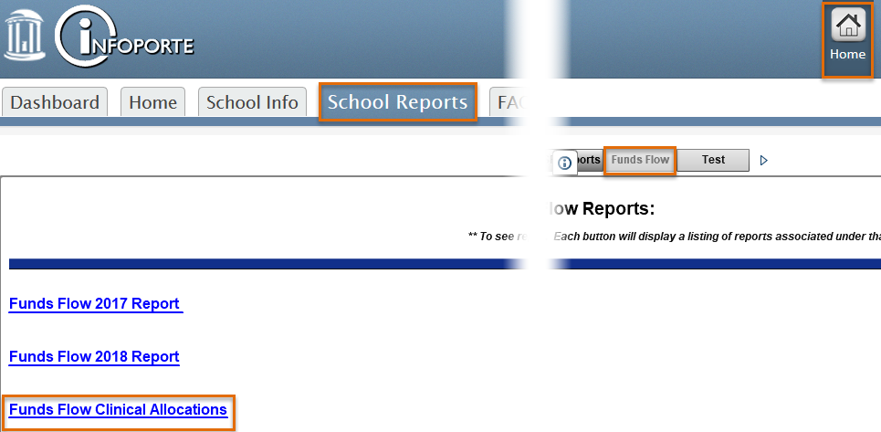
Infoporte Funds Flow Reporting Updates
Non MD Allocation Detail by Provider with Dept ID
Allows ability to tie directly to financials and Epic data

Slide 3
Current Resources
Monthly Training for ACAs/Business Managers and other applicable staff
Funds Flow Website https://www.med.unc.edu/fbo/funds-flow/
Infoporte Funds Flow Reports published monthly
Departmental Monthly Financial Meetings with FP and Funds Flow teams
Individual meetings upon request
What other training resources would be helpful?

Slide 4
Funds Flow Reminders
New Faculty
Do not forget to assign program codes to onboarding faculty
Many new faculty members have no cFTE and are not receiving Benefits or Overhead reimbursement
An adjustment for any months that were missed will occur mid-year

Slide 5
Coming Up Next
Next Funds Flow Training Session – December 11th (NOVEMBER MEETING CANCELLED)
CIC
Support Request Presentations due by 5pm tomorrow, October 26th
Present Growth Request Presentations next Monday, October 29th
Present Support Request Presentations on November 1st and 2nd
Presentations should be 5-10 minutes long and PowerPoint slides should adhere to the format sent out in CIC materials

