Slide 1


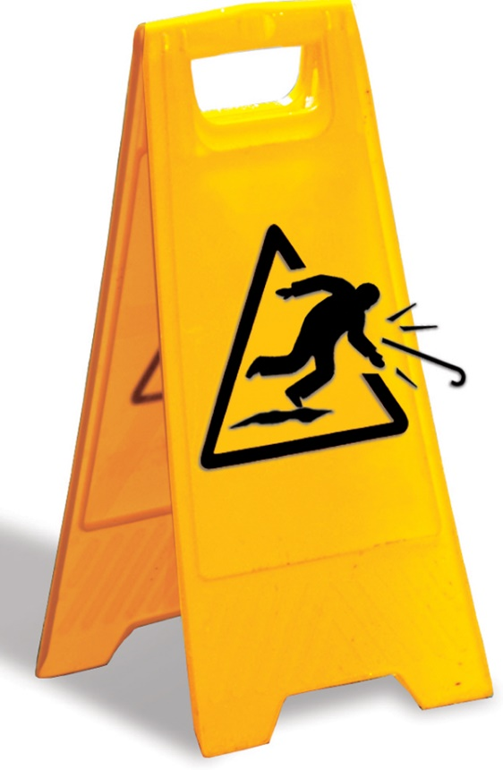
Geriatric Bone Health Improvement Project
Meredith Gilliam MD MPH, Project Lead
Sabrina Vereen DHA
Claire Larson MD
Sheri Mouw MD
Raven Pang MD
Juneve Toche MD
Jan Busby-Whitehead MD

Slide 2
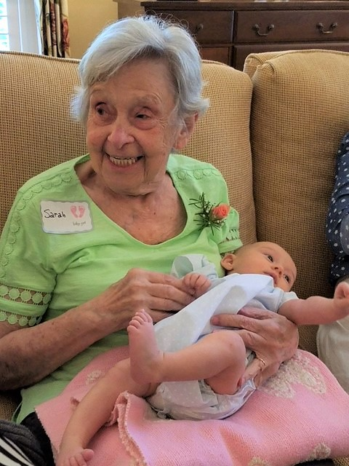
Sarah
Notes:
(Patient story of a common geriatric syndrome: Hip fractures and their natural consequences)
This is a photo of UNC Geriatrics patient, who is also my husband’s grandmother, pictured here with her namesake, my daughter.
In October of last year, as we were starting this project, Sarah was walking through the dining room of her dementia care facility when she fell and broke her right hip. Unfortunately, her story didn’t end there. Despite excellent surgical and post-acute care, Sarah developed postoperative delirium that persisted. She stopped eating and stopped getting out of bed. She then had a likely stroke, and transitioned to hospice, passing away two months after her fracture.

Slide 3
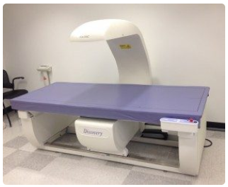
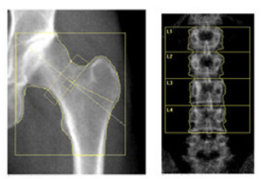
Osteoporosis
Osteoporosis: low bone density
Diagnosed by DEXA or fracture hx
Fragility fracture = bone fracture resulting from a fall from ≤ standing height
Treated with time-limited courses of bisphosphonates & other drugs
Notes:
(20 seconds) A quick background on osteoporosis
--osteoporosis is a condition of low bone density associated with aging, menopause, and a few other conditions
--it is diagnosed one of two ways: with a screening dexa scan, or based on a history of a fragility fx
--fragility fx is a fx that results from a fall from standing height or less
--most commonly: spine, hips, pelvis, forearms, humerus
--fragility fractures can be reduced by reducing falls and by treating osteoporosis
--osteoporosis is most commonly treated with bisphosphonate medications like alendronate, zoledronic acid, but there are also several newer and more expensive medications available

Slide 4
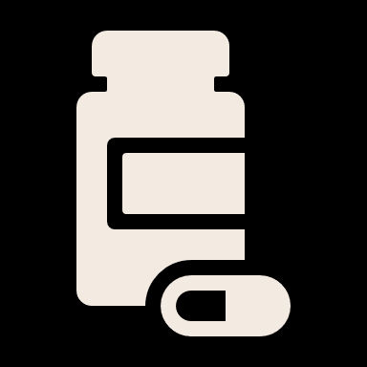



Burden of the problem
NNT=19
prevent 1 fx over 2y
1 out of 2
white ♀
Mortality ↑ 5-8x
After hip fx
1 out of 5
Black ♀ &
White ♂
$43,000
per fx
1 Cummings and Melton Lancet 2002
2 Haentjens et al Annals IM 2010
3 Burget et al J Bone Miner Res 2007
4 Lyles NEJM 2007, www.theNNT.com
Notes:
$43,000 on average - think about hip fracture (emergency surgery, hospitalization, rehab, pain and fragility management) ****
And not to mention the human burden as i mentioned before
Fragility fractures are common, morbid, and expensive
In the US, nearly 50% of white women and 20% of black women & white men will suffer a fragility fracture in his/her lifetime1
All-cause mortality is increased 5-8 fold in the 3 months after a hip fx2
Total cost of medical care for each fragility fracture = $43,0003
Osteoporosis drugs help. Treating 19 high risk women prevents 1 fx over 2 years but care gaps exist...
SHANA: I THINK THE SLIDES NEED SOME BRIEF KEYWORDS BY THE NUMBERS. E.G. 1 OUT OF 2/FRAGILITY FRACTURE (ESPECIALLY THE 1 OUT OF 2 AND 1 OUT OF 5)

Slide 5
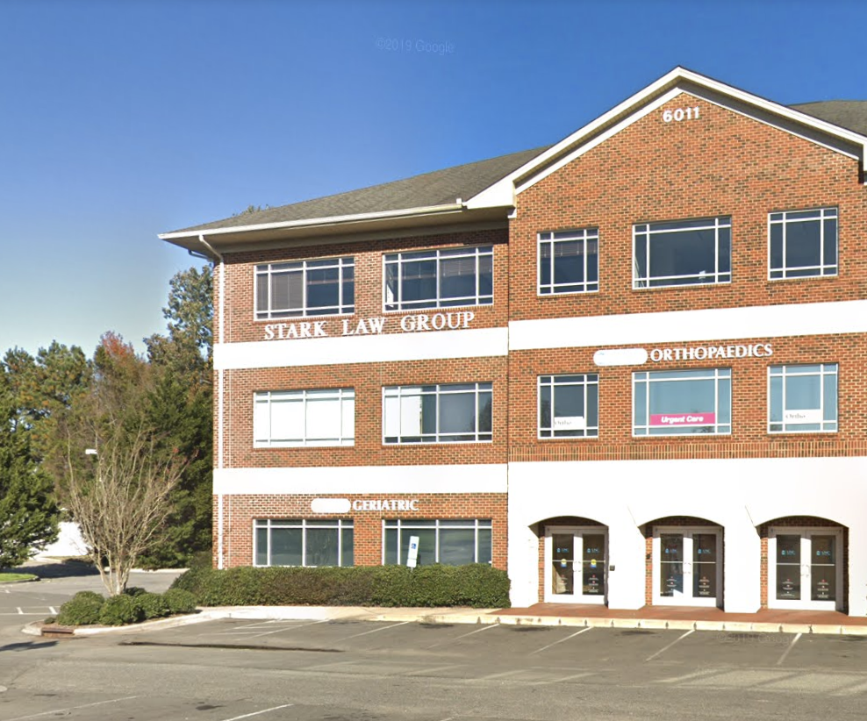
Aims
Global: To reduce fragility fractures among Geriatric Specialty Clinic patients
SMART:
  By August 2019, close 50% of gaps in appropriate screening for and treatment of osteoporosis (NQF #0037, ACOVE-3 Osteoporosis #2, MIPS #418, HEDIS OMW)
    “Gap” = absence of documented, shared decision about screening or treatment
Notes:
This is our setting – Geriatric Specialty Clinic - 2800 primary care pts, average age 76
IS IT POSSIBLE TO CROP THE SIDE OF THE PICTURE SO THAT “STARK LAW GROUP” IS LESS PROMINENT. MY EYE WENT RIGHT THERE

Slide 6

The first challenge:
Electronic tools to identify our target populations don’t exist!
Notes:
PROS:
We created a protocol for identifying the patients who need to be screened
We had some data pulls that pop health - good start but insufficient
We identified problems with the ways that patients are being identified
Lessons learned:
***
One slide:
We learned all these amazing lessons
BUT…
It took 19.5 hrs of physician time!

Slide 7
Creating an osteoporosis screening registry
Created a protocol for identifying patients needing their FIRST screening DEXA
  Focus on pts missing from existing EPIC tools
Lessons learned!
Pop Health data pulls – great start but insufficient
Outside DEXA scans not “pulling in”
Determining screening “appropriateness” is subjective – must consider pt’s global health & goals
476 pts
105 pts
into registry
Notes:
Created a protocol for identifying patients needing to be screened
Existing EPIC health maintenance tool captures women age 65-85, but we also wanted to capture women > 85 and men with risk factors like chronic steroid use
Protocol addressed issues like estimated life expectancy which affects a person’s ability to benefit from screening
Learned many lessons from this process
Pop health data pull – only 19% of patients identified had an “actual” dexa screening gap (476 → 105 pts)
DEXA scans done at outside EPIC institutions are not pulling in automatically, and often aren’t being entered manually
Osteoporosis absent from problem list in 52 cases (10%)
Screening “appropriateness” is complex in our very elderly patients with limited life expectancy and changing goals of care
As you might imagine, the work of

Slide 8
Creating an osteoporosis screening registry
Created a protocol for identifying patients needing their FIRST screening DEXA
  Focus on pts missing from existing EPIC tools
Lessons learned!
Pop Health data pulls – great start but insufficient
Outside DEXA scans not “pulling in”
Determining screening “appropriateness” is subjective – must consider pt’s global health & goals
Registry creation = 20 hours of MD work!
476 pts
105 pts
into registry
Notes:
Created a protocol for identifying patients needing to be screened
Existing EPIC health maintenance tool captures women age 65-85, but we also wanted to capture women > 85 and men with risk factors like chronic steroid use
Protocol addressed issues like estimated life expectancy which affects a person’s ability to benefit from screening
Learned many lessons from this process
Pop health data pull – only 19% of patients identified had an “actual” dexa screening gap (476 → 105 pts)
DEXA scans done at outside EPIC institutions are not pulling in automatically, and often aren’t being entered manually
Osteoporosis absent from problem list in 52 cases (10%)
Screening “appropriateness” is complex in our very elderly patients with limited life expectancy and changing goals of care
As you might imagine, the work of

Slide 9



Osteoporosis screening outreach
Geriatric PCPs are closely invested in their patients’ care
MyChart registration ≠ MyChart usage
“Unscreened” cohort is very elderly (86yo), multimorbid
Process:
Obtained approval from PCPs for outreach (40%)
Outreach to patients:
Lessons learned
Notes:
Our process for screening outreach was two steps: First, we engaged with PCPs about our plans
What we learned was, our PCPs are highly invested in the details of their patients’ care, including determining whether their very elderly, complex patients should be outreached to
In fact, PCPs only approved outreach on 40% of the 105 patients we approached them about
We then attempted to

Slide 10
Addressing screening gaps
Overall Osteoporosis Screening Rate
Geriatrics Clinic
41%
Goal
National Average
1 – 47%1
5
Outside DEXA brought in
2
DEXA ordered, not complete
5
DEXA complete
1 Morris et al JGIM 2004
Notes:
So here is what happened. We ended up only having a small pilot group of 40 pts to work with. Through our outreach efforts over time, these patients completed 5 DEXA scans, 2 were ordered but not done. Interestingly, only after outreach to the patients did we learn that another 5 had DEXAs done outside of UNC – just as many as we had newly screened at UNC.
Even though we didn’t greatly affect the overall screening rate, we learned and identified processes that when sustained, will help us improve this further

Slide 11
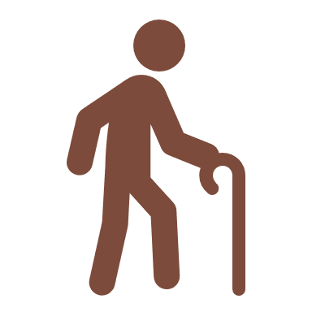
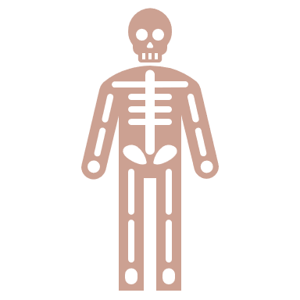
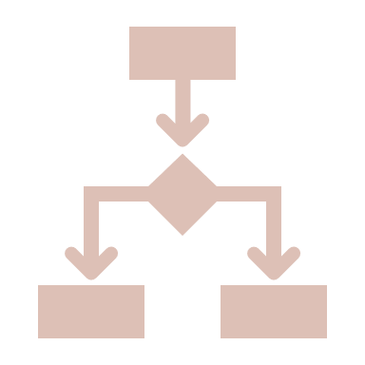


Patient story: Mr. D
78yo M
on androgen deprivation therapy
PCP approves MyChart outreach
Patient undergoes DEXA:
Osteoporosis diagnosed
Enters into treatment registry
Treated with denosumab
Notes:
•78 yo man with metastatic prostate cancer controlled on androgen deprivation therapy
•No Health Maintenance Reminder for DEXA scan as he is male
•Identified by our chart review as being at risk
•QI team reached out to patient via MyChart
•Patient completed DEXA, which showed osteoporosis of hip
-Entered into treatment registry, but PCP went ahead and started him on denosumab (after he declined bisphosphonates, worried about risks)

Slide 12
Addressing treatment gaps
Created osteoporosis treatment registry leveraging lessons learned from screening
Spreadsheets → Epic Reports
Learned new lessons
Osteoporosis often missing from Problem List
IV and SC drugs not automatically captured
“Bisphosphonate holidays” difficult to assess
Still analog, still time intensive!
389 pts
141 pts
389 patients in registry
141 pts with “gaps”
Notes:
So, moving on to osteoporosis treatment gaps, we started out with the same approach
We created an osteoporosis treatment registry, while also leveraging some lessons we learned from screening – for instance, we worked with lists in epic rather than spreadsheets outside of epic
We also learned new lessons:
Certain osteoporosis drugs (e.g. IV and SQ administered in clinic) are not being captured automatically
“Bisphosphonate holidays” are difficult to assess
Still analog, still time consuming!
(389 pts in registry → 141 pts with “gaps”)

Slide 13

Addressing treatment gaps
94
Goal
Pts become inappropriate for treatment
47
26
8
Patient declined
4
Treatment ordered (not yet given)
17
Patients treated
Notes:
--So here is what happened over the spring as we began addressing these treatment gaps. To orient you, the y axis is # of patients who we felt needed treatment, and we were working with 94 of these, and the x axis is time.
--Each stripe of color represents a disposition of one of these patients
--Starting in February, we engaged our stakeholders – namely our geriatric PCPs

Slide 14
Stakeholder Engagement & Education
Presentation to division meeting
Osteoporosis lecture for fellows
Surveyed PCPs on barriers to osteoporosis treatment
Notes:
First, I presented to division meeting about our plans for this project and got their feedback
We also talked about perceived barriers to osteoporosis treatment, and later we surveyed PCPs on this – their responses are in the histogram
I will just highlight the top two responses, which were expected: (1) Pt distrust of meds, particularly bisphosphonates due to media reports and word of mouth (2) having too many other issues besides osteoporosis that need to be addressed each clinic visit

Slide 15
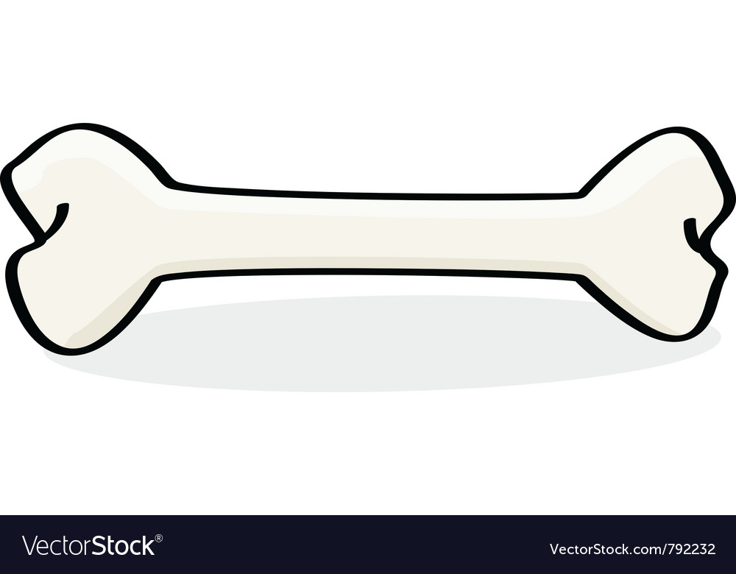
Addressing treatment gaps
94
Goal
CLINIC
Pts become inappropriate for treatment
47
26
8
Patient declined
4
Treatment ordered (not yet given)
17
Patients treated
Notes:
So, I thought it would be really smart to address both of these barriers by creating a special time and place to address OP with patients
It took awhile to get everything in place, but we started a ½ day per month “Bone Clinic”

Slide 16
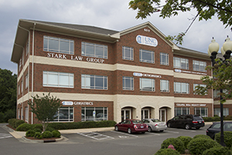

“Bone Clinic”
CLINIC
The Good
Some buy-in (7 referrals)
Lots of time to address patient concerns
Well received by those who attended
The Bad
Low attendance (3 pts)
Extra time/visit/cost
Doesn’t leverage PCP’s relationship with pt
The Hopeful
Created visit template
Could serve as referral center for future projects
Notes:
The idea was that I would accept internal referrals from geri PCPs for patients to meet with me for 30 minutes to answer all their questions about osteoporosis. And what happened? Well,
The good was that we had some buy-in with 7 referrals. Those who attended gave very positive verbal feedback.
The bad was: Low attendance. Only 3 patients attended. There was an extra visit and cost for those who did. And these visits didn’t really leverage the relationship that the PCPs already have with pt – and our PCPs are pretty comfortable addressing OP
We hope that this clinic may have a future role in accepting referrals from other sources
Ultimately, this PDSA pushed us in the direction of focusing more on “inreach” to PCPs – which is what PDSAs are designed to do

Slide 17
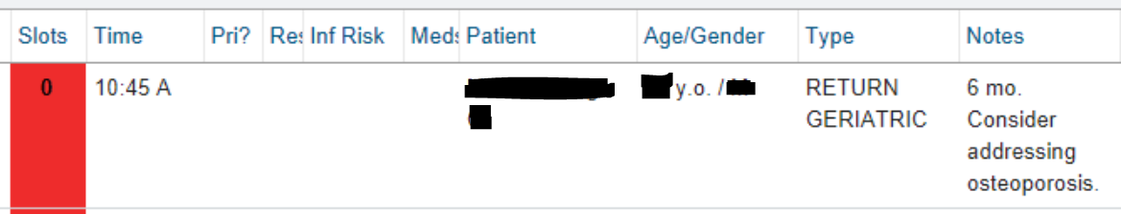
Addressing treatment gaps
94
Goal
CLINIC
Pts become inappropriate for treatment
47
26
8
Patient declined
4
Treatment ordered (not yet given)
17
Patients treated
Notes:
So, the next component of our project was inreach. We actually started this earlier in time, but there was a delay before we started seeing results

Slide 18

“Inreach” to PCPs
Reminders set on PCPs’ clinic schedule
Staff messages to PCPs if pt not on schedule
“I like that it is in the visit note because it is really hard for me to overlook there!” - PCP
Notes:
We conducted two basic types of inreach – setting reminders on PCP’s schedules on the days the patients with treatment gaps were coming into clinic, and when they weren’t on the schedule, we sent staff messages
As you might expect, the appointment reminders were much better received than staff messages. One PCP commented…

Slide 19
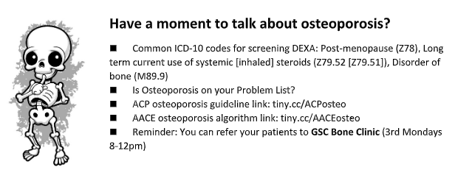
Addressing treatment gaps
94
Goal
CLINIC
Pts become inappropriate for treatment
47
26
8
Patient declined
4
Treatment ordered (not yet given)
17
Patients treated
Notes:
One other PDSA we tried is setting visual reminders around our workstation computers…

Slide 20
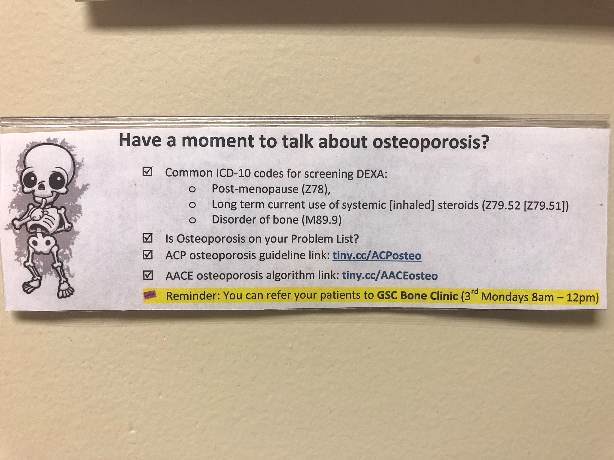
Computer workstation visuals
Notes:
…they looked like this and contain FAQs about osteoporosis
--We had learned earlier that knowing the right codes for screening for OP was a problem, so put them on there

Slide 21

Addressing treatment gaps
94
Goal
CLINIC
Pts become inappropriate for treatment
47
26
8
Patient declined
4
Treatment ordered (not yet given)
17
Patients treated
Notes:
You may wonder why there’s a long flat bar at this point in the run chart and frankly, that’s because our team of three wonderful fellows graduated!
This project has so far relied on a lot of work by trainees, and as we know that’s not fully sustainable
At the end of our project year, however, what we saw is that:
-- we were able to newly start treatment on 17 patinets
-- another 5 have had tx ordered
-- another 8 had documented risk/benefit discussions and declined tx (which we still consider a win – addressing a gap does not mean mandating tx)
-- 26 patients had something happen that made them ineligible. Mostly this was PCPs reviewing their cases and documenting that tx is not appropriate based on PCP’s judgment – which we defer to

Slide 22
Osteoporosis Treatment Results
GSC osteoporosis treatment rate
49% → 53%
National average: 20-25%1
Osteoporosis addressed with patient & documented
66% → 80%
8 different PCPs ordered new treatments (not just one “good egg”)
1 Liu et al JAGS 2013
Notes:
Overall, with this intervention we were able to move our osteoporosis treatment rate from 49% to 53%
When we look at the national average for OP tx, our clinic was actually doing much better than avg to begin with, so we weren’t working with “low hanging fruit”
In addition, OP was addressed with pt and documented 80% of the time, up from 66%, and it wasn’t just 1 great PCP doing all this work – 8 different PCPs ordered new txs
As you may recall, the # of patients needed to treat to prevent one fracture is small – just 19, so we think that even small gains in OP tx are important

Slide 23
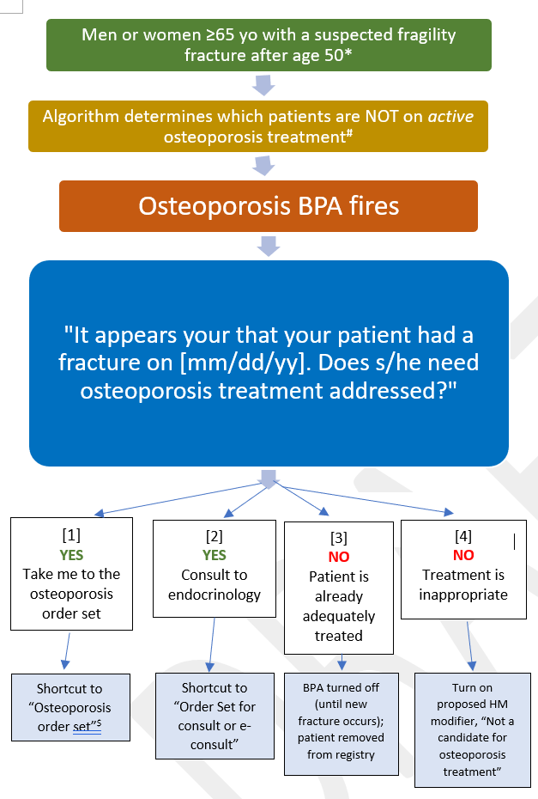
Next Steps
Going from “analog” to digital:
EPIC report and decision aid for osteoporosis treatment
Focuses on highest risk patients
Aligns with existing EPIC tools
Supports team-based care model
Spreadable to other clinics
Proposal presented to PCIC and PN Pop Health groups
Notes:
So where do we go from here?
We worked with analog processes that were time consuming, and we want to go digital
We have recently made proposals to PCIC and PN Pop Health for an improved osteoporosis EPIC Exclusion Report, and associated decision aid, that would focus on the highest risk patients –namely those with prior fractures.
Would align with existing health maintenance tools in EPIC
And support a team-based model of care, which is important since in FP we are transitioning to a model with higher staff to provider ratio
This tool could also be spread to other clinics

Slide 24

Takeaways
“Inreach” > outreach efforts for our clinic
Patient appointment reminders & meeting with stakeholders particularly effective
Pop Health interventions
Standard workflow
Individualization
Patient-centeredness
Notes:
This was an early QI intervention in our clinic

Slide 25
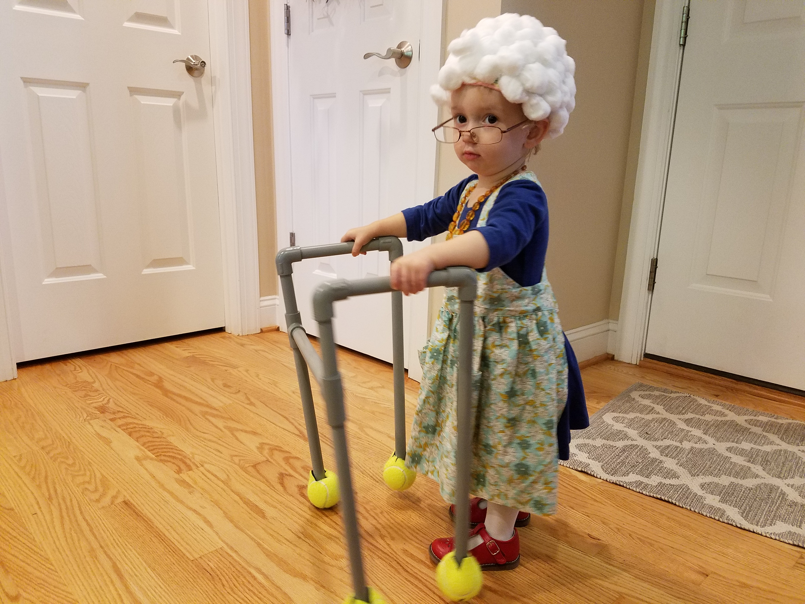
Questions?

