Slide 1

Global Women’s Health
– an Ob-Gyn’s experience –
Ben Chi, MD, MSc
UNC Global Women’s Health

Slide 2


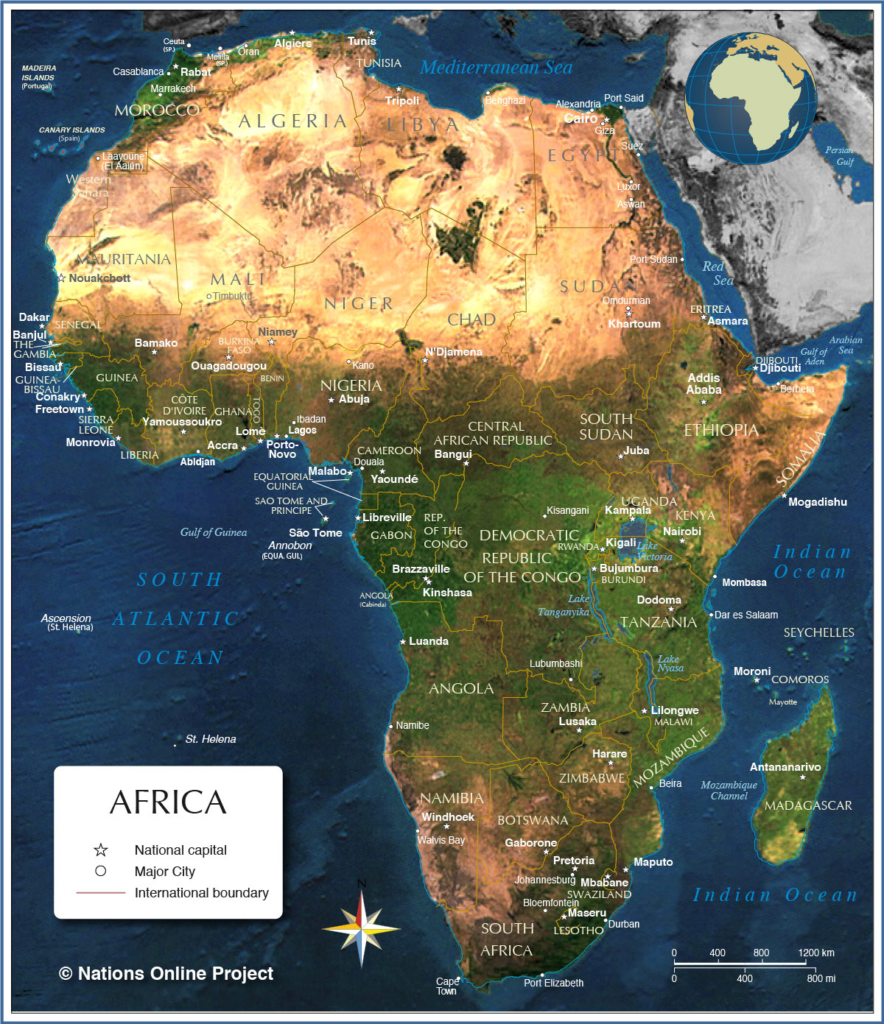







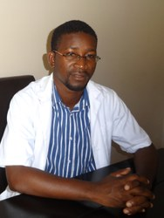

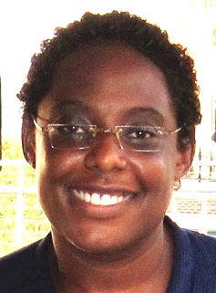
Division of Global Women’s Health
Zambia
Margaret Kasaro
Assistant Professor & Country Director
Jeffrey Stringer
Professor & Division Director
Groesbeck Parham
Professor
Bellington Vwalika
Professor
Benjamin Chi
Professor & Fellowship Director
Joni Price
Assistant Professor
Jennifer Tang
Associate Professor
Malawi
Elizabeth Stringer
Associate Professor (MFM)
Lameck Chinula
Assistant Professor
Alan Rosenbaum
Fellow
South Africa
Carla Chibwesha
Associate Professor

Slide 3
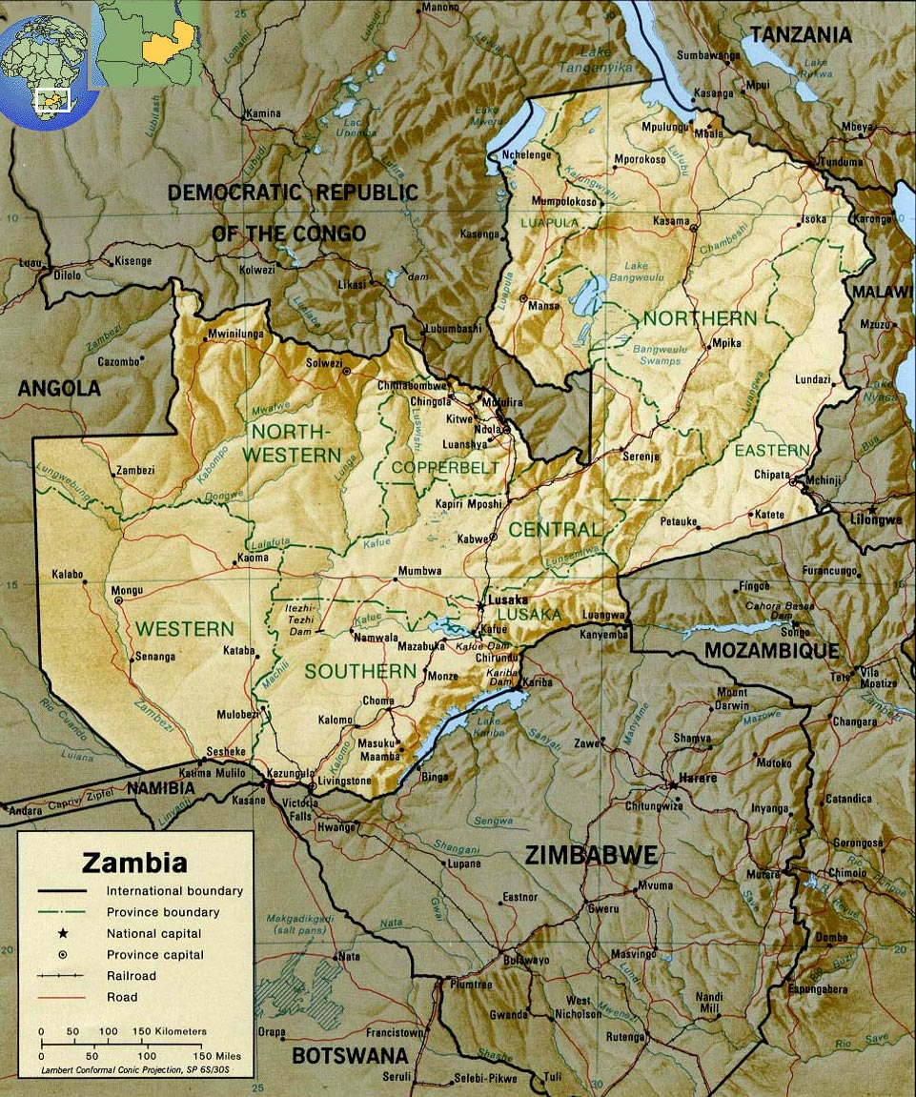
Zambia
Approximate size of Texas
14 million total; 2 million in Lusaka
Landlocked with 7 neighboring countries
Former British colony gained independence in 1964

Slide 4
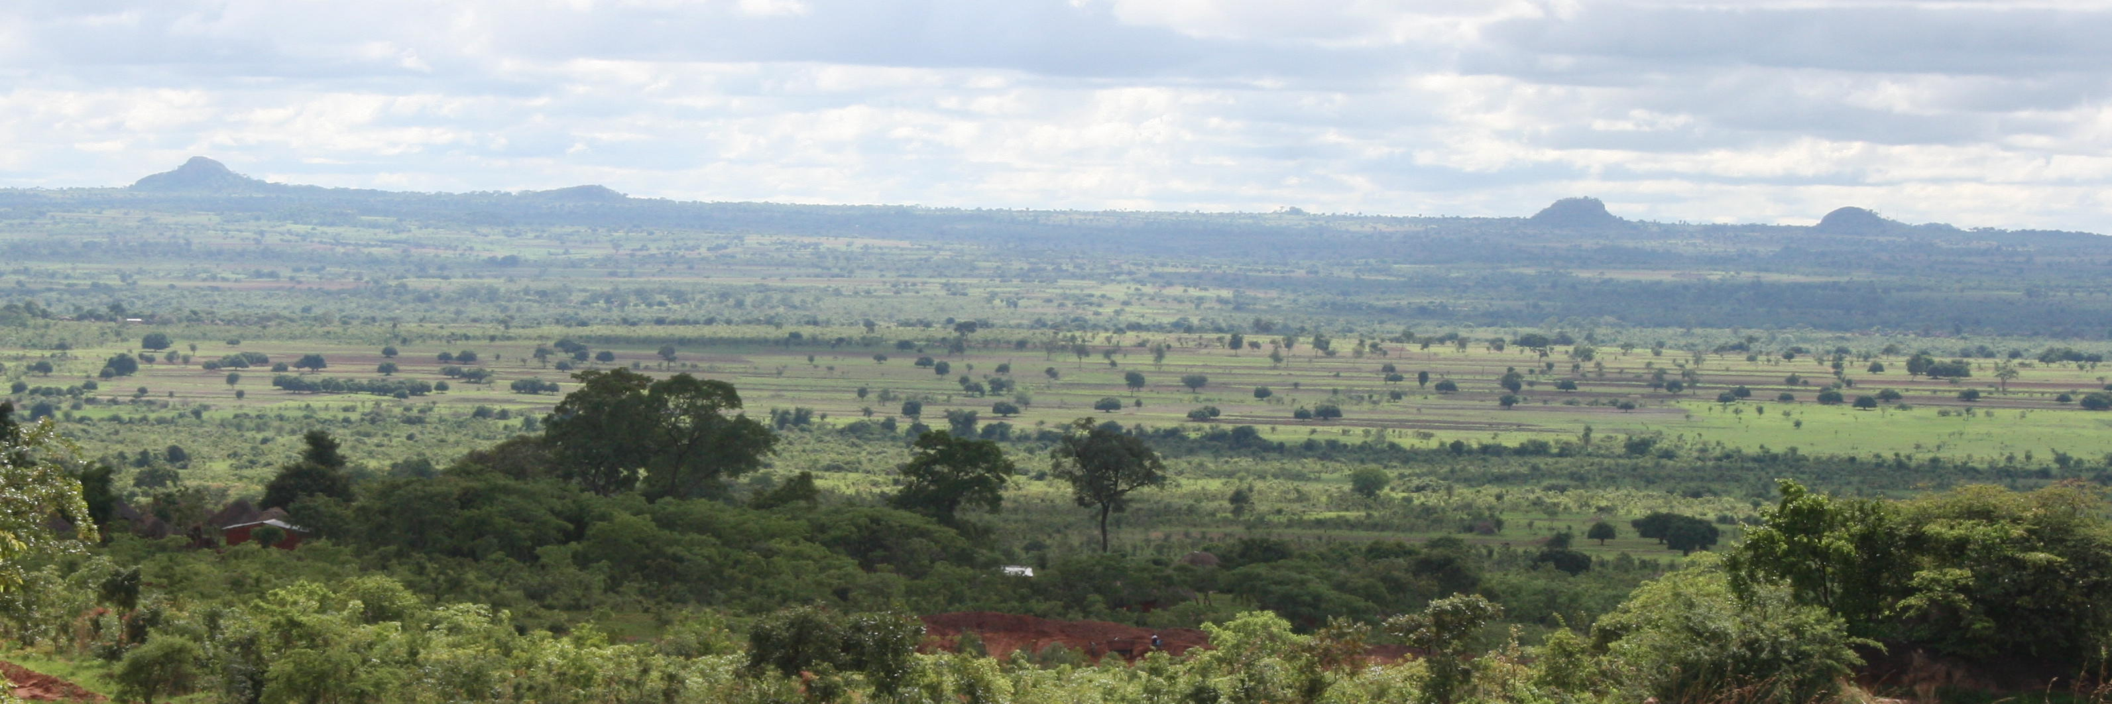
Economy
Mining (copper) and agriculture
GDP per capita = $1,800 (US = $52,800)
2/3 of Zambians live on < $2 per day
Most do not have running water or electricity

Slide 5


Slide 6
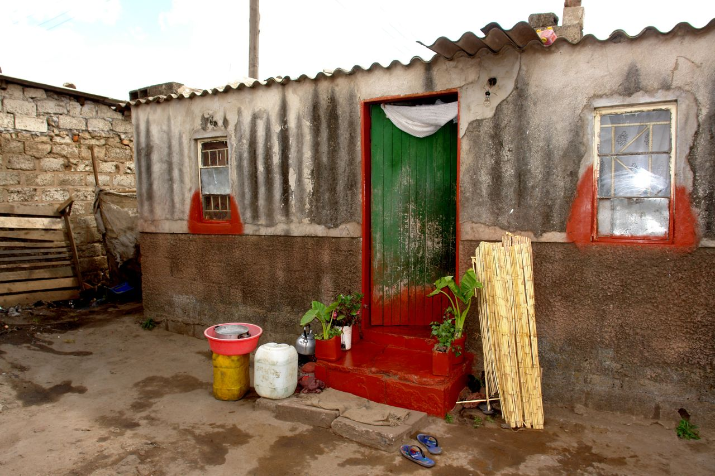

Slide 7
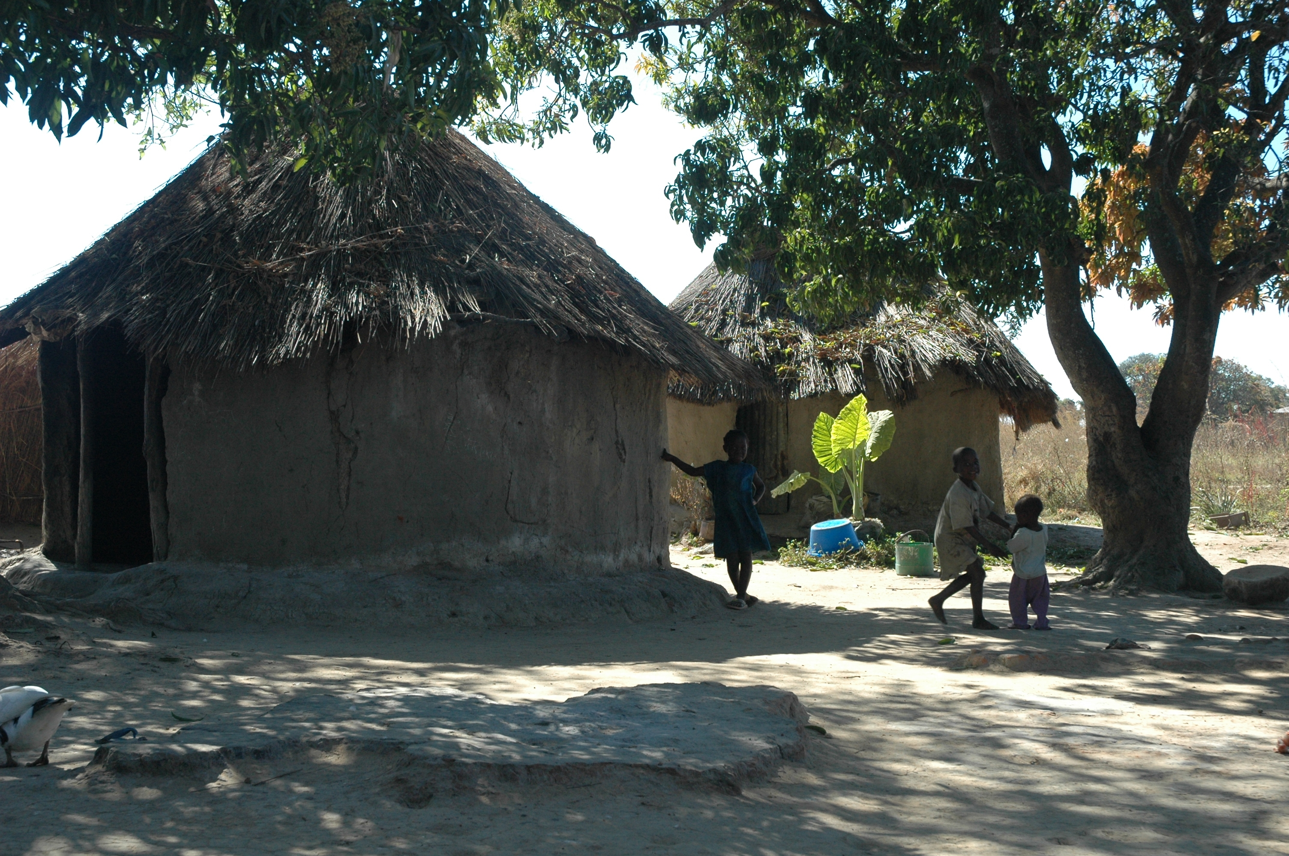

Slide 8
Health indicators: Zambia vs. US
 | Zambia | US
Total population | 14 mil | 318 mil
Adult life expectancy at birth, yrs | 57 | 79
Maternal mortality per 100,000 live births | 315.1 | 18.5
Maternal mortality, lifetime risk | 1 in 37 | 1 in 2400
HIV prevalence, 15-49 year olds | 12.7% | 0.6%
Estimated number women living with HIV | 490,000 | 310,000
Cervical cancer incidence per 100,000 women per year | 33.7 | 8.1
Physicians per 1,000 population | 0.06 | 2.67

Slide 9
Why is there such disparity?

Slide 10
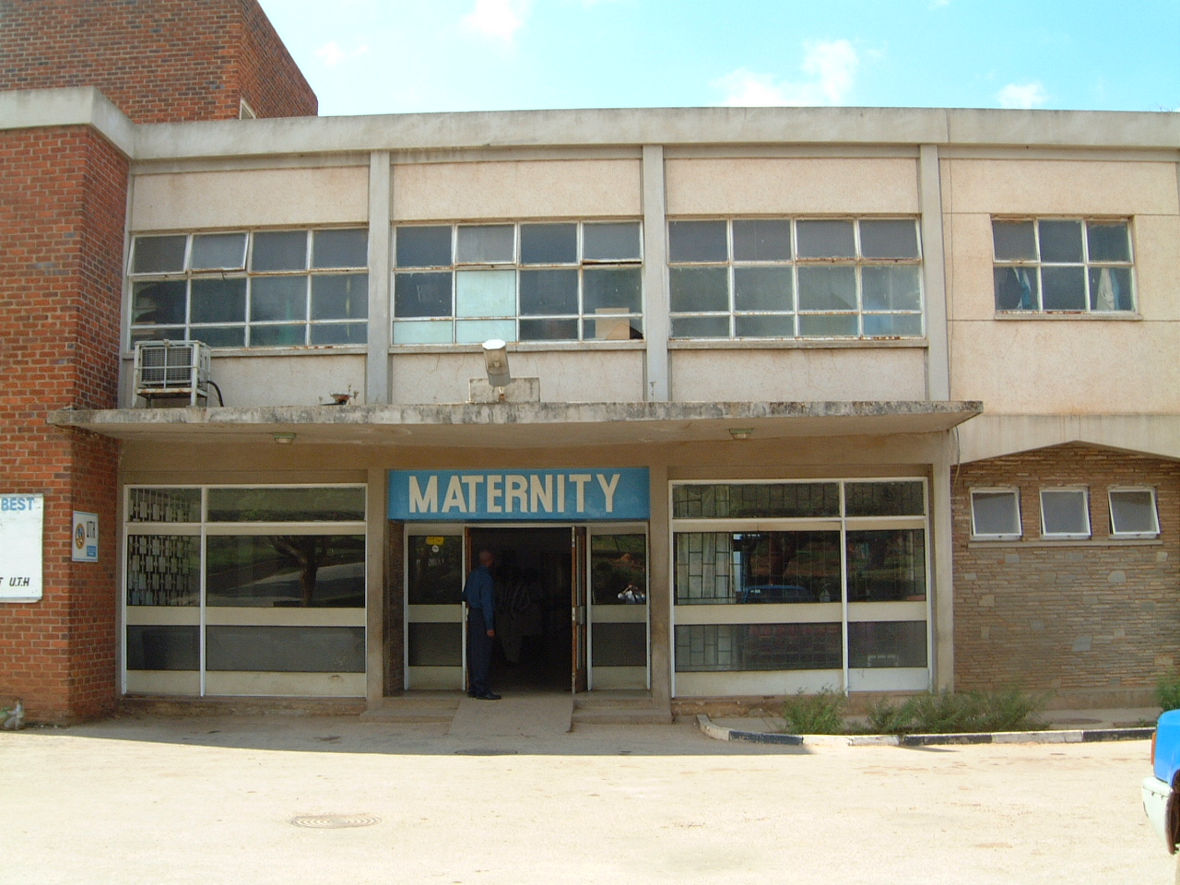
Notes:
UTH – 20,000+ deliveries per year

Slide 11
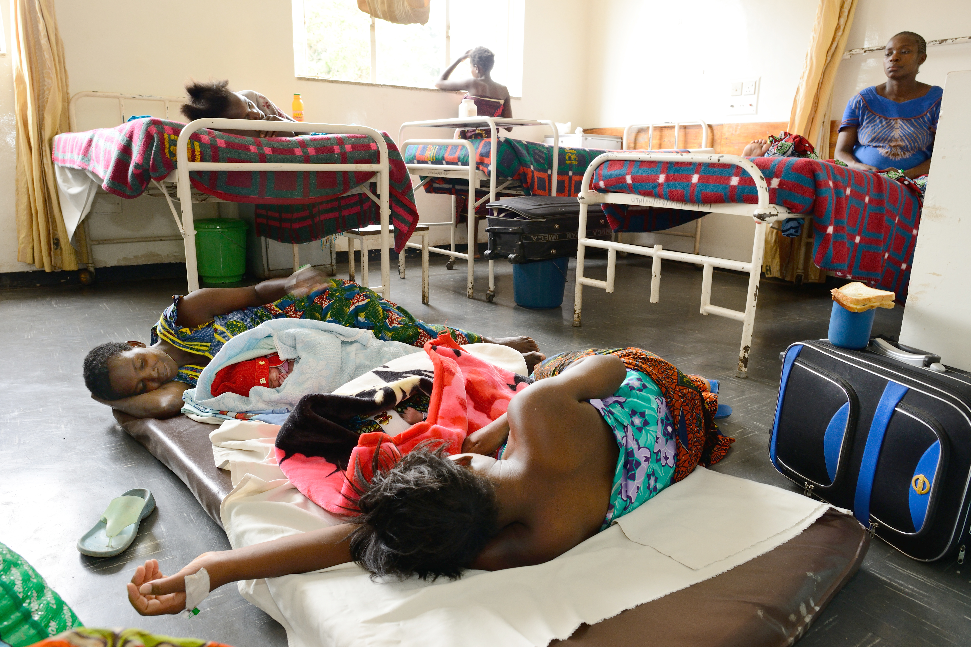

Slide 12
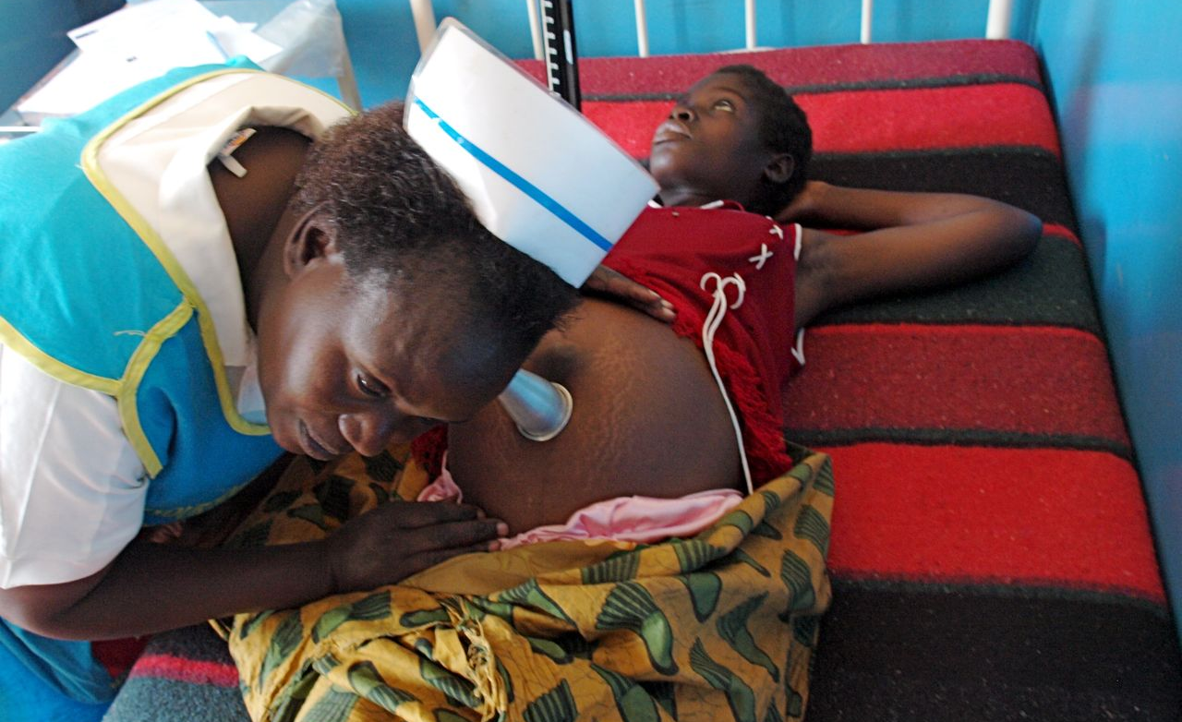
Notes:
Pinard horn – often made of wood or metal
19th century technology

Slide 13


Slide 14
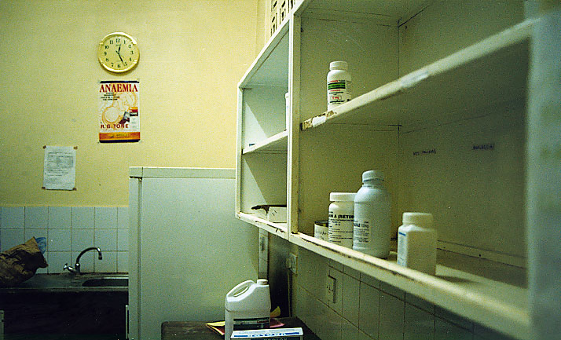

Slide 15

Individual patient records can be difficult to locate

Slide 16
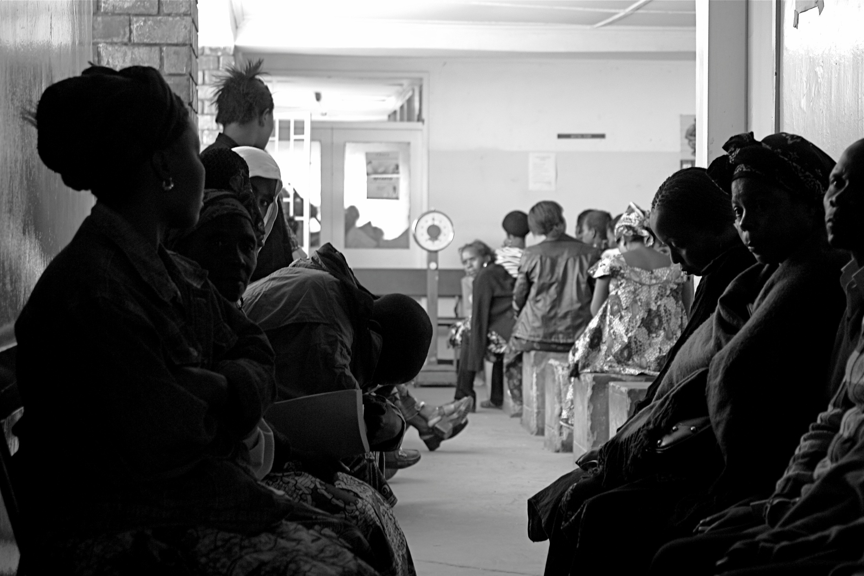

Slide 17
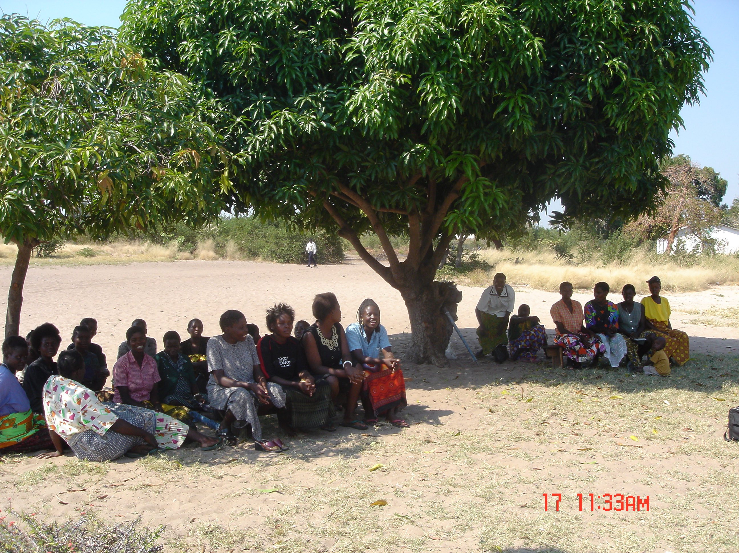

Slide 18


Slide 19



Public health programs (2004–2012)
Capacity building (2003–)
379,000 adults and children in HIV care
256,000 started on ART
230,000 tested for HIV in door-to-door initiatives
1,300,000 women received PMTCT services
134,000 HIV-infected patients screened for TB
90,000 women screened for cervical cancer
Supported Masters and PhD training for 41 Zambian investigators
30+ trained through year-long research attachments
7 trained in cervical cancer research, including US-based coursework and research funding
Primary partner to the University of Zambia to enhance maternal-child health services (~$2.5 million; NIH/PEPFAR)
New NIH award to support PhD training and postdoctoral fellows (10 overall)
Research (2003–)
100+ clinical, epidemiological, and implementation studies since 2003
Current portfolio:
  HIV and pregnancy
  Contraception and reproductive health
  Women’s cancers, including breast and cervical CA
180+ publications, all with Zambian co-authors
~$9 million annually in research and research training

Slide 20
Prevention of mother-to-child
transmission of HIV
(PMTCT)

Slide 21
Mother-to-child transmission in the absence of intervention
Pregnancy
Early breastfeeding
Delivery
Later breastfeeding
5%
20%
5%
10%
60% uninfected
Notes:
5 – 10….7.5
10 – 20 … 15
15 – 30…22.5
1 – 5 … 2.5

Slide 22
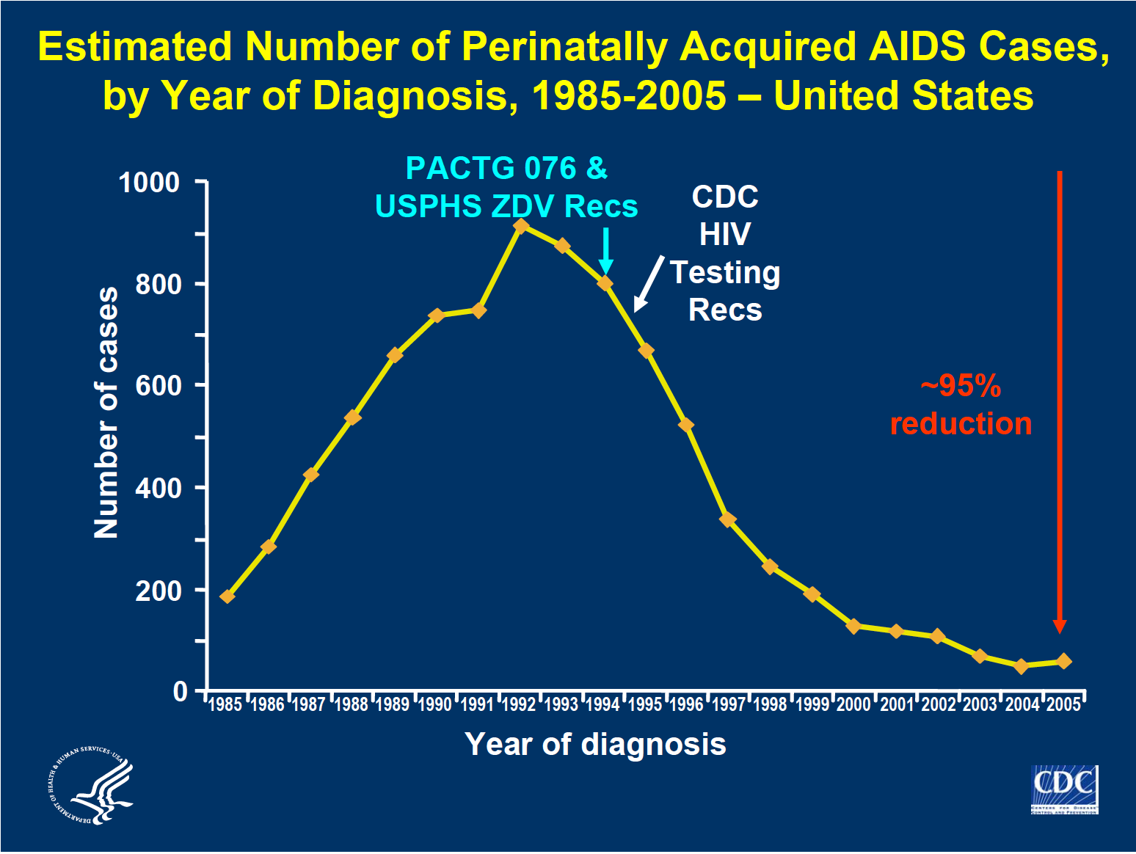

Slide 24
Evolution of regimens for the prevention of mother-to-child HIV transmission over time
14 wks
28 wks
Delivery
End of
breastfeeding
Infant infection
Mother
sdNVP
2001
16%
Baby
sdNVP
2004
Mother
ZDV
sdNVP
10%
Baby
sdNVP
sdNVP
2010
Mother
ART
2-3%
Baby
6 weeks NVP
2013
Mother
ART
2-3%
Baby
6 weeks NVP

Slide 25
Why is pediatric AIDS so difficult to eliminate in settings like Zambia?
Safe alternatives to breastfeeding too costly or altogether unavailable
Routine cesarean delivery is not a viable intervention
High rates of antenatal care and delivery outside of health facilities
Delivery of optimal antiretroviral regimens can be challenging
  Strained health care systems, including human resource shortages
  Availability of drugs
  Linkages between departments and facilities

Slide 26
Identifying program gaps

Slide 27
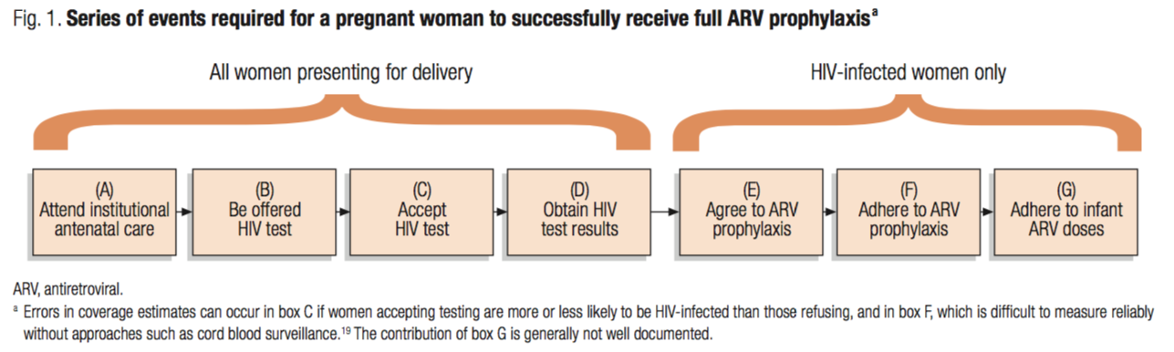
Early PMTCT cascade for simple HIV prophylaxis regimens
Stringer, et al. Bulletin of WHO, 2008

Slide 28
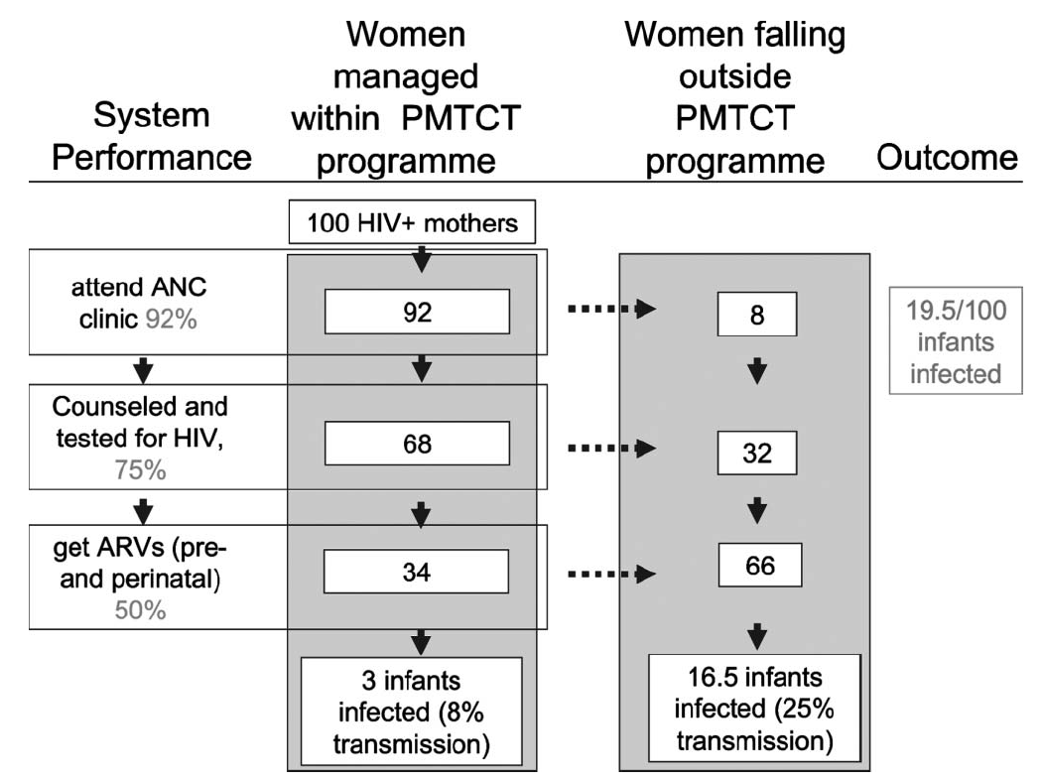
Health system inefficiencies negatively affect population-level outcomes
(8% transmission)
(25% transmission)
Barker, et al; JAIDS 2011

Slide 29
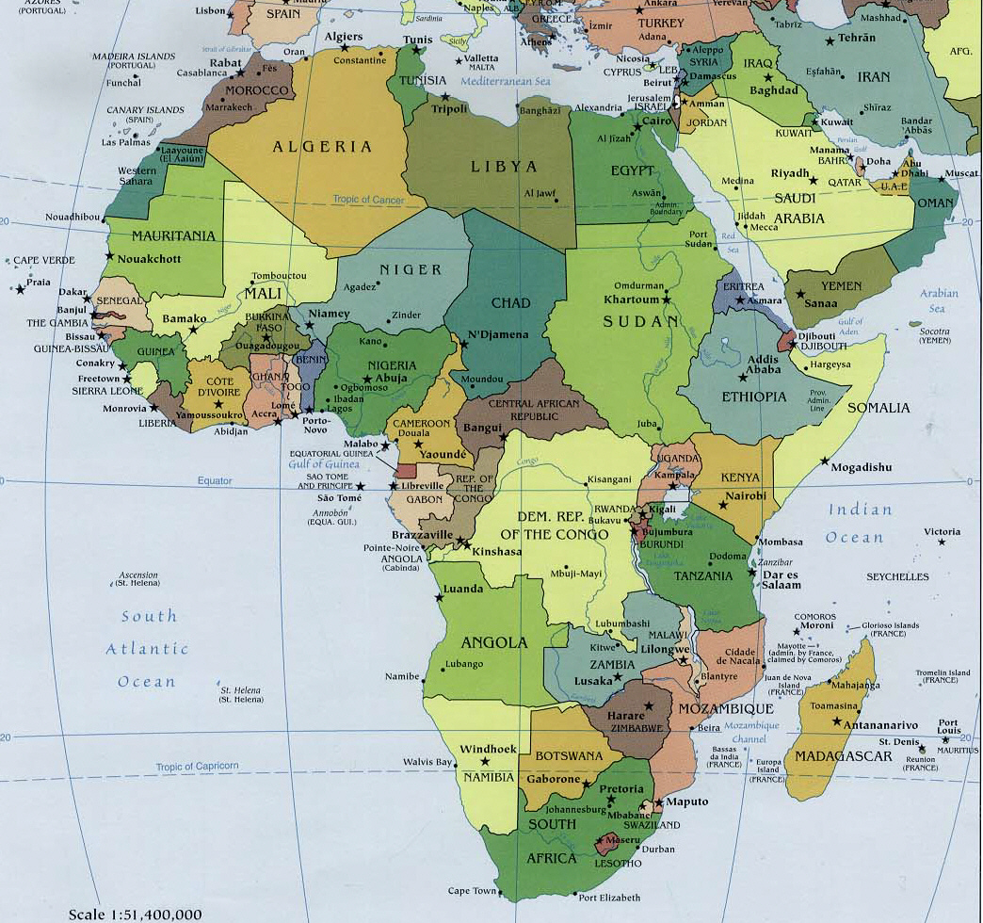
PEARL Study: Developing evaluation metrics for PMTCT
43 randomly selected sites in 4 countries
Anonymous cord blood surveillance
  Tested specimens for HIV antibodies and nevirapine
  Results linked by medical record review
Outcome:
  Maternal NVP dosing (drug in cord blood)
  Infant NVP dosing (by medical record)

Slide 30
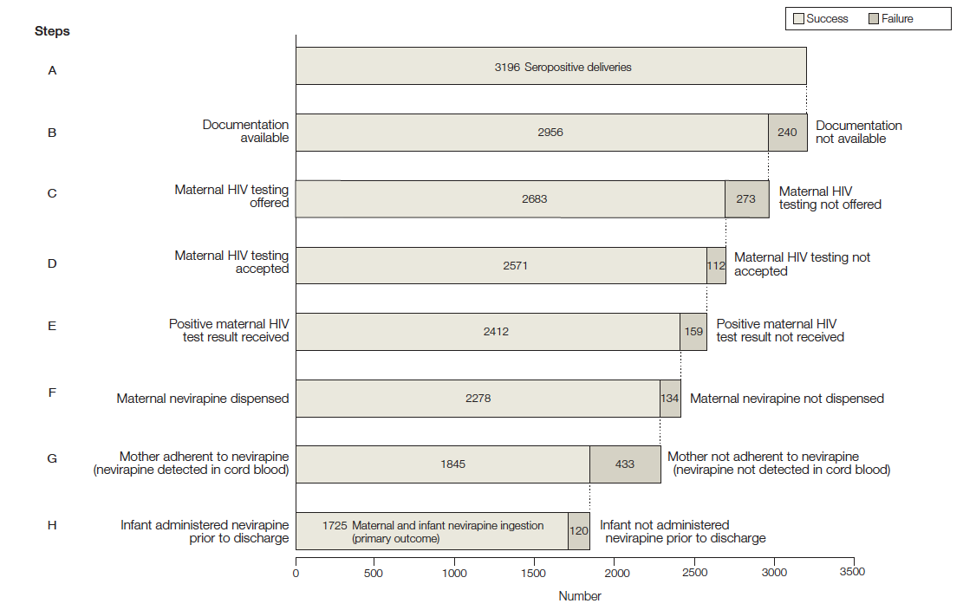
49% coverage
Stringer, et al., JAMA, 2010

Slide 32
Behavioral interventions
SMS reminders
Ongoing counseling
Differentiated care
Pharmacy interventions (e.g., vending machines, quarterly pick-ups)
Increased partner HIV testing
Community-based HIV testing
Distribution of HIV self-test kits
The PMTCT cascade provides a roadmap for interventions
Counseling
Readiness assessment
Integrated ANC and HIV services
Peer navigation
Peer navigation
Family-based treatment
Point-of-care assays
Notes:
HIV cascade – the steps needed to derive maximum benefit
This schematic has been recrafted for Option B+ (lifelong ART)

Slide 33
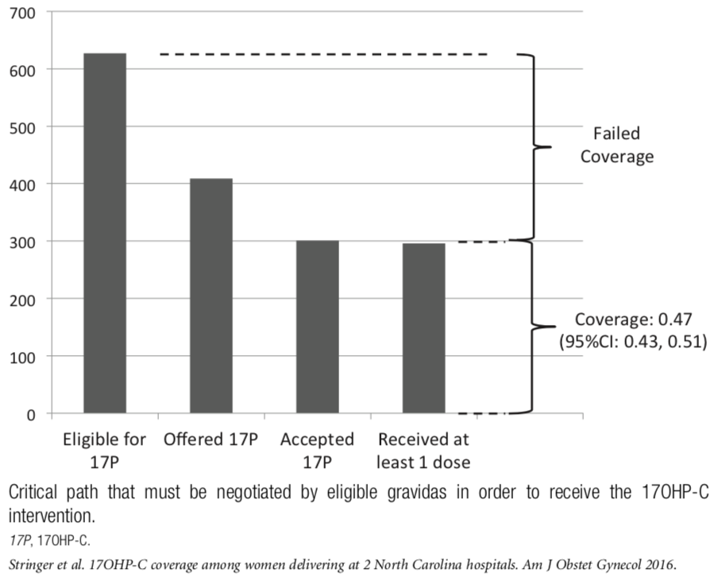
Uptake of 17-OHP among eligible women in two North Carolina hospitals (2012-2013)
Stringer, et al., Am J Obstet Gynecol, 2016
Notes:
Steps from determining eligibility for 17-OHP, to its being offered, accepted and used at least once
Intervene at patient-level, provider level, health systems level

Slide 34
Measuring program effectiveness

Slide 35
Evolution of regimens for the prevention of mother-to-child HIV transmission over time
14 wks
28 wks
Delivery
End of
breastfeeding
Infant infection
Mother
sdNVP
2001
16%
Baby
sdNVP
2004
Mother
ZDV
sdNVP
10%
Kafue PMTCT Project
Baby
sdNVP
sdNVP
2010
Mother
ART
2-3%
Baby
6 weeks NVP
2013
Mother
ART
2-3%
Baby
6 weeks NVP

Slide 36
The Kafue PMTCT Project (KPMTCT)
Pilot program of universal antiretroviral therapy during pregnancy and breastfeeding
Designed to assess feasibility, safety, and population impact
Conducted when effectiveness and safety of ART during breastfeeding not yet known
  Pre-dated WHO recommendations for Option B (2010) or B+ (2013)
Implemented at 4 clinics in rural / peri-urban Zambia
Rigorous evaluation
  Individual-level: cohort study
  Population-level: community survey

Slide 37
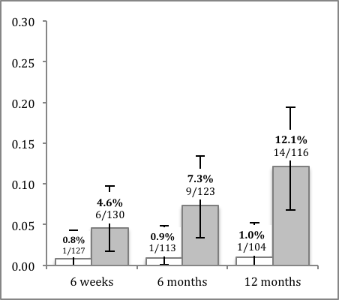
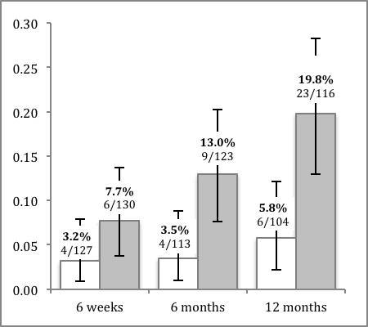
KPMTCT cohort study
RR: 12.6
(95%CI: 2.2–73.1)
at 12 months
Infant HIV infection
8-site cohort study
  4 control sites, 4 intervention sites
Enrolled at > 28 weeks
Followed every 2-4 weeks until delivery
Infant HIV DNA PCR at birth, 6 weeks, 6 months, and 12 months
Few study procedures; designed to emulate “real world” conditions
Sample size: 320 (160 in each arm)
  Study stopped early due to time constraints
RR: 3.4
(95%CI: 1.6–7.6)
at 12 months
Infant HIV infection or death
Gartland, AIDS, 2013

Slide 38
KPMTCT community survey
Two-round household survey
  First round prior to program implementation (2008-2009)
  Second round 2-years following implementation (2011)
Zones and households selected randomly using sampling frame
Household eligibility
  Reported a child born in the past 2 years
  Willing to provide informed consent
Mother and infant specimens tested for HIV
Only HIV-infected mothers and HIV-exposed infants included in the analysis
Adjusted HR: 0.40
95%CI: 0.26–0.62
Chi, Bulletin of WHO, 2014

Slide 39
New opportunities, new directions

Slide 41
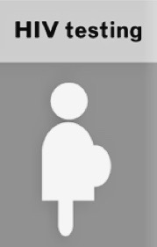
HIV
negative
Outside the cascade:
The traditional PMTCT cascade does not consider the large proportion of pregnant women who test HIV-negative.

Slide 42
In sub-Saharan Africa, rates of HIV incidence is high among pregnant and breastfeeding women.
Meta-analysis of 19 cohorts
(22,908 person-years)
Cumulative HIV incidence:
3.8 per 100 person-years
(95%CI: 3.3–6.1)
Comparable to cohort studies of FSW, discordant couples, and MSM
Drake, 2014

Slide 43
Implications of new maternal HIV infection
↑ risk of lifetime morbidity and mortality
↑ risk of transmission to HIV-uninfected partners
↑ risk of vertical transmission
  Exposure to high maternal viremia in utero
  Undiagnosed infection with no intervention
Drake, 2014
In the setting of ART, contribution of new maternal infections to mother-to-child transmission may be as high as 26-53%

Slide 44
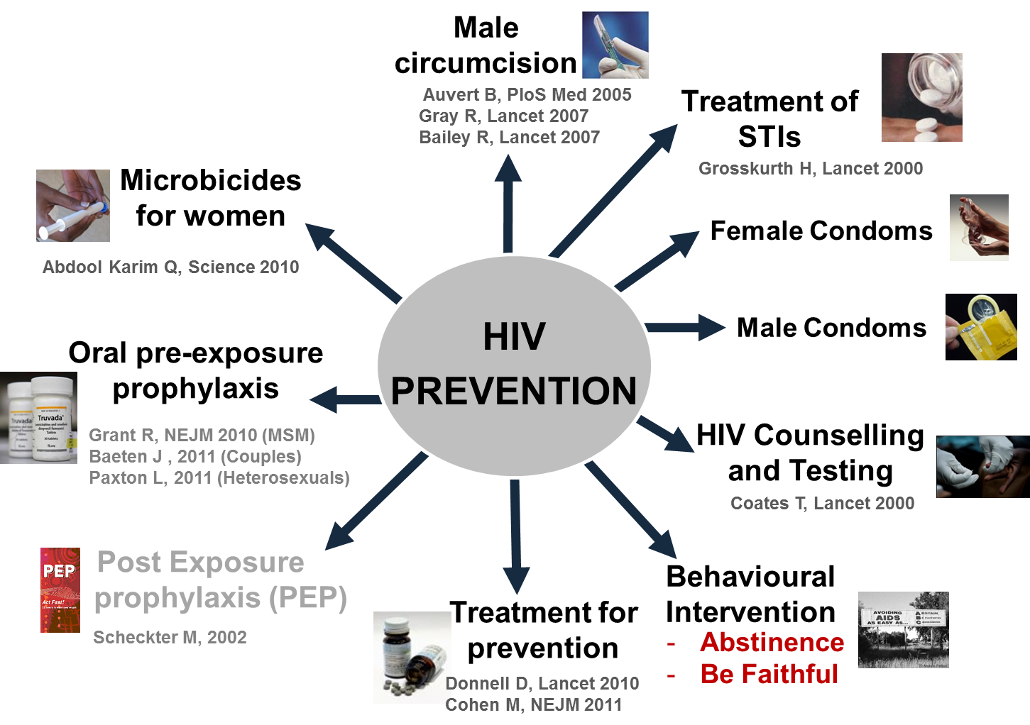
BNABs/Vaccines?
in the field
Courtesy of M. Cohen
Notes:
HIV prevention has seen a renaissance
Once there were only few approaches, now there are many
Some older (condoms, treatment of STIs, PEP)
Some newer – male circumcision, treatment for prevention, PrEP,
Many new modalities on the way – which we’ll talk about a little
Still, however, there is no magic bullet. The general approach is one of combination prevention – the idea that we tailor moderately to highly effective interventions in a way that brings down population transmission

Slide 45
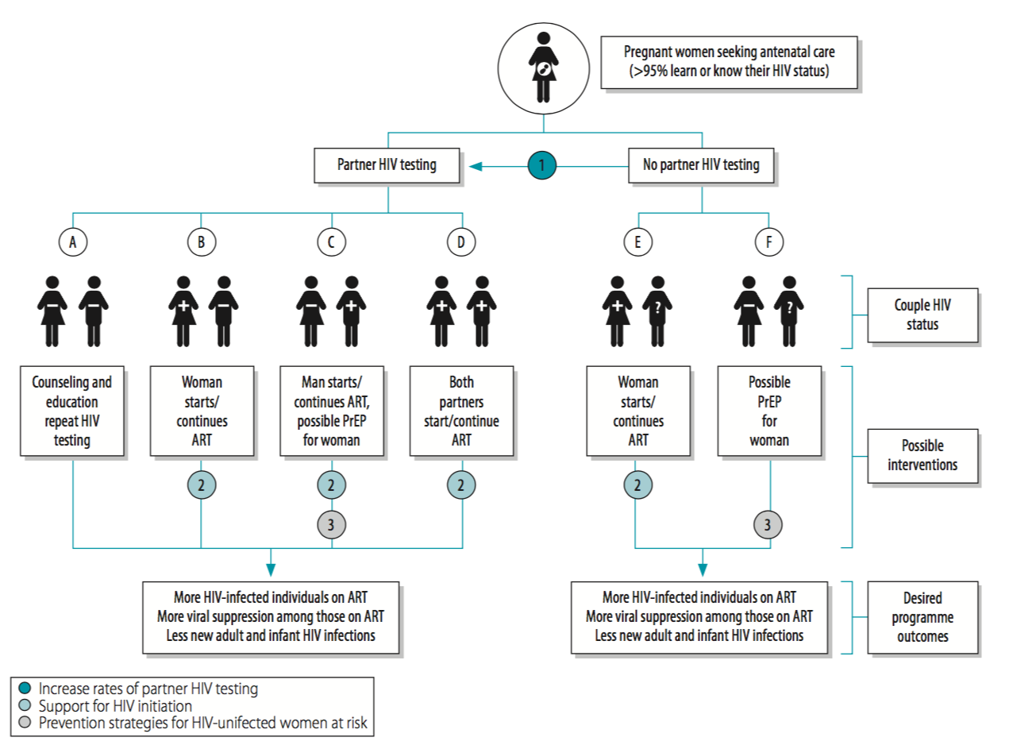
Chi, et al., Bulletin of WHO, 2018

Slide 46
Chi, et al., Bulletin of WHO, 2018

Slide 47
Chi, et al., Bulletin of WHO, 2018

Slide 48
Chi, et al., Bulletin of WHO, 2018

Slide 49
A dyad approach to combination HIV prevention during pregnancy in Zambia & Malawi
Funded by NIH/NIAID (R01 AI131060), started 12/2016
Part of the Methods for Prevention Packages Program (MP3)
Overarching goal: develop a combination HIV prevention package for vulnerable populations
Formative phase
  Qualitative studies, May 2018
  Mathematical modeling, July 2018
  Systematic reviews, July 2018
Design phase
  Consensus meetings with Zambian & Malawian MOHs, Sept 2018
Evaluation phase
  Formal evaluations of component strategies, Nov 2018–Dec 2020

Slide 50
Incorporating global health
into an academic career

Slide 51
1998-2002
2003
2004
2005
2006
2007
2008
2009
2010
2011
2012
2013
2014
2015
2016
2017
2018
U.S.
Zambia
U.S.
Formative
Postdoctoral training
Early career
(Assistant Professor)
Mid-career
(Associate Professor & Professor)

Slide 52
Considerations for global health
Mentorship, environment, and institutional support
Research vs. public health vs. clinical medicine
Duration abroad
Depth vs. breadth of work
Engagement with local partners
Unstructured vs. structured opportunities for career development

Slide 53
1998-2002
2003
2004
2005
2006
2007
2008
2009
2010
2011
2012
2013
2014
2015
2016
2017
2018
U.S.
Zambia
U.S.
Formative
Postdoctoral training
Early career
(Assistant Professor)
Mid-career
(Associate Professor & Professor)
Global Framework (D43)
MHIRT
Institutional funds
Self-funded
F31
T32
Fogarty Global Health Fellowship
Global Framework (D43)
MHIRT
F32
T32
Fogarty Global Health Fellowship
Individual career dev award (K01, K23)
Institutional career dev award (K12)
Private foundations (DDCF, HHMI)
Mentoring award (K24)
Private foundations

Slide 54
UNC Global Women’s Health Fellowship
Research-focused
Immersive experience – minimum of 24 months in the field
Key topical areas:
  Infectious diseases and pregnancy
  Contraception
  Women’s cancers
Experienced faculty mentors in-country and in the US
Exploring combined fellowships with other subspecialty fellowships at UNC (e.g., MFM, Gyn Onc, FP)

Slide 55










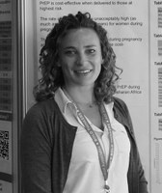
Carla Chibwesha, MD, MSc
2009-2012
Cervical cancer screening
Assistant Professor, UNC
Marcela Castillo, MD, MSCR
2014-2017
Preterm birth
Assistant Professor, UT-Austin
Leeya Pinder, MD, MPH
2016-2018
Breast cancer screening
Gyn Onc fellowship, UW (2018)
Yvonne Butler, MD
2011-2012
Safe motherhood
Senior Consultant, Mayo Clinic
Catherine Ford MD, MPH
2015-2017
Early infant diagnosis of HIV
Assistant Professor, UIC
Kartik Venkatesh, MD, PhD
2017-current
Predictive algorithms for PTB
Combined MFM-Global Health
fellowship
Nancy Hancock, MD, MPH
2013-2015
Family planning services
Clinical practice, NC
Nurain Fuseini, MD, MSCR
2015-2017
Immunology of pregnancy
Clinical practice, NJ
Alan Rosenbaum, MD
2018 -current
U/S for low-resource settings
Dawn Kopp, MD, MPH
2014-2016
Obstetric fistula
Clinical practice, WA
Joni Price, MD, MPH
2015-2017
Preterm birth & HIV
Assistant Professor, UNC
Notes:
-- 11 fellows over the past decade
-- broad range of topical interests – from pregnancy outcomes to cervical cancer to obstetric fistula
-- because we are research-focused, the majority have gone on to academic jobs, incorporating global health in some way

Slide 56
UJMT Fogarty Global health Fellows Program
Supports a 12-month attachment to an approved site
Research-focused program
  80% of activity during fellowship must be research-related
  Application requires project proposal
Strong emphasis on mentorship
  Requires commitment from US and international mentors
Two funding levels – doctoral and postdoctoral
Fellowship packages includes
  Stipend: based on NRSA payscales
  Research funding: $7,000 for doctoral students, $10,000 for postdocs
  Health insurance, evacuation insurance
  Travel

Slide 57
