Slide 1
Making a CAPP Referral
Using the CMEP Provider Portal

Slide 2
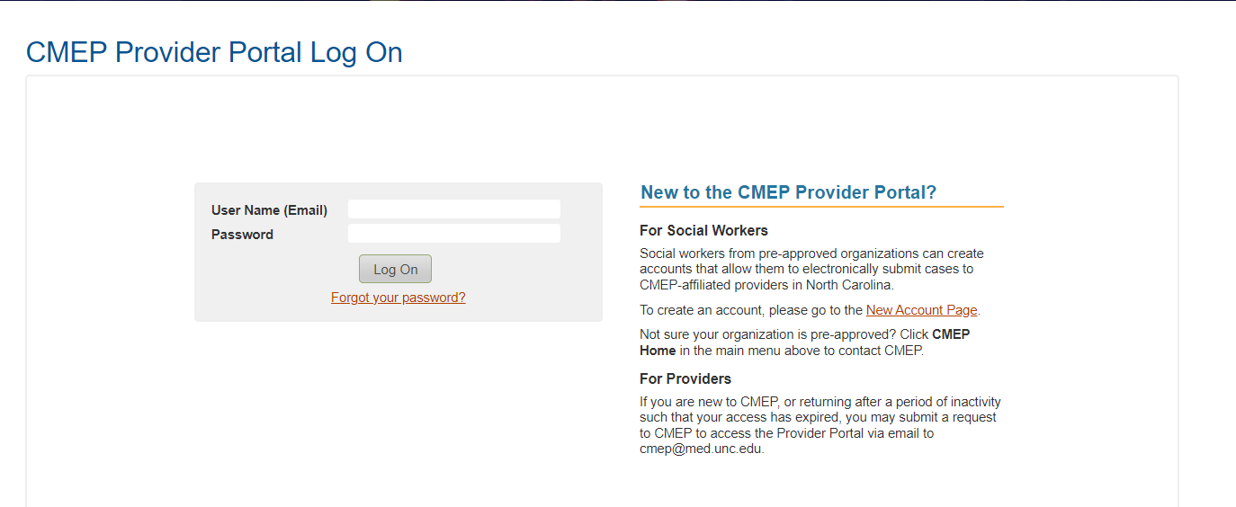
1. Access or create your CMEP Provider Portal Account
The CMEP Provider Portal can be used to locate both CAPP and Child Medical Evaluation (CME) providers. To search for rostered providers by county, visit https://cmepweb.dhhs.nc.gov/
To log into an existing CMEP Provider Portal Account, enter your email and password
To create a new account, click this link

Slide 3
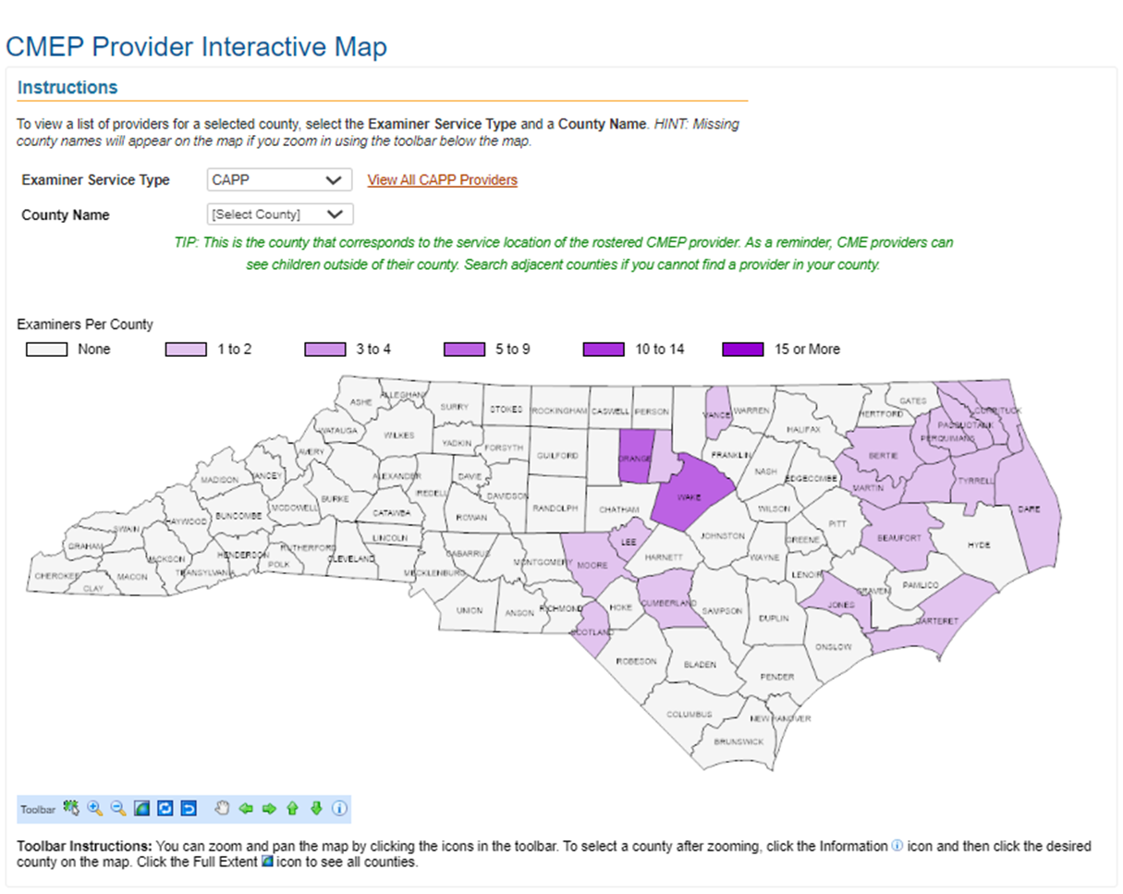
2. Identify a CAPP provider using the CMEP Provider Portal
Choose Examiner Service Type: CAPP
Select county to view all rostered providers in that county. This includes providers that are willing to travel to the selected county.

Slide 4
3. Contact the CAPP provider to ensure they can conduct the evaluation
CAPP Provider and practice contact information is maintained on the CMEP Provider Portal

Slide 5
4. Complete and submit the CAPP Authorization Request and Consent/Authorization Form for a CAPP (DSS-5401) through the CMEP Provider Portal
Click on the Submit Case link begin the authorization process. You will be prompted to enter demographic information and to upload a completed CAPP Authorization Request AND DSS-5401.

Slide 6
Following submission…
The CAPP requires CMEP’s authorization prior to the assessment. CMEP will review the request and provide authorization via email to the referring child welfare worker and CAPP Provider.
Once the authorization has been received, the child welfare worker and CAPP Provider can coordinate scheduling of the assessment.
The CAPP Provider will send the completed CMEP CAPP Report to the child welfare worker no later than two weeks post date of service.

Slide 7
Please contact cmep_capp@med.unc.edu with questions.

