Slide 1
Traditional Statistical Methods to Machine Learning: Methods for Learning from Data UNC Collaborative Core Center for Clinical Research Speaker Series August 14, 2020
Jamie E. Collins, PhD
Orthopaedic and Arthritis Center for Outcomes Research, Brigham and Women’s Hospital
Department of Orthopaedic Surgery, Harvard Medical School

Slide 2
Outline
Overview, Terminology
Machine Learning vs. Traditional Statistical Modeling
Examples: Statistical Modeling to Machine Learning

Slide 3
Overview
What is the difference between machine learning and statistical modeling?
“The short answer is: None. They are both concerned with the same question: how do we learn from data?” – Dr. Larry Wasserman, Professor of Statistics and Data Science in the Department of Statistics and Data Science and in the Machine Learning Department at Carnegie Melon
https://normaldeviate.wordpress.com/2012/06/12/statistics-versus-machine-learning-5-2/

Slide 4
Overview
Machine Learning
Is a method of data analysis that automates analytical model building.
The process of teaching a computer system how to make accurate predictions when fed data.
Gives computers the capability to learn without being explicitly programmed.

Slide 5
Overview
Machine Learning includes
Supervised Methods
Unsupervised Methods
Semi-Supervised Methods

Slide 6
Overview
Supervised Methods
Labeled outcomes or classes
Goal is usually prediction or classification
Focus may be on best prediction algorithm, or on which variables (features) are most closely associated with outcome
Examples from traditional statistical methods: linear regression, logistic regression
Examples from ML: random forest, support vector machines

Slide 7
Overview
Unsupervised Methods
No labels/annotations
Goal is to uncover hidden structure/patterns in the dataset
Examples from traditional statistical methods: principal component analysis, K-means clustering
Examples from machine learning: model-based cluster analysis, distance weighted discrimination

Slide 8
Overview
Semi-Supervised Methods
Combination of Supervised and Unsupervised approaches
Outcomes/classes are labeled for some part of the dataset
Analysis usually done in steps with supervised followed by unsupervised or vice versa

Slide 9
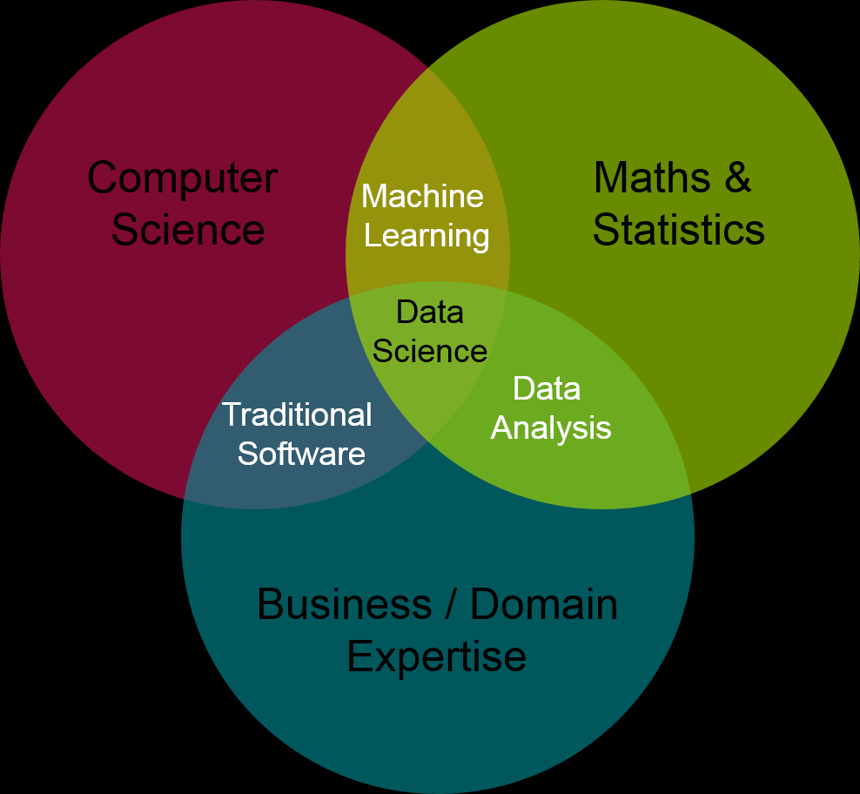
Machine Learning vs. Statistical Modeling
https://blog.intact-systems.com/data-science-the-future-is-now/

Slide 10
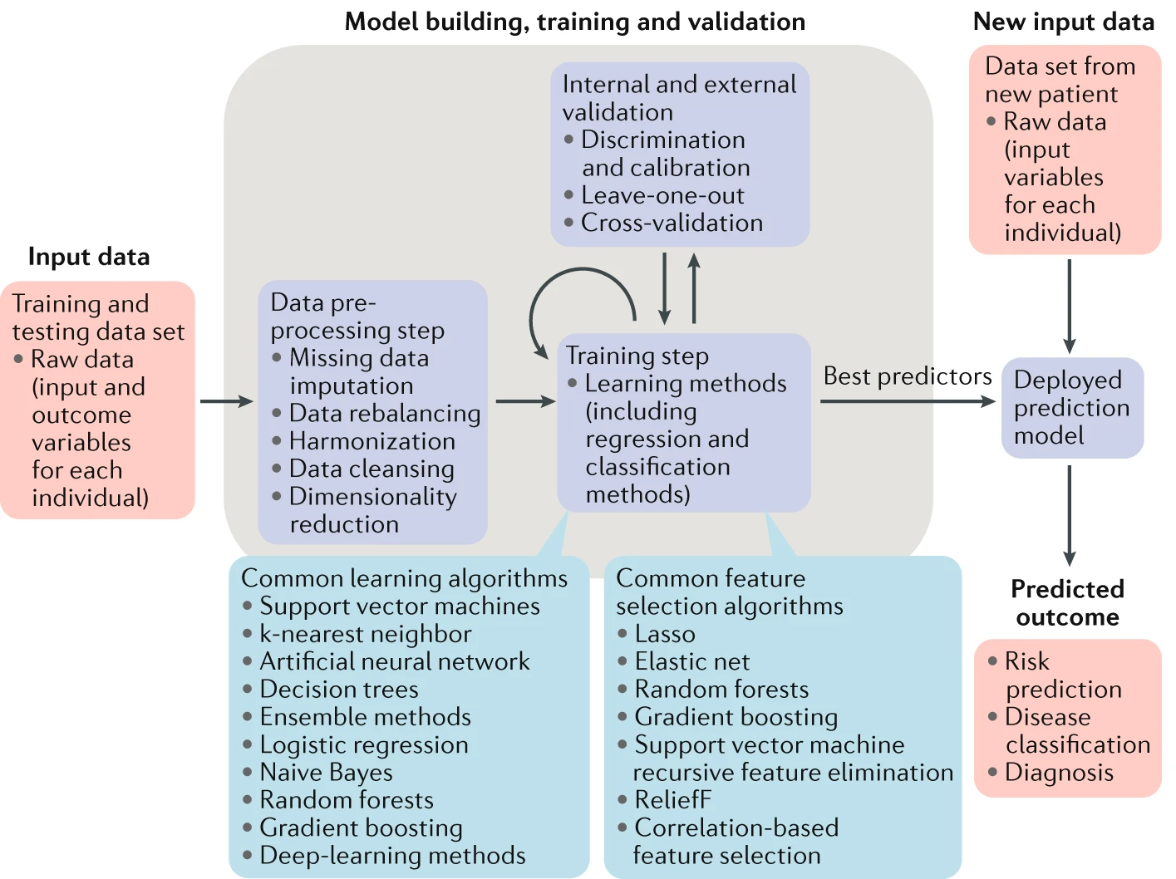
Jamshidi, A., Pelletier, J. & Martel-Pelletier, J. Machine-learning-based patient-specific prediction models for knee osteoarthritis. Nat Rev Rheumatol 15, 49–60 (2019).

Slide 11
From Traditional Statistical Models to ML
Exposure | Outcome
 | Yes | No
Yes | a | b
No | c | d
Risk in Exposed: a/a+b
Risk in Unexposed: c/c+d
Risk Ratio = (a/(a+b))/(c/(c+d))
Odds in Exposed: a/b
Odds in Unexposed: c/d
Odds ratio= (a/b) / (c/d) = a*d / b*c
Agreement/Accuracy = (a+d)/(a+b+c+d)
Sensitivity = a/(a+c)
Specificity = d/(b+d)
http://sphweb.bumc.bu.edu/otlt/MPH-Modules/EP/EP713_Association/EP713_Association_print.html

Slide 12
From Traditional Statistical Models to ML
Prior Knee Injury | Disease Progression in Knee OA
 | Yes | No
Yes | 50 | 150
No | 100 | 700
Risk in Exposed: 50/(50+150)=0.25
Risk in Unexposed: 100/(100+700)=0.125
Risk Ratio = (0.25)/(0.125)=2
Odds in Exposed: 50/150=0.33
Odds in Unexposed: 100/700=0.14
Odds ratio= (0.33) / (0.14) = 2.33
Agreement/Accuracy = (750)/(1000)=75%
Sensitivity = 50/150=33%
Specificity = 700/850=82%

Slide 13
Logistic Regression
Parametric Generalized Linear Model that we use when we have a binary outcome
log(Odds of Outcome) = β₀ + β₁*covariate
Assumes a linear relationship between the log odds of outcome and covariate(s)
Available in standard software: PROC LOGISTIC in SAS, glm function in R, logit command in Stata
Obtain odds ratio by exponentiating estimate for β₁
Example: log(odds (OA progression)) = -1.95 + 0.847*injury
OR(history of injury vs. no injury) = exp(0.847) = 2.33

Slide 14
Logistic Regression
Multivariable logistic regression – two or more predictors
log(Odds of Outcome) = β₀ + β₁*covariate1 + β₂*covariate2 + …
Odds ratio – quantifies adjusted association between each predictor and outcome
Adjusted association: holding all other predictors constant
http://sphweb.bumc.bu.edu/otlt/MPH-Modules/BS/BS704_Multivariable/BS704_Multivariable8.html

Slide 15
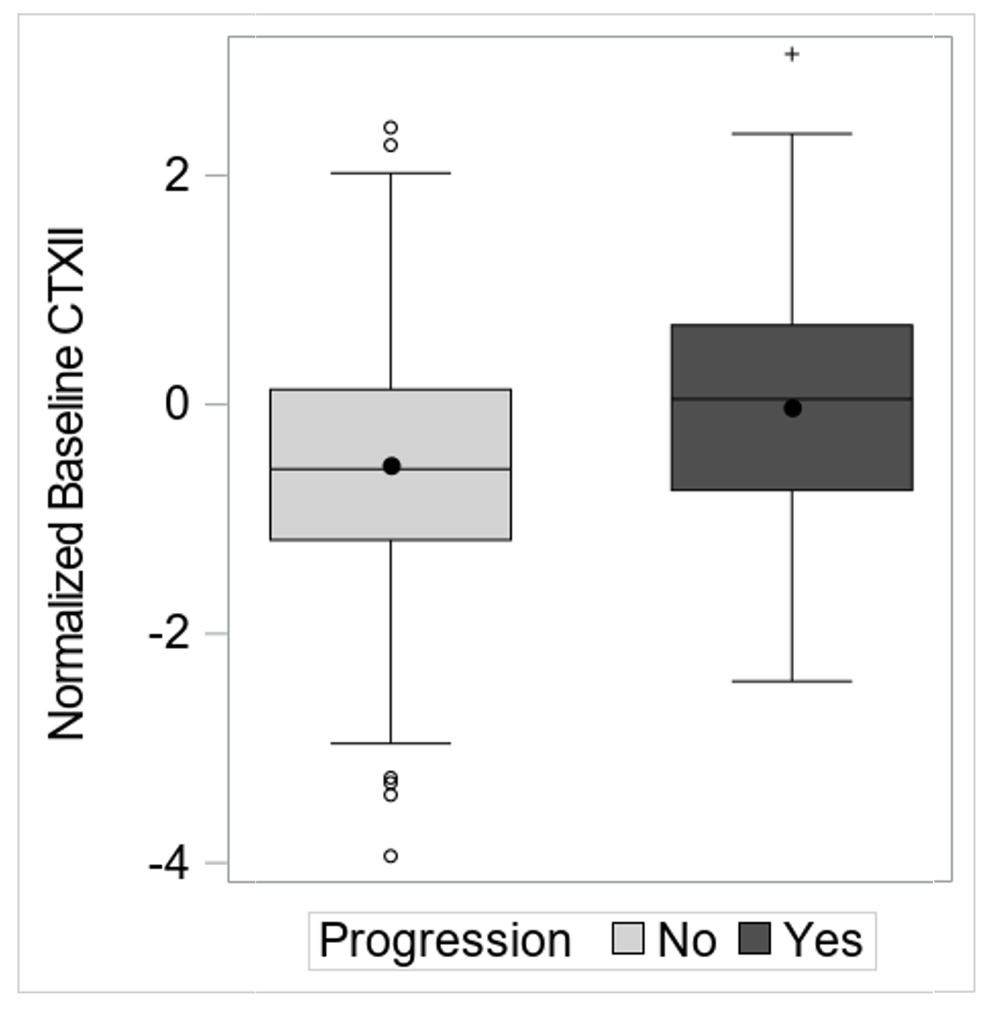
Logistic Regression with Continuous Predictor
log(Odds of Outcome) = β₀ + β₁*CTXII
log(Odds of Progression) = -1.59 + 0.511*CTXII
OR(1 unit increase in CTXII) = exp(0.511) = 1.7

Slide 16
Logistic Regression with Continuous Predictor
Is there a cut-point in CTXII that best discriminates (classifies) between progressors and non-progressors?
Maximize agreement (accuracy)?
Maximize sensitivity?
Maximize specificity?
Maximize some combination?

Slide 17
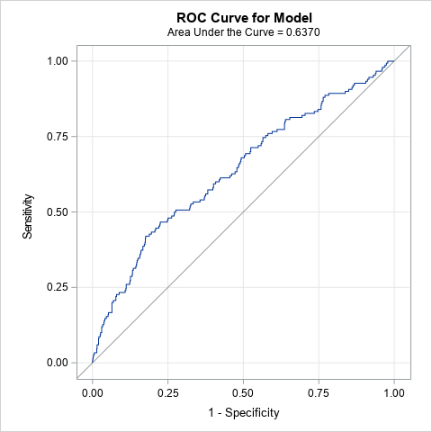
Logistic Regression with Continuous Predictor
ROC Cuve
Plots sensitivity vs. 1-specificity for all possible cut-points
$\hat{Y}$=1
$\hat{Y}$=1
$\hat{Y}$=0
Low specificity (25%)
High sensitivity (86%)
Corresponds to CTXII value of ~ -1
$\hat{Y}$=1
$\hat{Y}$=0
$\hat{Y}$=0
Maximize Sens + Spec
Specificity (82%)
Sensitivity (43%)
Corresponds to CTXII value of ~0.1
High specificity (87.5%)
Low sensitivity (26%)
Corresponds to CTXII value of ~0.5
Pepe MS. The Statistical Evaluation of Medical Tests for Classification and Prediction. Oxford University Press; New York: 2003.
Akobeng, Anthony K. "Understanding diagnostic tests 3: receiver operating characteristic curves." Acta paediatrica 96.5 (2007): 644-647.

Slide 18
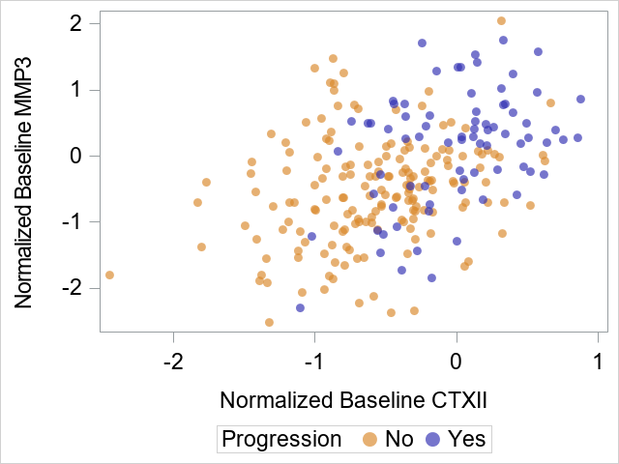
Logistic Regression with Two Continuous Predictors

Slide 19
Logistic Regression
Sample Size – rule of thumb: 10 outcomes for each predictor (really, each degree of freedom)
E.g., in our OA progression example, n=1000
n=250 progressors
n=750 non-progressors
Suggests model with ~25 predictors
How do we choose the “best” combination of predictors?
What if the number of predictors > 25?
What if the number of predictors > 1000? (p>n)
Overfitting: the model should generalize to populations that were not included in the sample. Overfitting is when the model captures random variation in the data.

Slide 20
Regression Selection Procedures
Backward
Start with all predictors in the model, remove the predictor with the highest p-value, continue until all p-values are < p-critical (e.g., 0.05).
Forward
Start with predictor with lowest p-value (and < p-critical), check each remaining predictor to find adjusted p-value and add predictor with smallest p-value. Continue until no more predictors reach p < p-critical.
Stepwise
Combines backward and forward. Start as in forward with predictor with lowest p-value, add predictor with lowest adjusted p-value. Now go back, and check original predictor, if p > p-crit for this predictor, then remove. After each new predictor is added, go back and check every other predictor in the model.
* Can also do this based on other fit statistics (e.g., AIC, BIC, adjusted R²)
Steyerberg, Ewout W. Clinical prediction models. Springer International Publishing, 2019.
Hosmer DW, Lemeshow S: Applied Logistic Regression. 2000, New York: Wiley

Slide 21
Regression Selection Procedures
Best Subsets
Check every possible subset of variables, and choose the subset with the best fit (e.g., based on set criteria like AIC, BIC, R²)
Steyerberg, Ewout W. Clinical prediction models. Springer International Publishing, 2019.
Hosmer DW, Lemeshow S: Applied Logistic Regression. 2000, New York: Wiley

Slide 22
Regression Selection Procedures
Concerns
Best subsets – How many combinations to check? 5 predictors = 31 subsets, 25 predictors > 30 million subsets (2 ^{# predictors} – 1)
Backward selection – convergence issues
Overfitting/issues with multiple testing
Very sensitive to the order that variables are added
Steyerberg EW et al. "Stepwise selection in small data sets: a simulation study of bias in logistic regression analysis." Journal of clinical epidemiology. 1999.
Harrell FE et al. "Multivariable prognostic models: issues in developing models, evaluating assumptions and adequacy, and measuring and reducing errors." Statistics in medicine. 1996. P.C. Sainani, Kristin L. "Multivariate regression: the pitfalls of automated variable selection." PM&R 5.9 (2013): 791-794.

Slide 23
Penalized Regression
Also referred to as shrinkage or regularization methods
There is a penalty for complexity
Regression coefficients are “shrunk” towards zero to avoid overfitting → less variance, potentially more bias
LASSO (Least Absolute Shrinkage and Selection Operator.)
Sum of the absolute values of the regression coefficients must be less than some constant
May force some of the coefficient estimates to be exactly equal to zero (i.e., can work as variable selection)
Typically performs better when there are few important predictors
Ridge
Sum of the squares of the regression coefficients must be less than some constant
Shrinks the coefficients towards zero, but it will not set any of them exactly to zero → include all the predictors in the final model
Typically performs better when all predictors are important
Elastic net → Combination of ridge and lasso
Tibshirani, R. (1996). Regression shrinkage and selection via the lasso. J. Royal. Statist. Soc B., Vol. 58, No. 1, pages 267-288).
Harrell Jr, Frank E. Regression modeling strategies: with applications to linear models, logistic and ordinal regression, and survival analysis. Springer, 2015.

Slide 24
Cross-Validation
Cross-validation: re-sampling procedure to estimate how the model might perform out of sample
Full Data
Randomly split into k (here, 10) samples for k-fold cv
1
2
3
4
5
6
7
8
9
10
Test model
prediction m1
prediction m2
prediction m3
prediction m4
prediction m5
prediction m6
prediction m7
prediction m8
prediction m9
prediction m10
Full Data with predicted values ($\hat{p,}\hat{Y}$)
Train - develop model
Train - develop model
Test model

Slide 25
Cross-Validation
With our full data with out of sample predictions we can
Assess the performance of our model by calculating cross-validated fit statistics (e.g., AUC)
Choose the penalty for penalized regression that minimizes residuals (or whatever fit statistic we choose)
Assess multiple models, and choose the one with the best fit
Choose a weighted combination of models
Important to assess overfitting, especially when we do not have a validation sample
Optimism: our model is always going to perform better on the data on which is was trained vs. data it hasn’t seen

Slide 26
Two Continuous Predictors
CTXII > 0.1
No
Yes
MMP3 > 0
MMP3 > -0.75
No
Yes
No
Yes
$\hat{Y}$=0
$\hat{Y}$=1
$\hat{Y}$=0
$\hat{Y}$=1

Slide 27
Classification and Regression Trees (CART)
Recursive partitioning: the data are partitioned into subsets – there is no regression equation (non-parametric)
Every value of a predictor is considered as a potential split
Optimal split is based on minimizing incorrect classifications
where split is made is called the node
Terminal Node: no further splits
Stop splitting based on: number of observations, lack of improvement, tree depth
Pruning: removing sections of the tree (nodes) to avoid overfitting

Slide 28
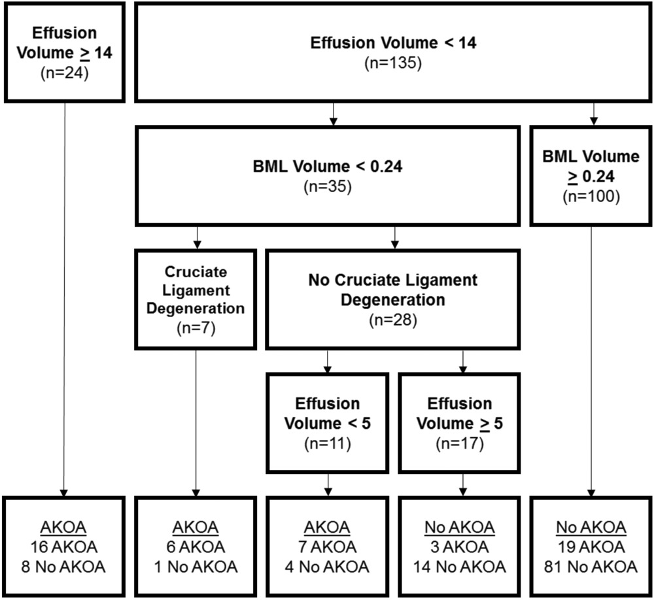
Classification and Regression Trees (CART)
Example:
Price LL et al. "Role of Magnetic Resonance Imaging in Classifying Individuals Who Will Develop Accelerated Radiographic Knee Osteoarthritis." Journal of Orthopaedic Research® 37.11 (2019): 2420-2428.

Slide 29
Classification and Regression Trees (CART)
Explicitly models interactions between variables (effect of variable b depends on level of variable a)
Results are intuitive and clinically interpretable – clear rules

Slide 30
Classification and Regression Trees (CART)
Concerns with CART:
“greedy approach” → overfitting
Highly dependent on input data – small changes can lead to different trees
Especially dependent on the first split

Slide 31
Ensemble Machine Learning
Combines the information from multiple models to improve model performance
Develop many prediction models
Combine to form a composite predictor
Bagging (Bootstrap Aggregation): draw a bootstrap sample from the data, fit a model to this sample. Repeat. Average predicted values across all bootstrapped samples.
Boosting: way to improve so-called “weak learners.” sequential technique – focus each iteration on the incorrectly classified data points from the previous iteration
Rose, Sherri. "Mortality risk score prediction in an elderly population using machine learning." American journal of epidemiology 177.5 (2013): 443-452.
Hastie, Tibshirani, Friedman. The elements of statistical learning: data mining, inference, and prediction. Springer Science & Business Media, 2009

Slide 32
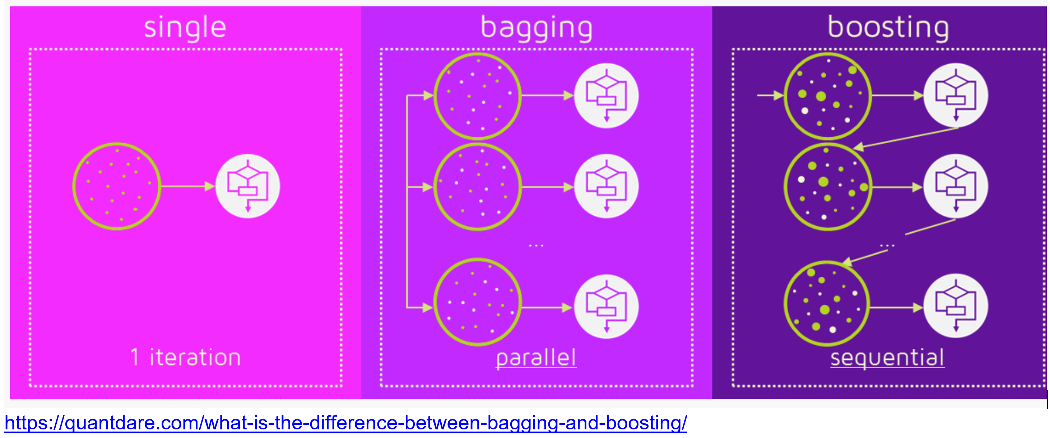
Ensemble Machine Learning
Combines the information from multiple models to improve model performance
Develop many prediction models
Combine to form a composite predictor
Bagging (Bootstrap Aggregation): draw a bootstrap sample from the data, fit a model to this sample. Repeat. Average predicted values across all bootstrapped samples.
Boosting: way to improve so-called “weak learners.” sequential technique – focus each iteration on incorrectly classified data points from the previous iteration
Rose, Sherri. "Mortality risk score prediction in an elderly population using machine learning." American journal of epidemiology 177.5 (2013): 443-452.
Hastie, Tibshirani, Friedman. The elements of statistical learning: data mining, inference, and prediction. Springer Science & Business Media, 2009

Slide 33
Random Forest
Tree-based approach (like CART) with bagging
Draw a random sample of subjects and a random sample of predictors and then create decision tree
Average across trees
Pros: improved prediction, more stable
Cons: interpretability – we can use measures to assess variable importance, but there is no clear measure to assess the association between predictors and outcome (e.g., OR), no final tree

Slide 34
Random Forest
https://tex.stackexchange.com/questions/503883/illustrating-the-random-forest-algorithm-in-tikz

Slide 35
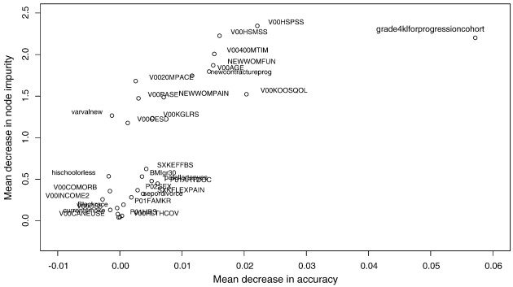
Random Forest
SF-12 Physical Component
Riddle DL et al. "Two-year incidence and predictors of future knee arthroplasty in persons with symptomatic knee osteoarthritis: preliminary analysis of longitudinal data from the osteoarthritis initiative." The Knee 16.6 (2009): 494-500.
Advanced structural disease
Family history of KR

Slide 36
Super Learner
An ensembling machine learning approach that combines multiple algorithms into a single algorithm.
Run many algorithms – use cross-validation to assess model performance
Combine the models, weighting by model performance in CV
Relies on stacking (averaging across multiple different algorithms) rather than bagging or boosting
Rose, Sherri. "Mortality risk score prediction in an elderly population using machine learning." American journal of epidemiology 177.5 (2013): 443-452.
Naimi, Ashley I., and Laura B. Balzer. "Stacked generalization: an introduction to super learning." European journal of epidemiology 33.5 (2018): 459-464.

Slide 37
Super Learner
An ensembling machine learning approach that combines multiple algorithms into a single algorithm.
Run many algorithms – use cross-validation to assess model performance
Combine the models, weighting by model performance in CV
Relies on stacking (averaging across multiple different algorithms) rather than bagging or boosting
Rose, Sherri. "Mortality risk score prediction in an elderly population using machine learning." American journal of epidemiology 177.5 (2013): 443-452.
Naimi, Ashley I., and Laura B. Balzer. "Stacked generalization: an introduction to super learning." European journal of epidemiology 33.5 (2018): 459-464.

Slide 38
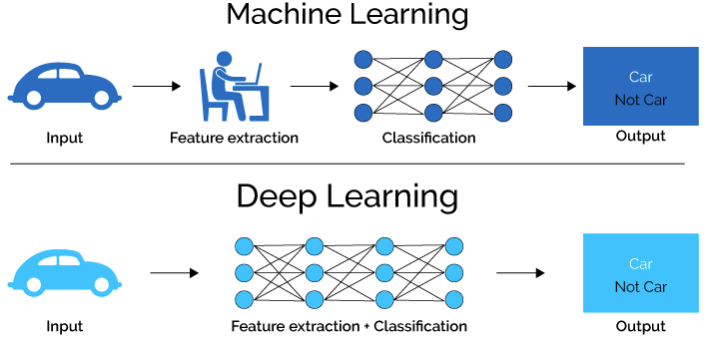
Deep Learning

Slide 39
Deep Learning
Example: Tiulpin, Aleksei, et al. "Multimodal machine learning-based knee osteoarthritis progression prediction from plain radiographs and clinical data." Scientific Reports 9.1 (2019): 1-11. → directly utilizes raw radiographic data

Slide 40
Statistical Modeling vs. Machine Learning
Statistical Modeling | Machine Learning
Draws population inferences from a sample | Finds generalizable predictive patterns
Overall prediction with an interpretable model is the goal, need to understand associations between variables and outcomes. “Not just to predict, but to understand” – Dr. Bhramar Mukherjee | Overall prediction is the goal, without being able to succinctly describe the impact of any one variable
Low dimensions, small sample size | High dimensions (p>n)
Formal assessment of uncertainty | Flexibility: many complex relationships between predictors/interactions
https://www.fharrell.com/post/stat-ml/#fn:There-is-an-inte
Bzdok, D., Altman, N. & Krzywinski, M. Statistics versus machine learning. Nat Methods 15, 233–234 (2018).
https://normaldeviate.wordpress.com/2012/06/12/statistics-versus-machine-learning-5-2/

Slide 41
References
Hastie, Tibshirani, Friedman. The elements of statistical learning: data mining, inference, and prediction. Springer Science & Business Media, 2009.
Harrell Jr, Frank E. Regression modeling strategies: with applications to linear models, logistic and ordinal regression, and survival analysis. Springer, 2015.
Pepe MS. The Statistical Evaluation of Medical Tests for Classification and Prediction. Oxford University Press; New York: 2003.
Steyerberg, Ewout W. Clinical prediction models. Springer International Publishing, 2019.
van der Laan MJ, Rose S. Targeted Learning: Causal Inference for Observational and Experimental Data. Springer, 2011.
Collins, Gary S., et al. "Transparent Reporting of a Multivariable Prediction Model for Individual Prognosis or Diagnosis (TRIPOD) The TRIPOD Statement." Circulation 131.2 (2015): 211-219.

Slide 42
References
Maria Hügle, Patrick Omoumi, Jacob M van Laar, Joschka Boedecker, Thomas Hügle, Applied machine learning and artificial intelligence in rheumatology, Rheumatology Advances in Practice, Volume 4, Issue 1, 2020
Bzdok, D., Altman, N. & Krzywinski, M. Statistics versus machine learning. Nat Methods 15, 233–234 (2018).
Jamshidi, A., Pelletier, J. & Martel-Pelletier, J. Machine-learning-based patient-specific prediction models for knee osteoarthritis. Nat Rev Rheumatol 15, 49–60 (2019).
Sherri Rose, Intersections of machine learning and epidemiological methods for health services research, International Journal of Epidemiology, , dyaa035, https://doi.org/10.1093/ije/dyaa035

Slide 43
Thank You!
JCollins13@bwh.harvard.edu
@CollJamie

